Slide 1
Wastewater treatment from problem to opportunity
Case Bekkelaget WWTP
Professor dr. Lars J. Hem
Oslo water and sewerage works/
The Norwegian University of Life Sciences

Slide 2
Content
WWTPs in Oslo
The present Bekkelaget WWTP
Biogas
CSO reduction
Deammon
Plant extension

Slide 3
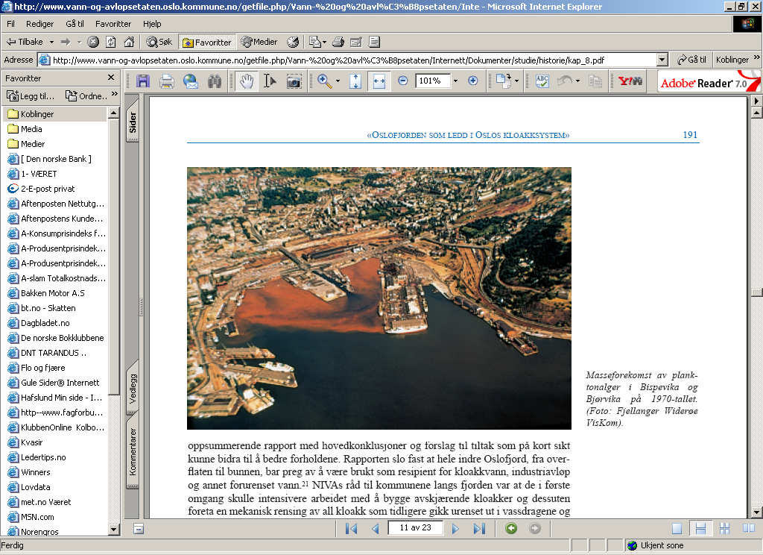
The plant was buildt because of contamination in the fjord and in the harbour area in particular

Slide 4
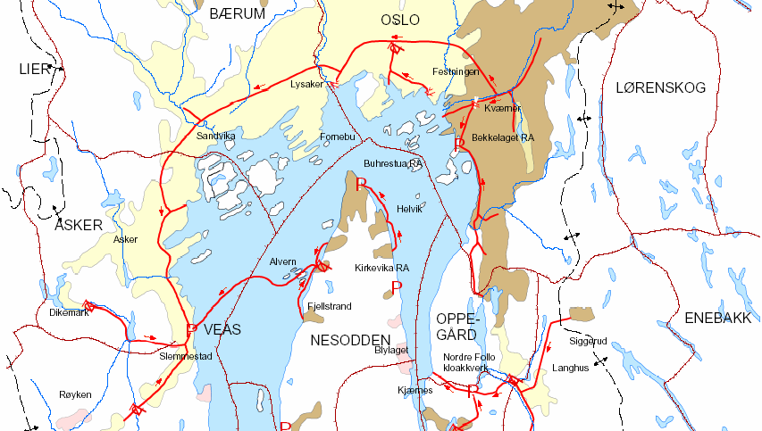
The Main Sewerage System of the inner Oslo fjord
Bekkelaget WWTP
Norway’s second largest WWTP , Treats wastewater from Oslo’s eastern parts, approx. 290.000 p.e.

Slide 5
Bekkelaget WWTP – A Brief Overview
Currently Bekkelaget WWTP serves 290 000 p.e. (population equivalent) which is approximately 40% of all wastewater generated in Oslo.
The plant with nitrogen removal process was placed inside rock caverns and was in operation from 2000.
Owned by the City of Oslo but operated by a private company
Average flow rate approx. 100.000 m³/d and treats approx. 42.2 million m³/year.
  Discharge permit :
  P-removal > 90%
  N-removal > 70% (including overflow)
  Organic matter > 70 %

Slide 6
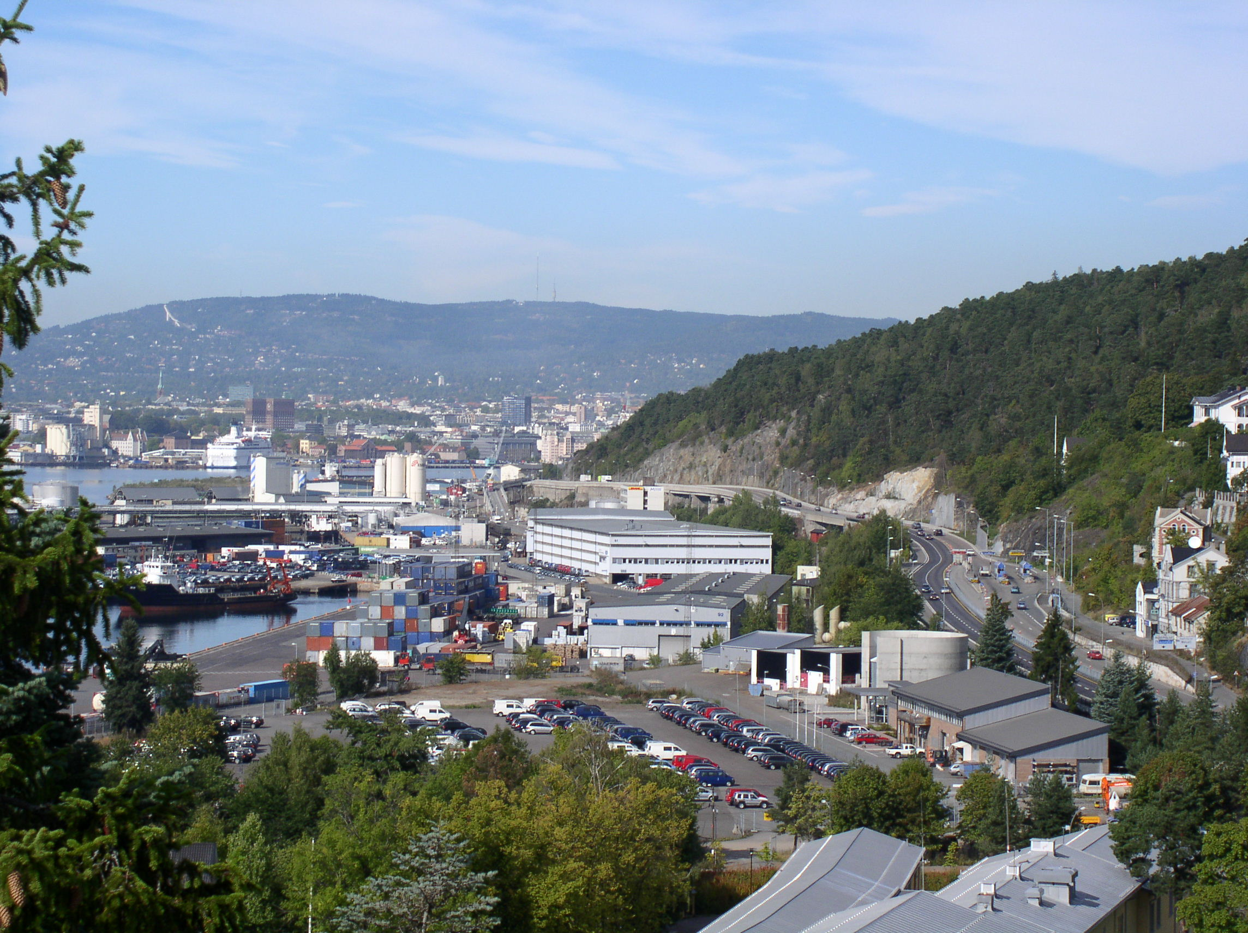
Gas holder and
Upgrading plant
Rock caverns
Admin building
Notes:
The plant was built in the period 1998 to 2001, replacing the old plant from 1963 in the neighborhood.
The plant is located in rock caverns with a total area of 45.000 square meters.
In the back ground you can see the city hall and Holmekollen ski jump
The Municipality of Oslo, signed in 2001 a 15 years operation contract for Bekkelaget WWTP with Bekkelaget Water inc.
Bekkelaget water inc. have 15 employees, and is owned by Anglian Water Group (AWG) (UK)

Slide 7
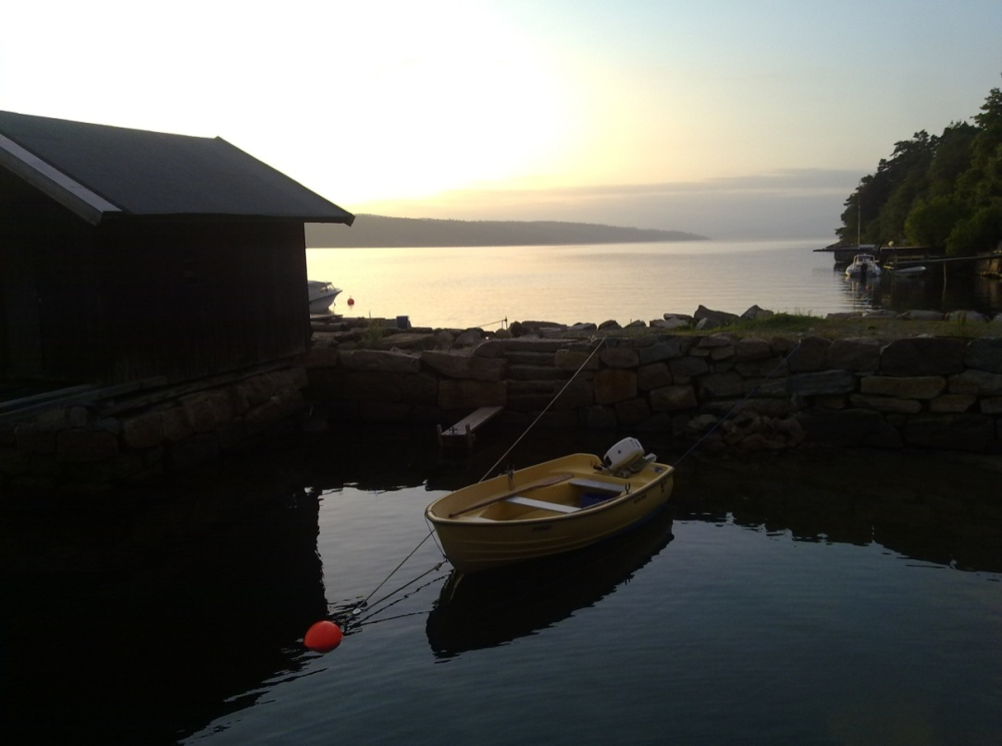
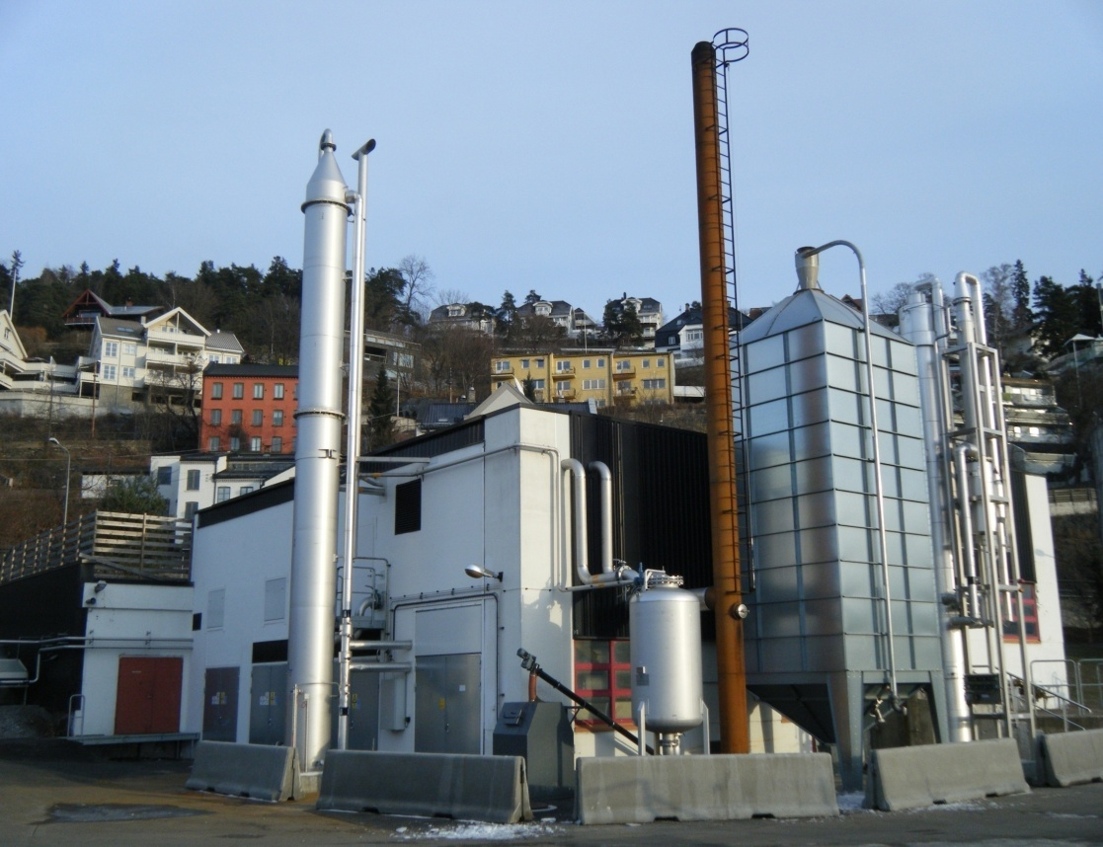
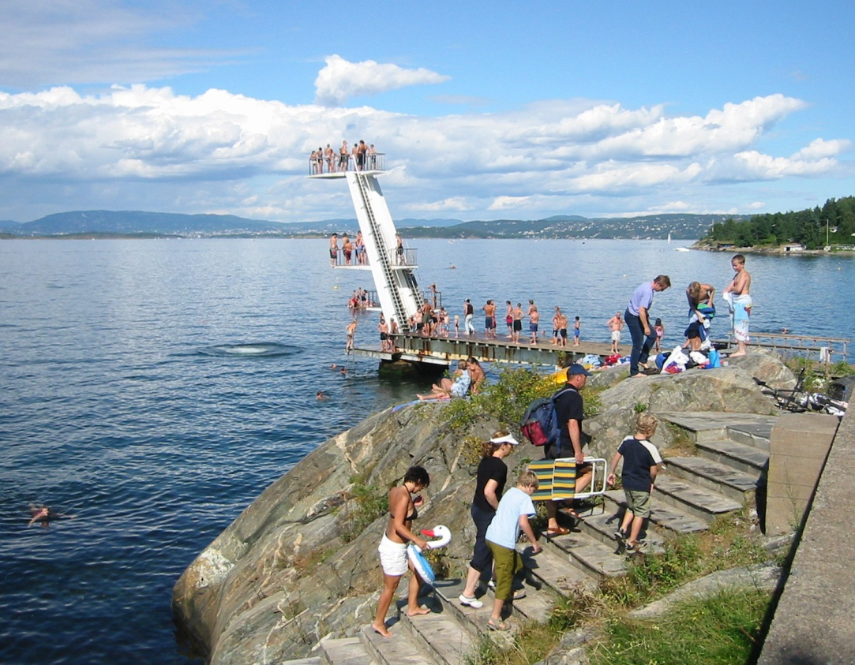
The treatment plant’s surroundings

Slide 8
Water and sludge treatment processes
PAX-18
Precipitation
Primary
1900 l/s<Q< 4000 l/s
PAX-18
Overflow
Magasin~35.000m³
Q<1900 l/s
Primary
Activated sludge
Clarifier
Filter
Q=1900 l/s
Sand, grit and screenings
FeSO₄
Bio sludge
Biogas-
upgrading
4000 l/s < Q < 6000 l/s
Biogas
Thickener
Primary sludge
Buffertank
Digester
Digester
Dewatering
Silo
Silo
Buffer

Slide 9
Water capacities
Dry weather flow 1450 l/s -125.000 m³/d – tertiary treatment - biologically and chemically treated with filtration (max capacity 1900 l/s)
  Removes Nitrogen, phosphorus and organic matters
Water flow rates between 1900-4000 l/s is treated chemically and partly filtration
  Removes phosphorus and organic matters (partly)
Water flow rates between 4000 - 6000 l/s is treated through 3 mm screens
  Removes waste

Slide 10
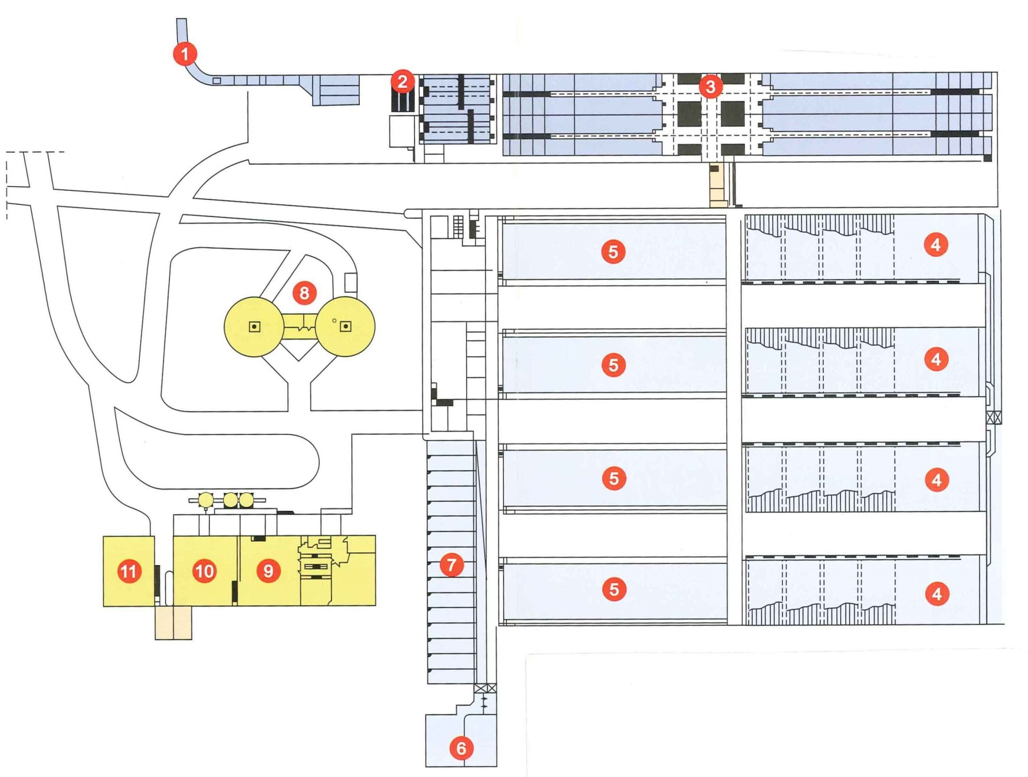
Overview
Water treatment
Inlet tunnel
Screens, sand and grit removal
Primary settling/ direct precipitation
Bio step, activated sludge
Clarifiers
deAmmon®
Sand filters
Sludge treatment
Digesters
Sludge treatment
Sludge treatment
Ventilated air treatment – odor control
Biogas, upgrading (out)
212 m
12

Slide 11
Nitrogen removal – step by step
nitrification
de-nitrification
ammonia
nitrate
nitrogen gas
aeration
carbon

Slide 12
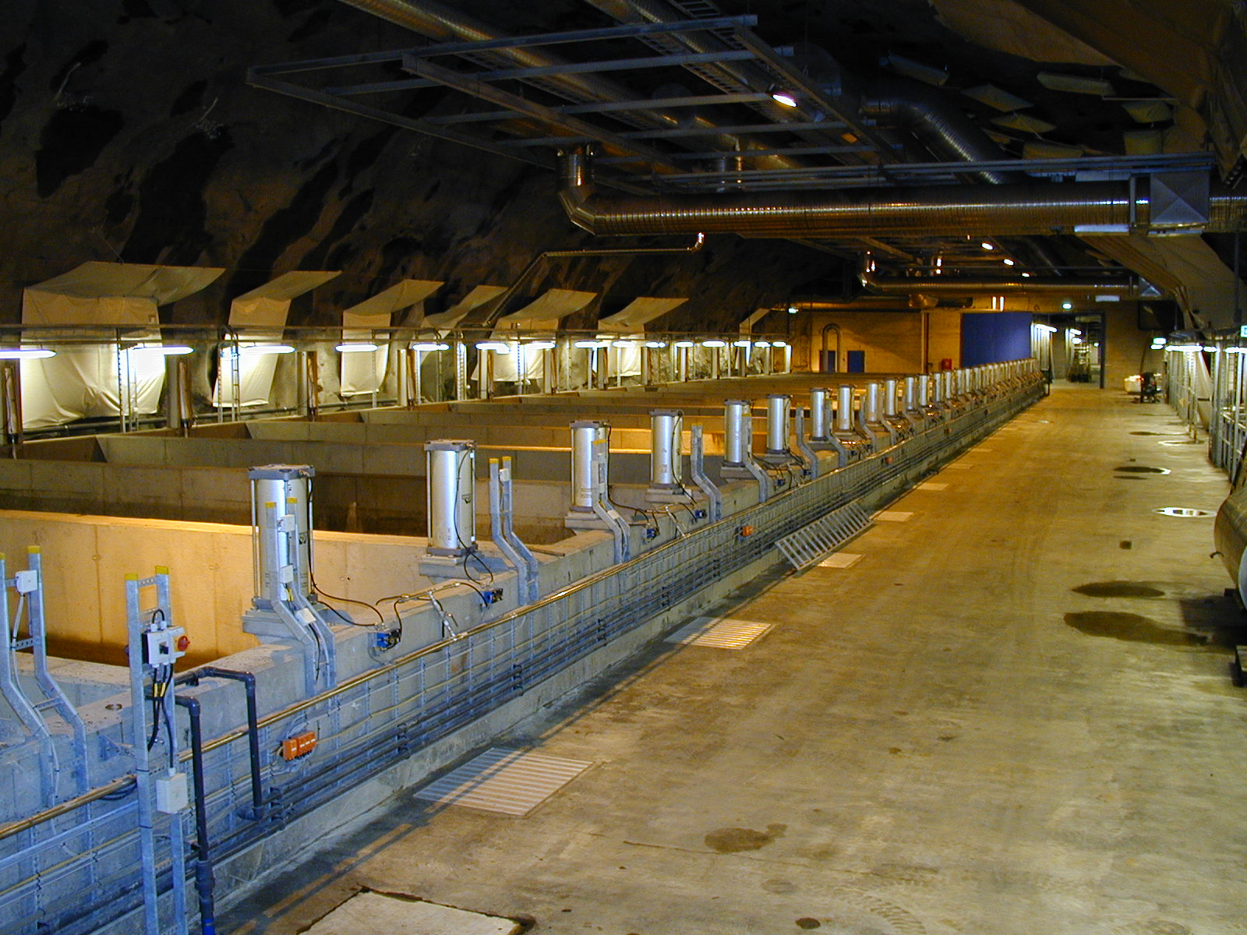

Slide 13
Typical results (2014)
 | Inlet (mg/l) | Effluent (mg/l) | Removal eff. (%)*
Tot-P | 3,5 | 0,30 | 91
Tot-N | 27 | 8.6 | 68
COD | 403 | 36 | 91
BOD | 132 | 3.5 | 97
 |  | mill. m³
Wastewater production |  | 53
Tertiary treatment (mechanical-chemical-biological) |  | 42
Secondary treatment (mechanical- chemical) |  | 9
Overflow |  | 2

Slide 14
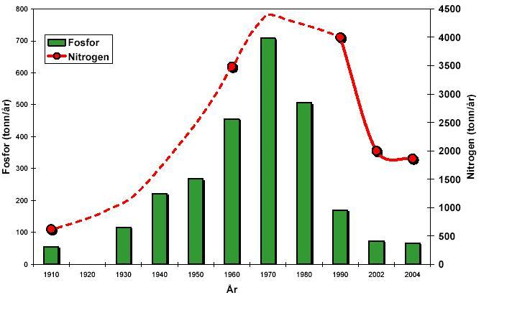
Phosphorus and Nitrogen loads to
Inner Oslofjord 1910-2004

Slide 15
Oxygen level in the fjord outside Bekkelaget
Present plant in operation

Slide 16
Upgraded biogas (biomethane)
Biogas = CH₄ + CO₂ +H₂S ++ some pollutions
Fuel = Biomethane = CH₄, remove CO₂ +H₂S ++
The upgrading plant purifies the biogas to biomethane

Slide 17
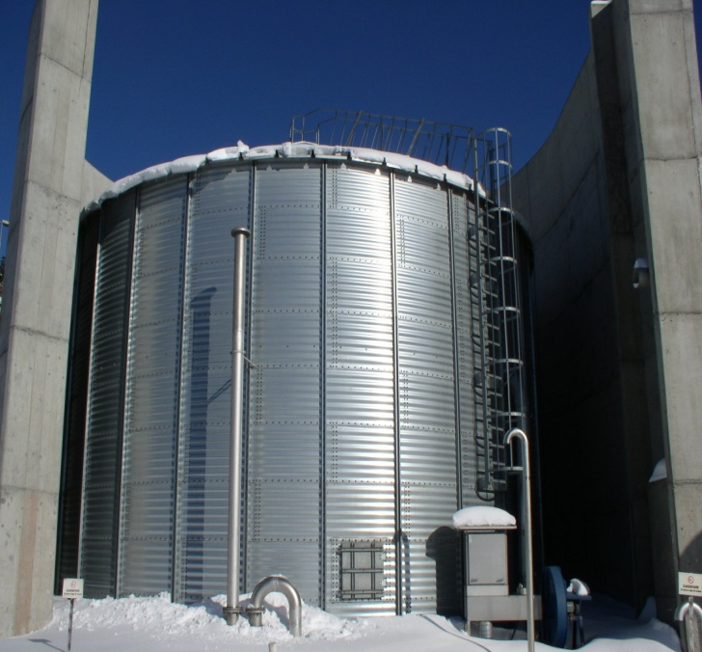
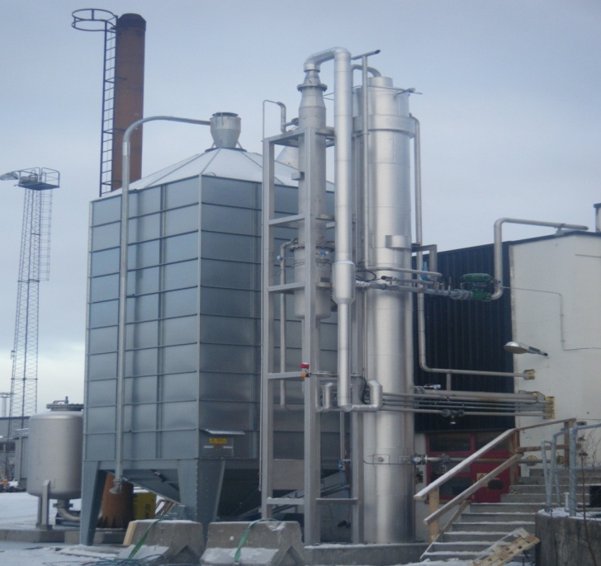
Biogas and Biomethane Production
The thermophilic digestion of the sludge
produces 3.6 million Nm3/year of biogas.
By upgrading biogas to biomethane, the
amount of biomethane produced
corresponds to 2.2 million litres of diesel
equivalent. This is enough to replace 80
buses powered by diesel with 80 buses
powered by biomethane.
This is around 20 % of the total number of
buses operating in Oslo

Slide 18
The impact on Greenhouse emission for Oslo
CO₂ emissions from private and public transport is approximately 50- 80% of the total emissions in the city of Oslo.
The City of Oslo’s main goal is:
  To cut 50% of greenhouse emissions by the year 2030.

Slide 19
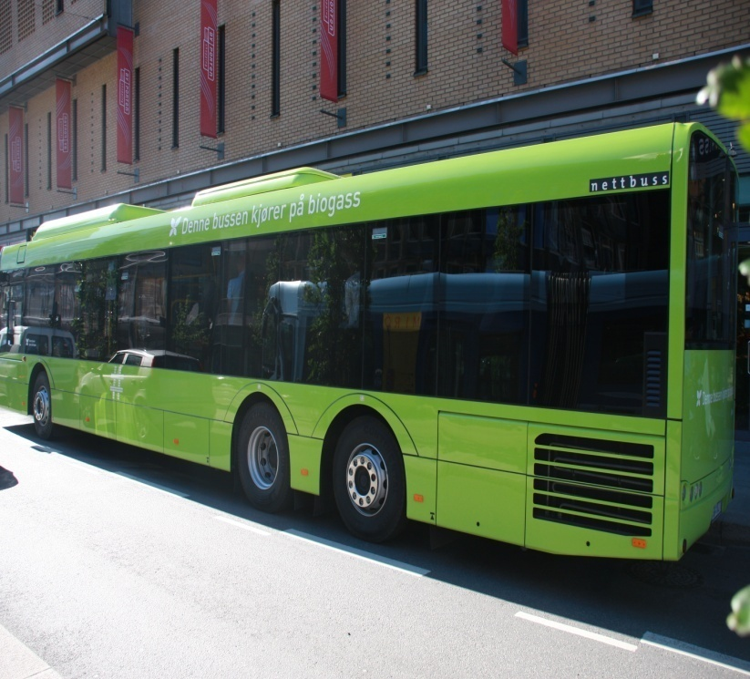
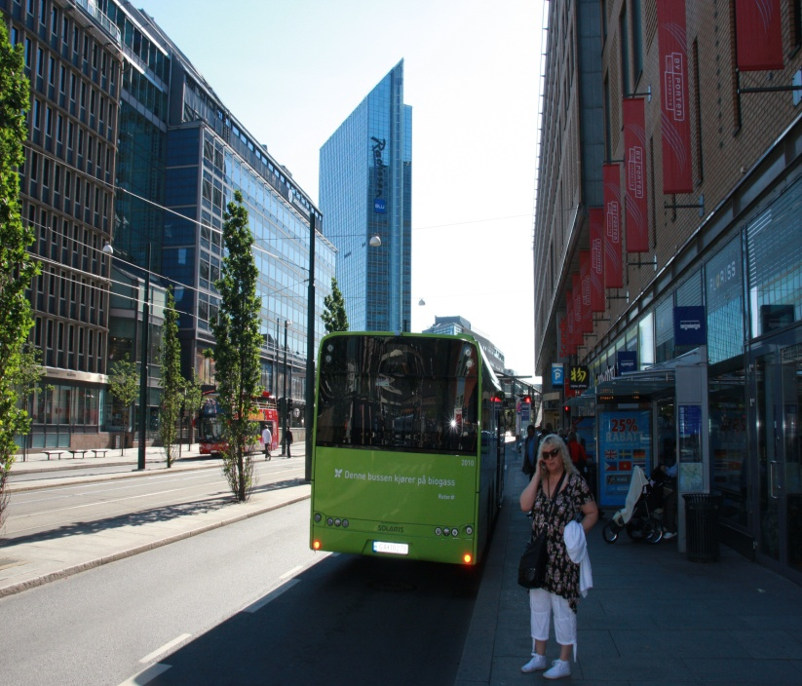

Why use biomethane as vehicle fuel ?
It is an environmental friendly, carbon neutral vehicle fuel
77 % of NO_{x} emissions is reduced when using bio-methane powered vehicle fuel as compared to diesel powered vehicle.
98 % of particulate matters emissions is reduced when using bio-methane powered vehicle fuel as compared to diesel powered vehicle
There is a considerable noise reduction of 92 % when using bio-methane powered vehicles as compared to diesel powered vehicles
An improvement of the air quality in the city when using bio-methane powered vehicles
Offers the potential for future large scale use of renewable and sustainable biomethane as vehicle fuel

Slide 20
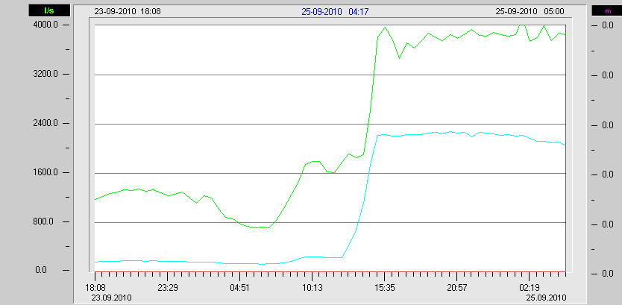
Inlet flow variations

Slide 21
Midgardsormen transport system and storage/equalisation basin
Main purpose: Reduce CSO operation
Combination of tunnels, shafts and (large) pipes
Tested 2014, in operation from 2015

Slide 22
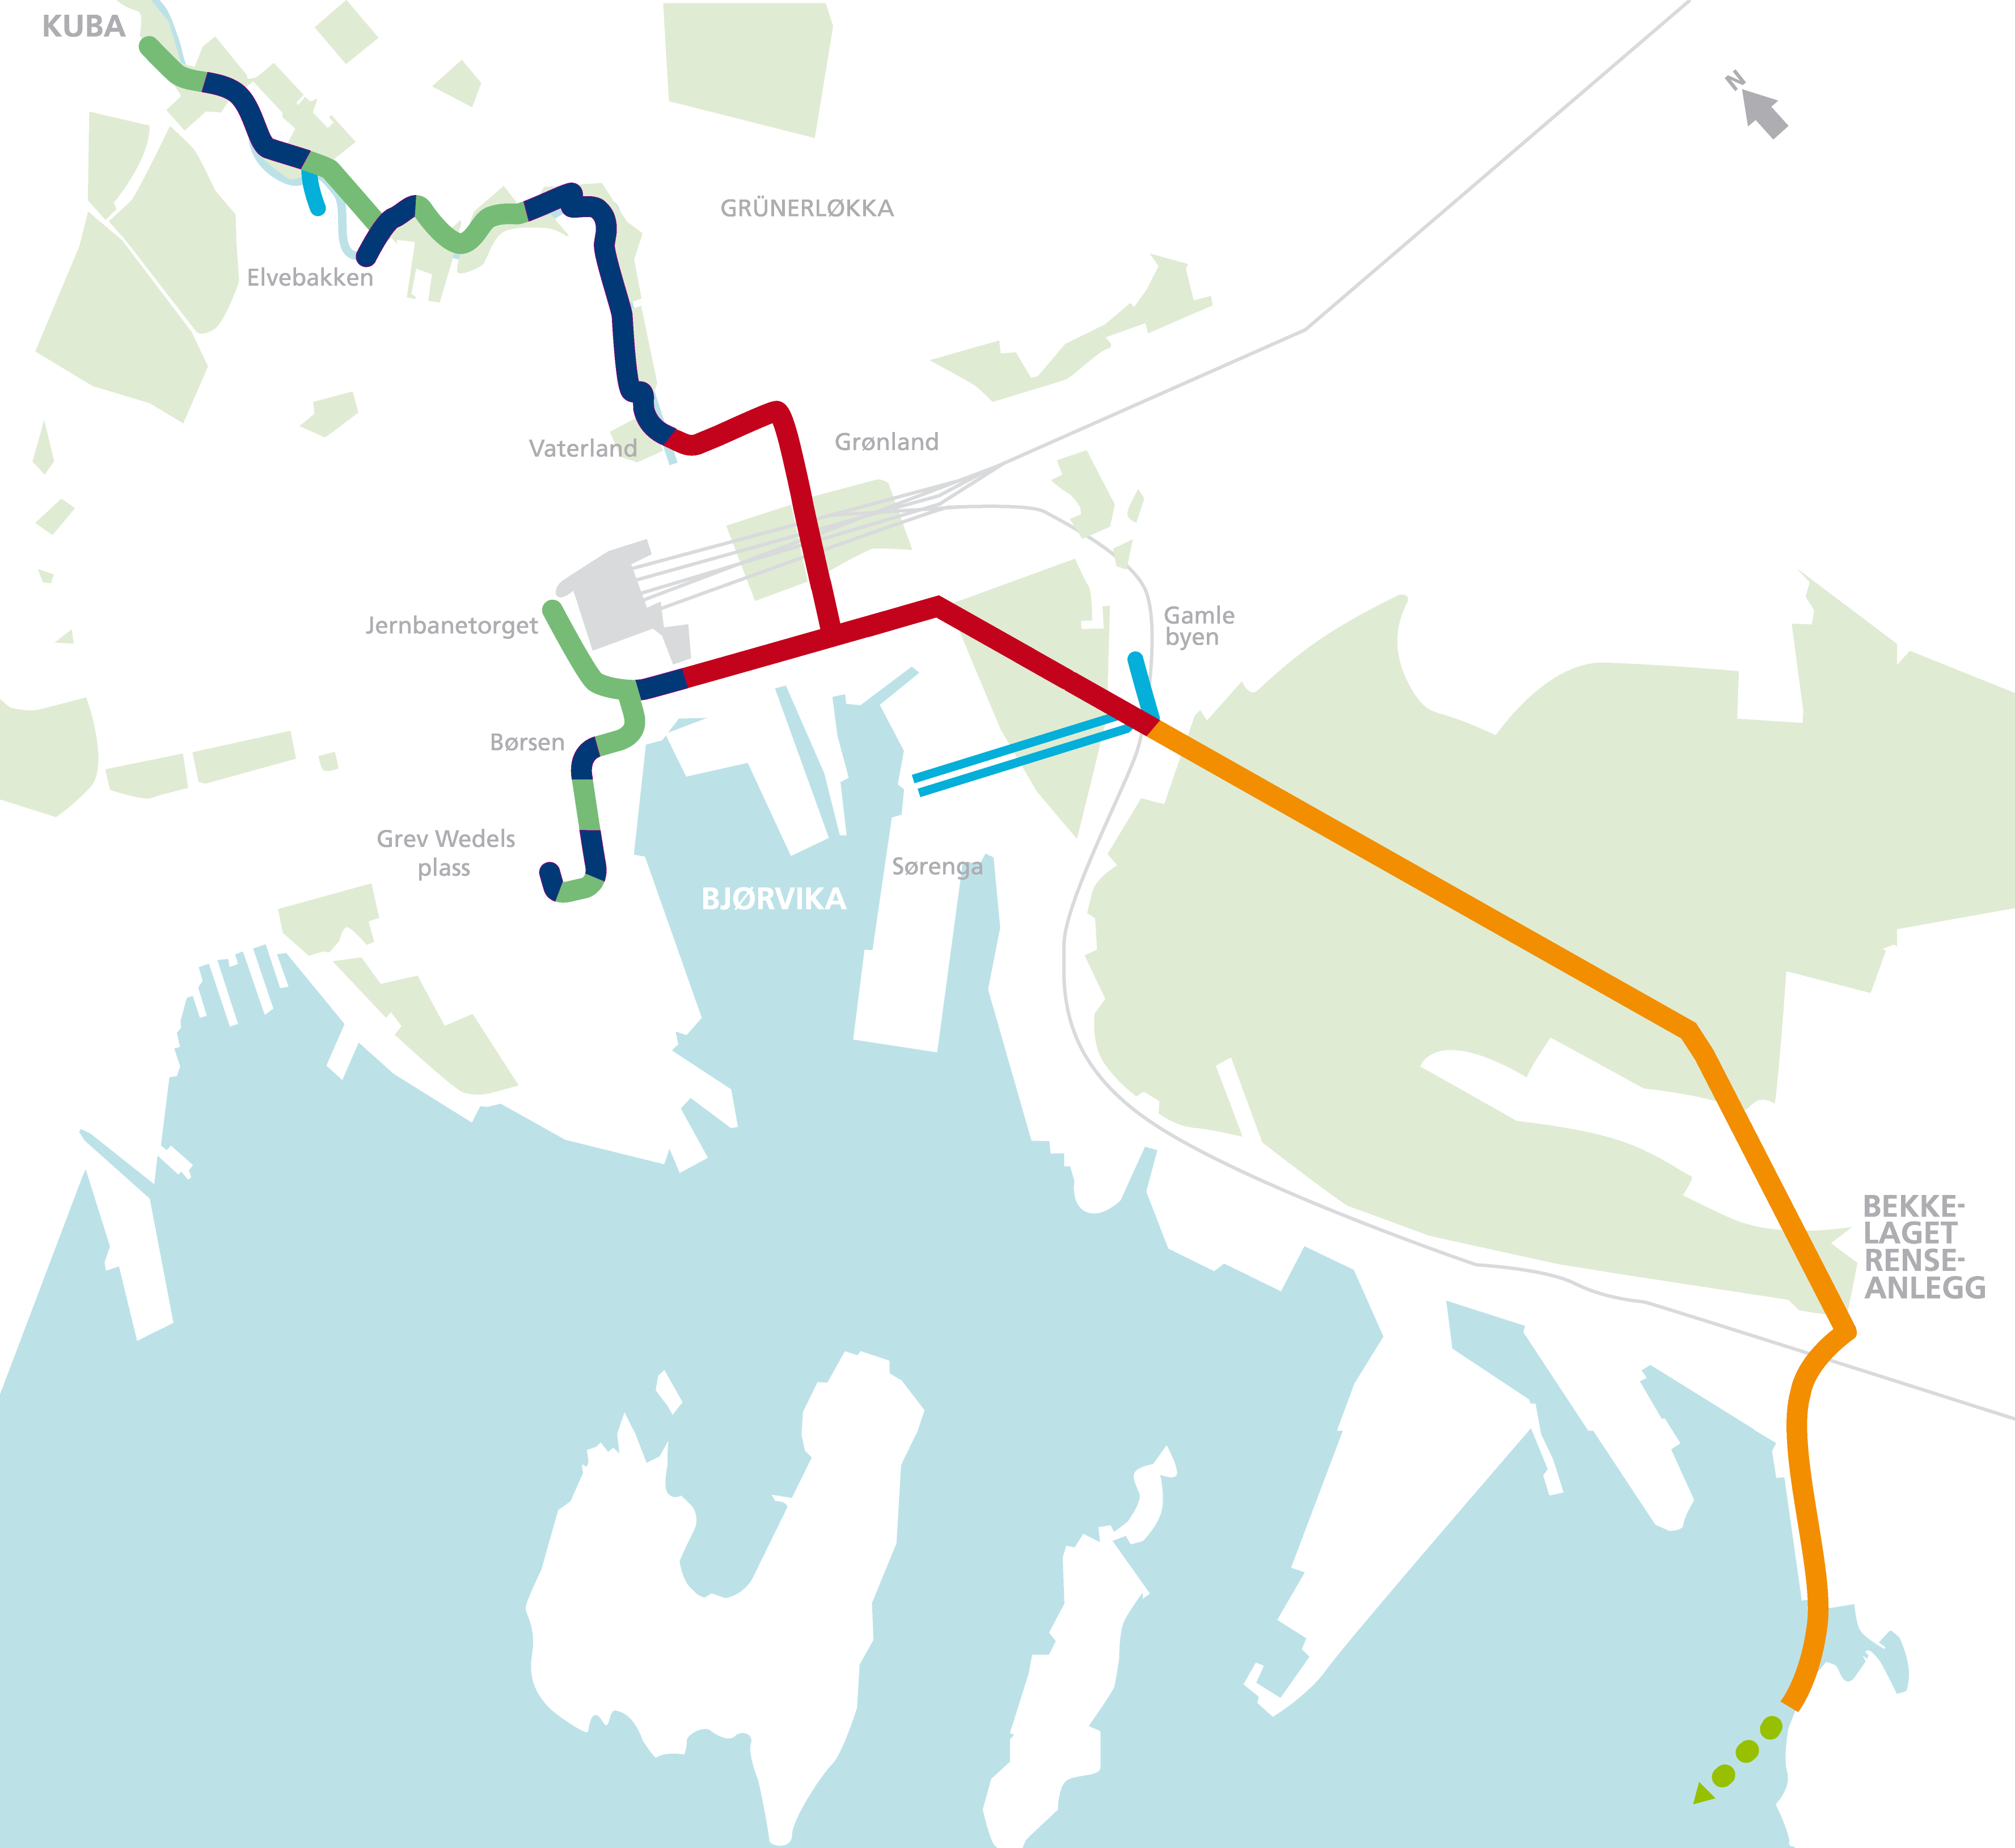

Slide 23
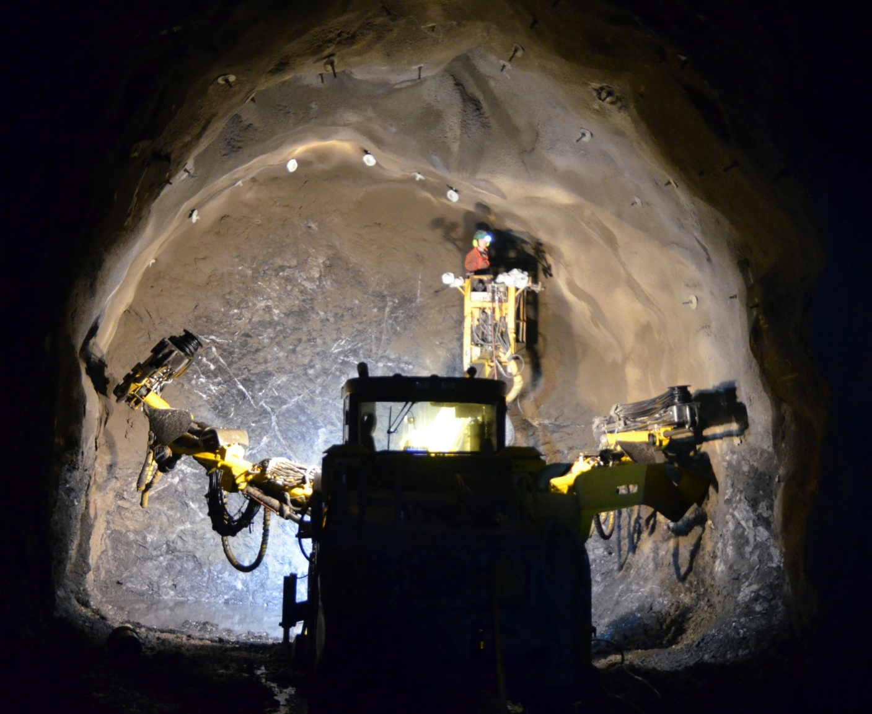

Slide 24
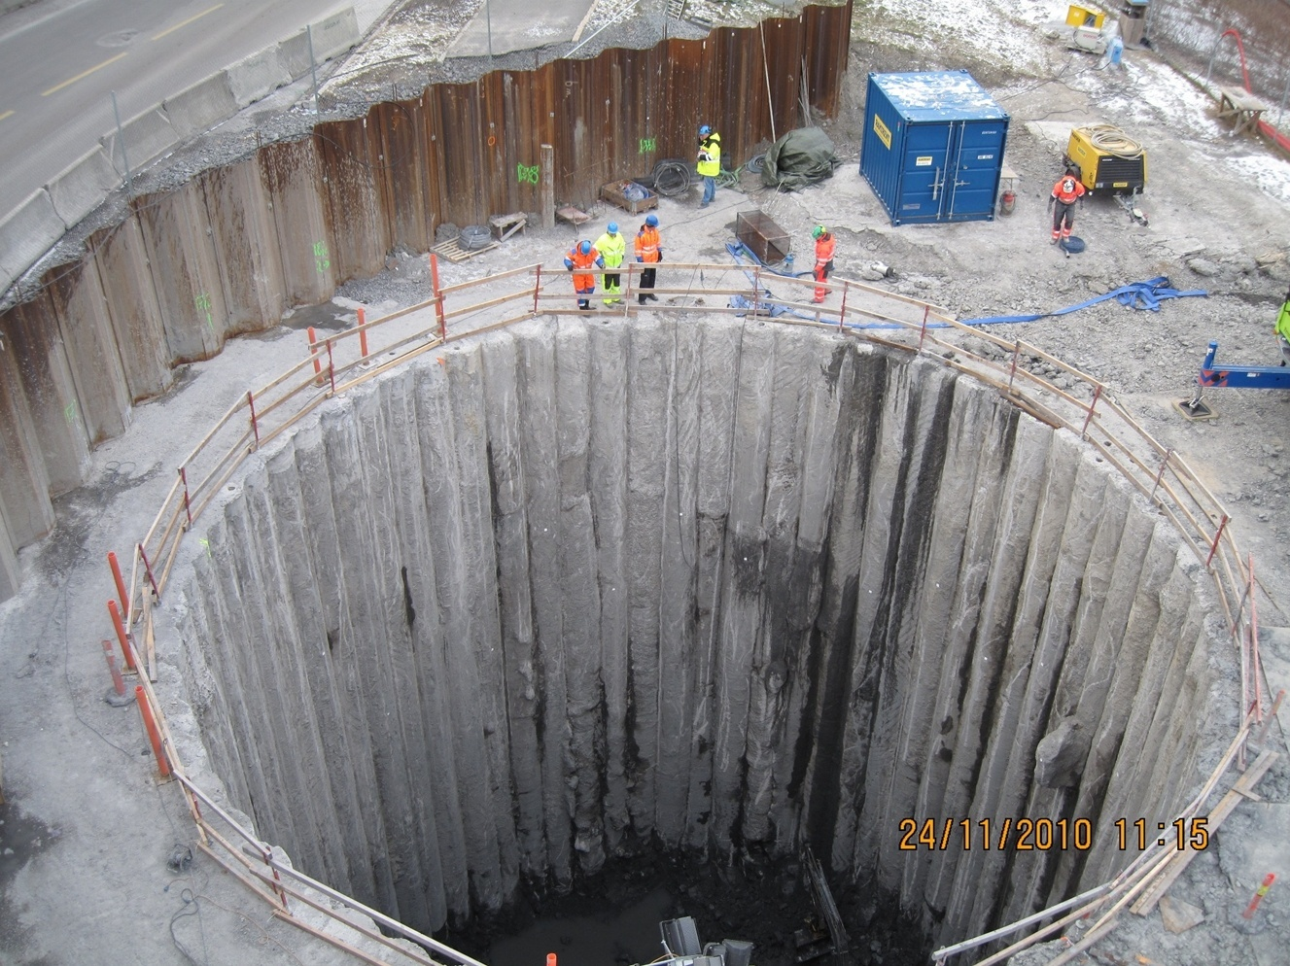

Slide 25
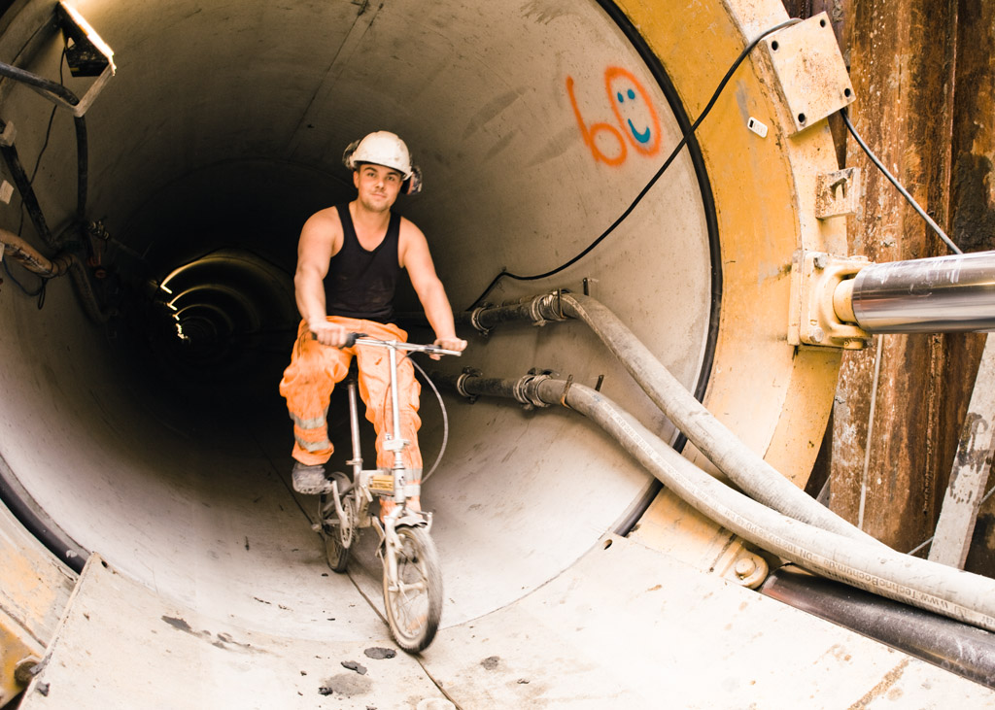

Slide 26
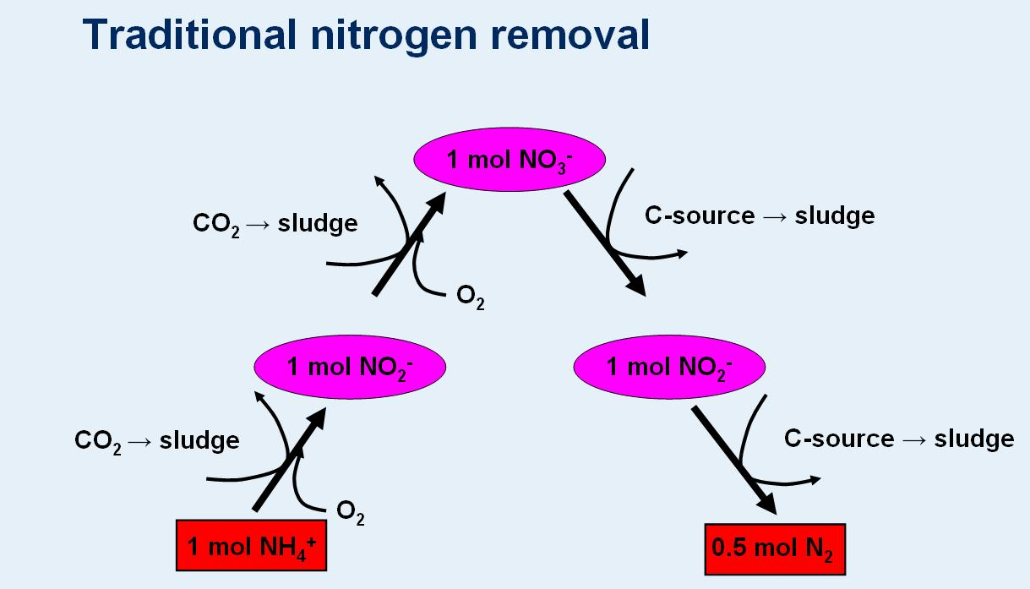

Slide 27
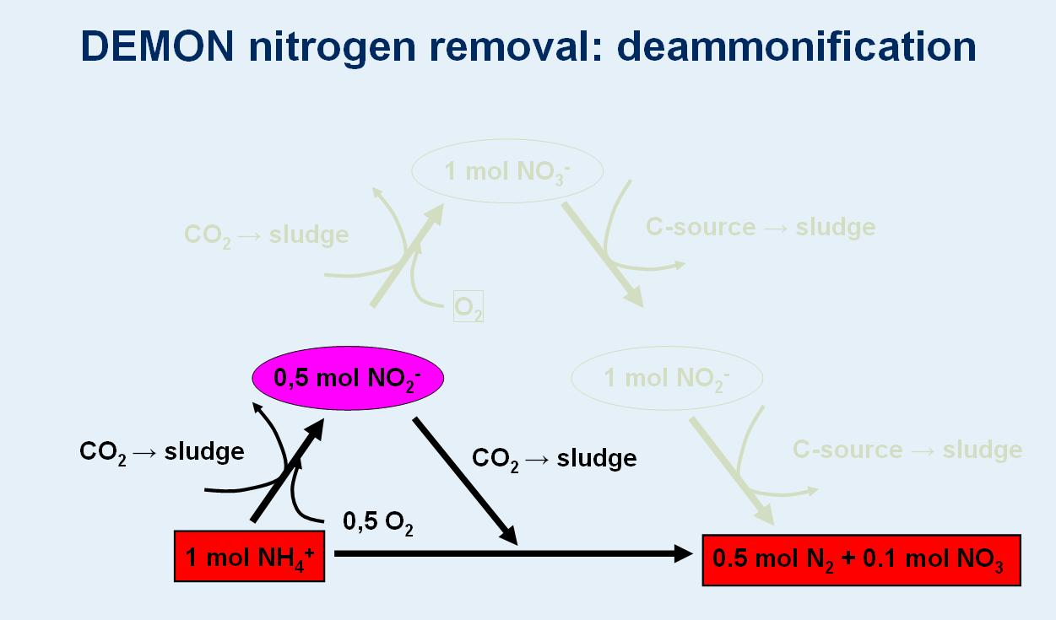

Slide 28
Deammon at Bekkelaget
Treatment of reject water from dewatering
This will increase the plant’s capacity for N-removal by 15-20 %

Slide 29
Challenges
New demands from 01.01.2009:
Nitrogen 70% of all nitrogen must be removed
Phosphorus: 90% of all phosphorus must be removed
Organic matters: 70% of organic matters as BOD_{5,}must be removed
The total amount of overflow must be less than 2% of the total loads of nitrogen, phosphorus and organic matters
These new demands together with increasing load to the plant will cause some challenges in the future

Slide 30
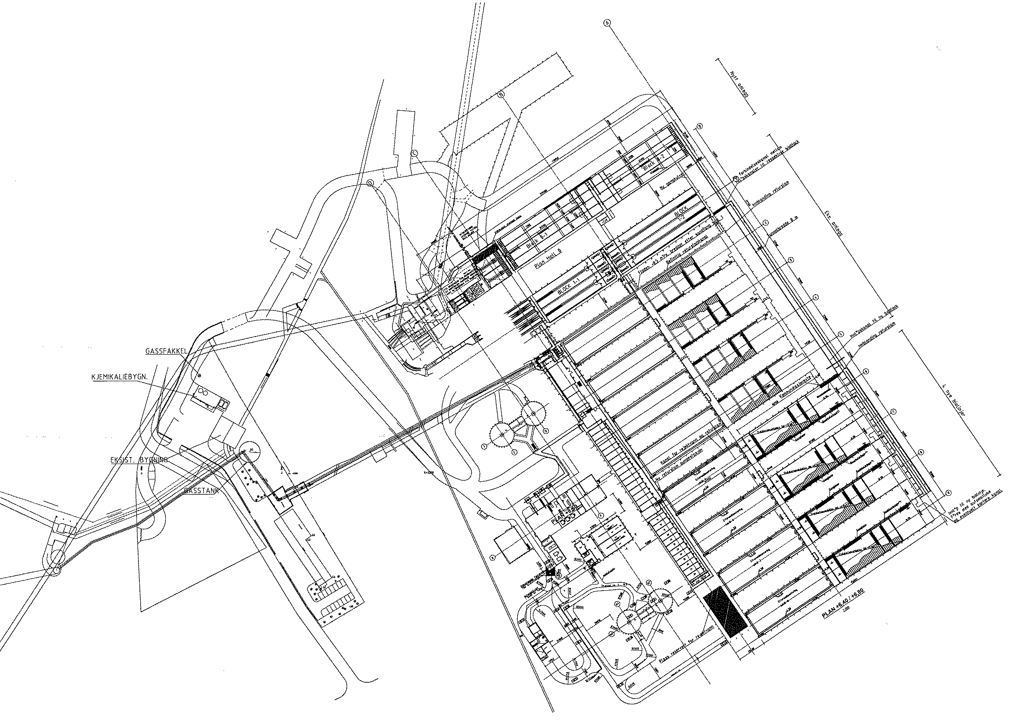
BRA 2017 / 2030

Slide 31
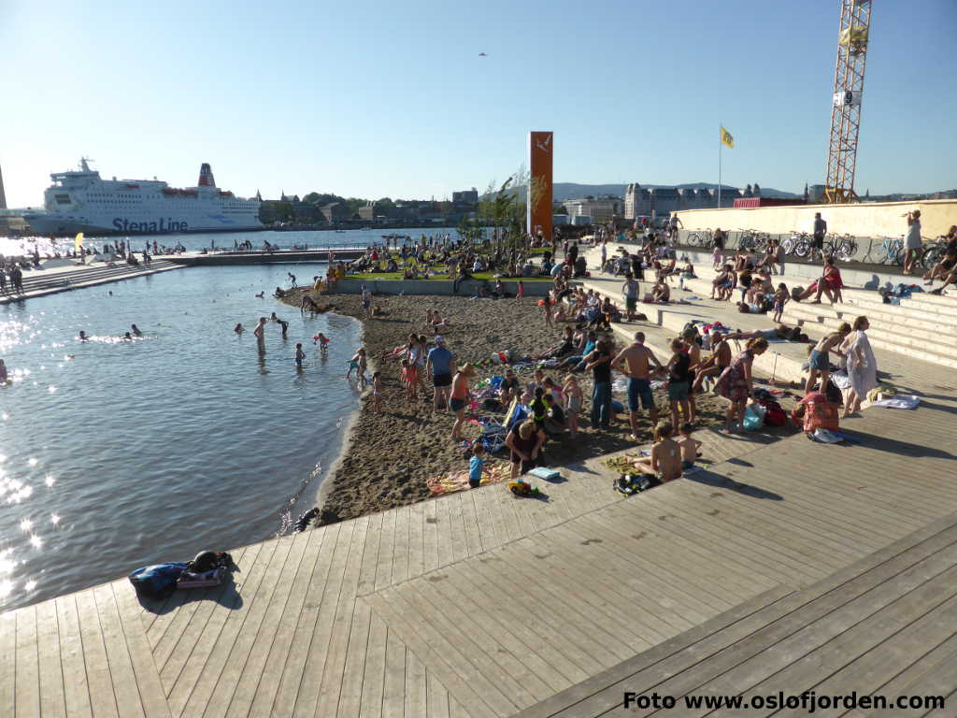

Slide 32
Converting Sewage (Trash) into Valuable Treasure
Wastewater
Treated Water discharged to the Oslo Fjord
Biogas - A valuable sustainable energy source
A substitute fuel source for 80 buses in Oslo City (replacing 80 diesel powered buses)
Generation of 140 tons of phosphorus per year equivalent to 110 000 bags of mineral fertilizer (30 kg bag)
Nutrient Recovery
(Fertilizer -biosolids)
- for agricultural use
Improving water quality and biodiversity in the Fjord
Zero CO₂ emissions – A carbon neutral source

Slide 33
THANK YOU FOR YOUR ATTENTION!

