Slide 1
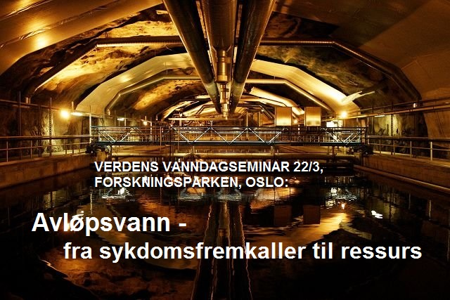
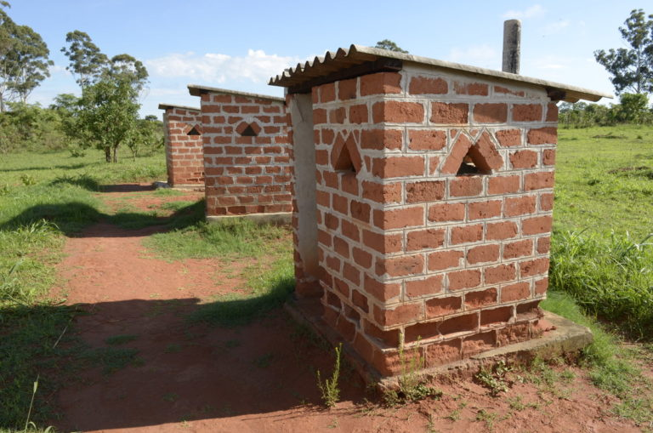
Internasjonale fokus på avløpsvann: FNs bærekraftsmål og EUs perspektiv
Forskningsleder Sindre Langaas, NIVA

Slide 2

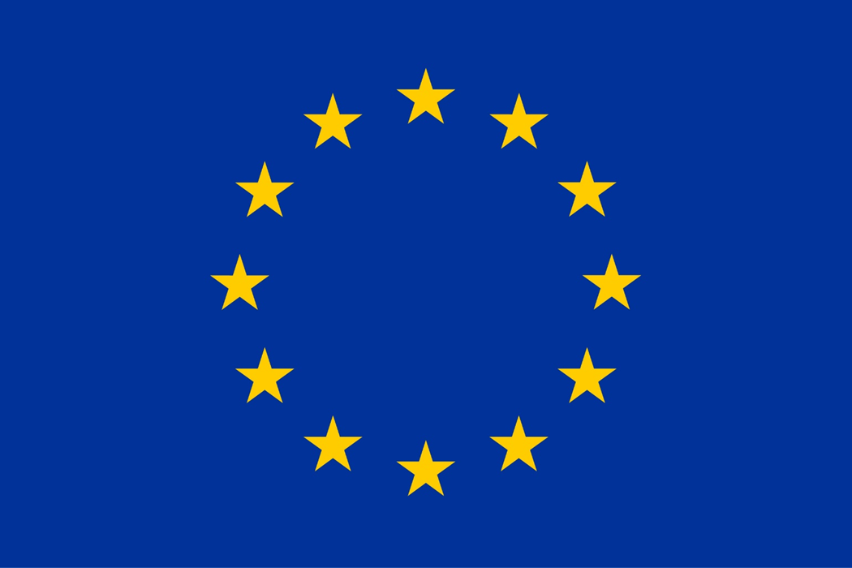
Presentasjonens struktur
FN
EU

Slide 3
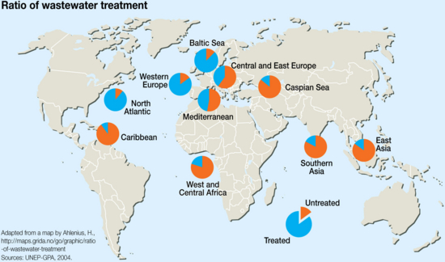
Ratio treated/non treated wastewater
The ratio of treated to untreated wastewater reaching water bodies for 10 regions. An estimated 90 per cent of all wastewater in developing countries is discharged untreated directly into rivers, lakes or the oceans (UN Water, 2008).
Year: 2010
From collection: Sick Water - The Central Role of Wastewater Management in Sustainable Development
Cartographer: UNEP/GRID-Arendal, Hugo Ahlenius

Slide 4

FN

Slide 5
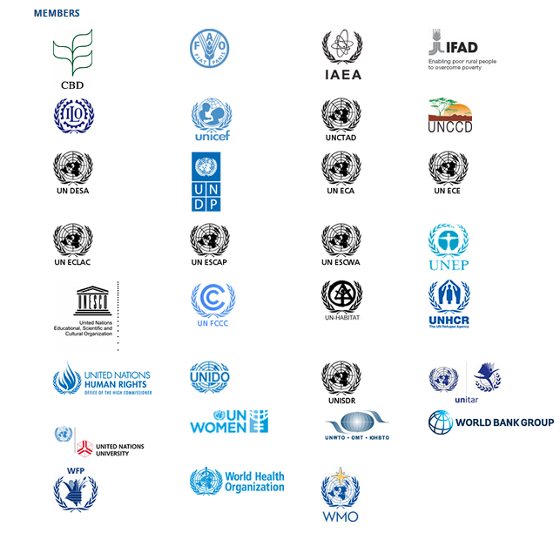
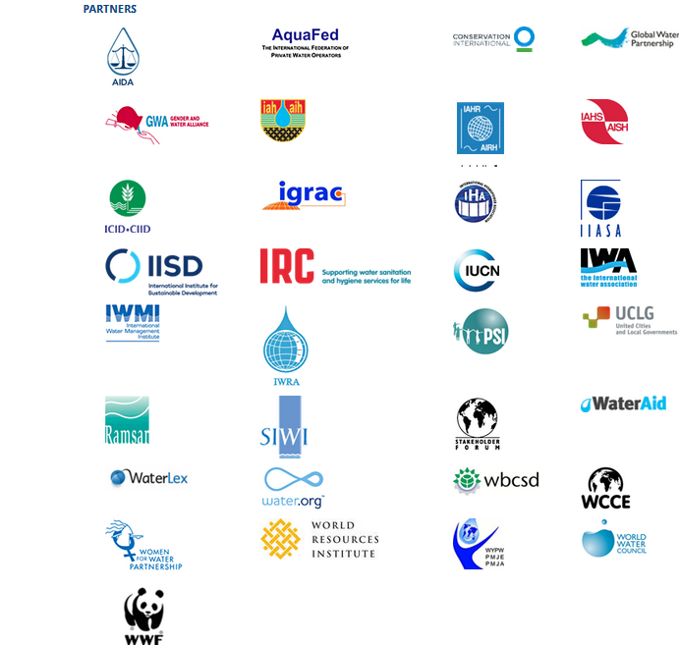
The main purpose of UN-Water is to complement and add value to existing programmes and projects by facilitating synergies and joint efforts, so as to maximize system-wide coordinated action and coherence as well as effectiveness of the support provided to Member States in their efforts towards achieving the time-bound goals, targets and actions related to its scope of work as agreed by the international community

Slide 6
Eksempel - WHO
WHO
  The Protocol on Water and Health to the 1992 Convention on the Protection and Use of Transboundary Watercourses and International Lakes
  “first major international legal approach for the prevention, control and reduction of water-related diseases in Europe”
    adequate supplies of wholesome drinking-water;
    adequate sanitation of a standard that sufficiently protects human health and the environment;
    effective protection of water resources used as sources of drinking-water, and their related water ecosystems, from pollution from other causes;
    adequate safeguards for human health against water-related diseases; and
    effective systems for monitoring and responding to outbreaks or incidents of water-related diseases.

Slide 7
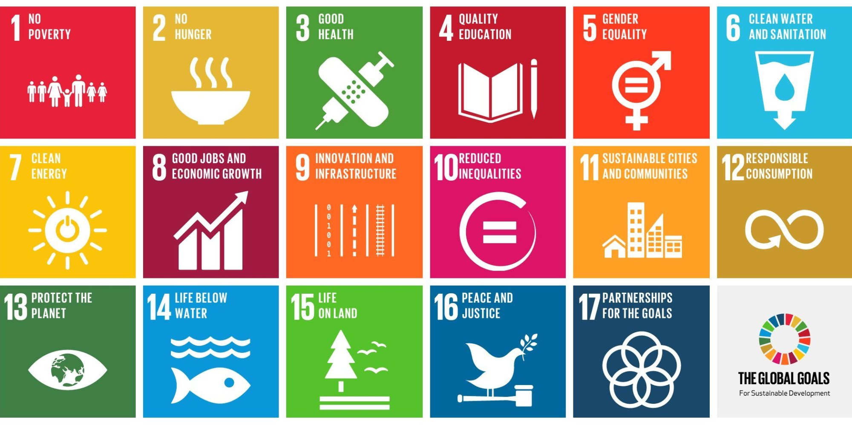

Slide 8
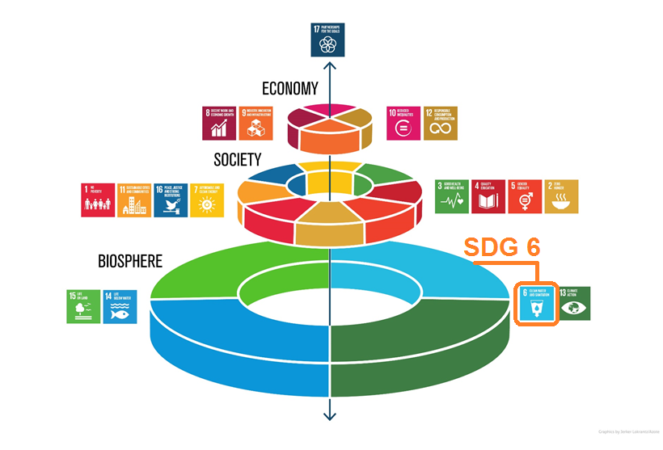

Slide 9
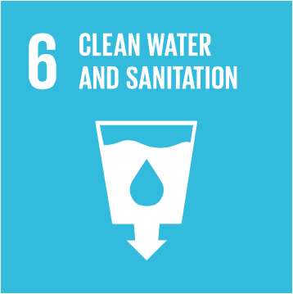
Goal 6: Ensure access to water and sanitation for all
2.6 billion people have gained access to improved drinking water sources since 1990, but 663 million people are still without
At least 1.8 billion people globally use a source of drinking water that is fecally contaminated
Between 1990 and 2015, the proportion of the global population using an improved drinking water source has increased from 76 per cent to 91 per cent
But water scarcity affects more than 40 per cent of the global population and is projected to rise. Over 1.7 billion people are currently living in river basins where water use exceeds recharge
2.4 billion people lack access to basic sanitation services, such as toilets or latrines
More than 80 per cent of wastewater resulting from human activities is discharged into rivers or sea without any pollution removal
Each day, nearly 1,000 children die due to preventable water and sanitation-related diarrhoeal diseases
Hydropower is the most important and widely-used renewable source of energy and as of 2011, represented 16 per cent of total electricity production worldwide
Approximately 70 per cent of all water abstracted from rivers, lakes and aquifers is used for irrigation
Floods and other water-related disasters account for 70 per cent of all deaths related to natural disasters

Slide 10
Sustainable Development Goal 6
Ensure availability and sustainable management of water and sanitation for all
Targets
Indicators
6.1 By 2030, achieve universal and equitable access to safe and affordable drinking water for all
6.2 By 2030, achieve access to adequate and equitable sanitation and hygiene for all and end open defecation, paying special attention to the needs of women and girls and those in vulnerable situations
6.3 By 2030, improve water quality by reducing pollution, eliminating dumping and minimizing release of hazardous chemicals and materials, halving the proportion of untreated wastewater and substantially increasing recycling and safe reuse globally
6.4 By 2030, substantially increase water-use efficiency across all sectors and ensure sustainable withdrawals and supply of freshwater to address water scarcity and substantially reduce the number of people suffering from water scarcity
6.1.1 Proportion of population using safely managed drinking water services
6.2.1 Proportion of population using safely managed sanitation services, including a hand-washing facility with soap and water
6.3.1 Proportion of wastewater safely treated
6.3.2 Proportion of bodies of water with good ambient water quality
6.4.1 Change in water-use efficiency over time
6.4.2 Level of water stress: freshwater withdrawal as a proportion of available freshwater resources

Slide 11
Sustainable Development Goal 6
Ensure availability and sustainable management of water and sanitation for all
Targets
Indicators
6.5 By 2030, implement integrated water resources management at all levels, including through transboundary cooperation as appropriate
6.6 By 2020, protect and restore water-related ecosystems, including mountains, forests, wetlands, rivers, aquifers and lakes
6.6.1 Change in the extent of water-related ecosystems over time
6.A By 2030, expand international cooperation and capacity-building support to developing countries in water- and sanitation-related activities and programmes, including water harvesting, desalination, water efficiency, wastewater treatment, recycling and reuse technologies
6.B Support and strengthen the participation of local communities in improving water and sanitation management
6.5.1 Degree of integrated water resources management implementation (0-100)
6.5.2 Proportion of transboundary basin area with an operational arrangement for water cooperation
6.A.1 Amount of water- and sanitation-related official development assistance that is part of a government-coordinated spending plan
6.B.1 Proportion of local administrative units with established and operational policies and procedures for participation of local communities in water and sanitation management

Slide 12
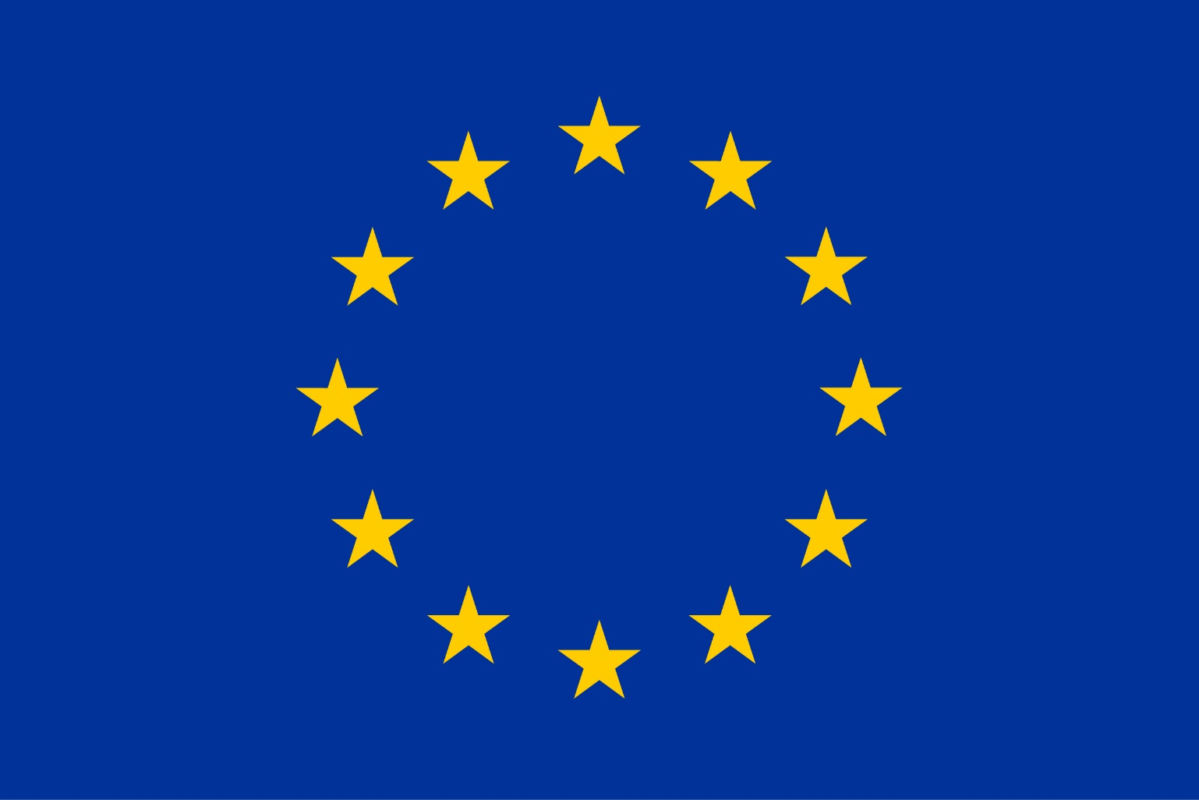
EU

Slide 13
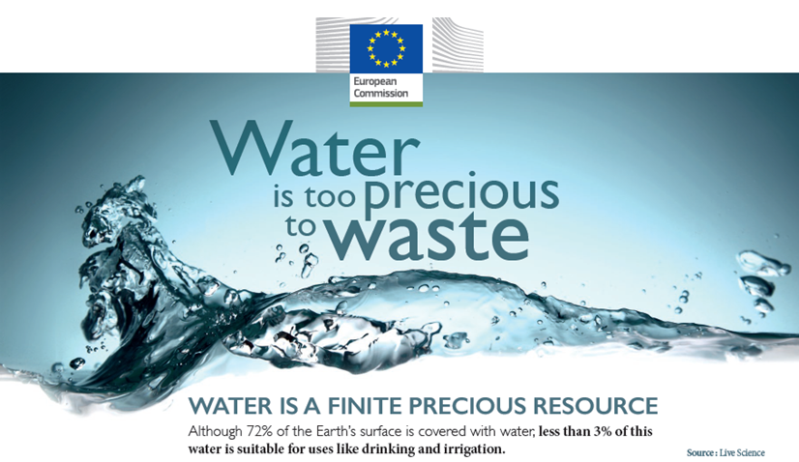

Slide 14
Avløpsvann og EU – en relasjon i utvikling
Urban Waste Water Treatment Directive (1991)
  A 1991 European Union directive concerning urban waste water "collection, treatment and discharge of urban waste water and the treatment and discharge of waste water from certain industrial sectors".
  It aims "to protect the environment from adverse effects of waste water discharges from cities and "certain industrial sectors".
  It prescribes the waste water collection and treatment in urban agglomerations with a population equivalent of over 2000, and more advanced treatment in places with a population equivalent greater than 10,000 in "sensitive areas"

Slide 15
EU:s vannrammedirektiv (2001)
  Utøker perspektivet fra UWWTD med et tydeligere resipientperspektiv med forsterkede mål om og forventninger til forbedringer i vannkvalitet i resipientene
  Forsterket fokus også på en liste med såkalte «prioriterte stoffer» som øker kravet på rensing av disse (og ikke minst redusert bruk/tap «oppstrøms»)
  Vannrammedirektivet har vært en sterk driver for å framskynde investeringer i renseanlegg og relaterte VA-løsninger, også i Norge

Slide 16
EU:s sirkulære økonomi pakke (2015)
  De foreslåtte tiltakene i denne pakka vil
    bidra til å "lukke kretsløpet" av produktlivssykluser gjennom økt resirkulering og gjenbruk, til gavn for både miljø og økonomi.
    generere maksimal verdi og bruk av alle råvarer, produkter og avfall, bidra til energisparing og reduksjon av klimagassutslipp.
  Kommisjonens forslag belyser konsekvensene av vannmangel på miljø og økonomi i enkelte deler av EU og inneholder tiltak for å fremme gjenbruk av renset avløpsvann, herunder foreslått lovgivning om minimumskrav til avløpsvann til irrigasjon og grunnvannspåfylling.
  EU-kommisjonen er også for tiden arbeider med et veiledningsdokument på integrering av vann gjenbruk i planlegging og forvaltning.

Slide 18
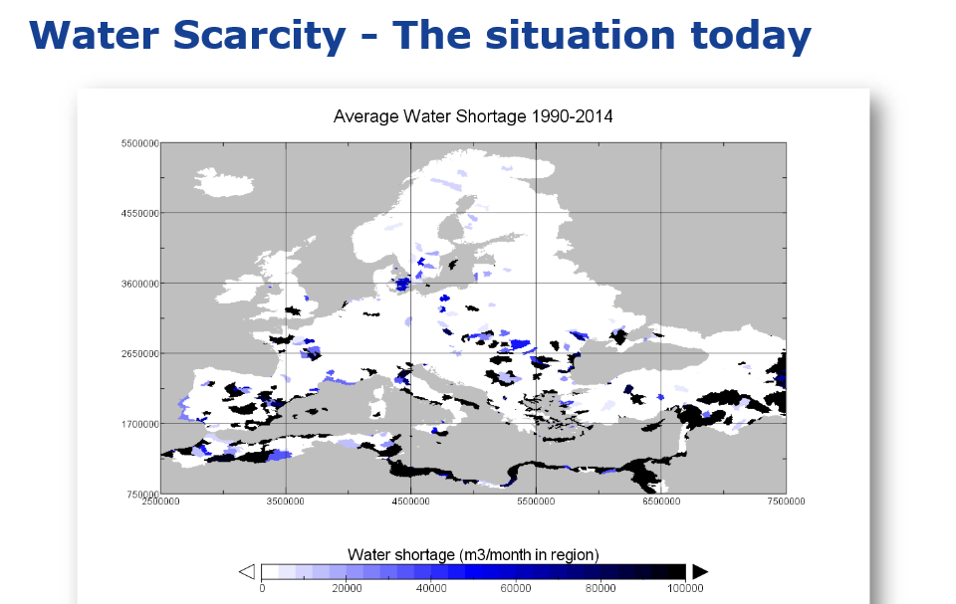
BM Gawlik, JRC. 2017

Slide 19
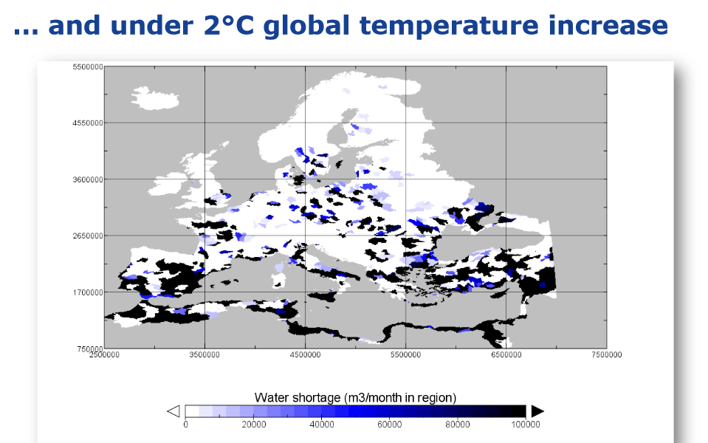
BM Gawlik, JRC. 2017

Slide 20
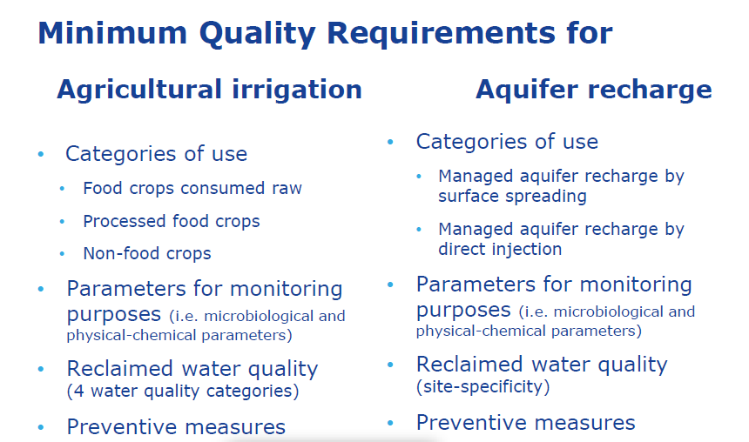
BM Gawlik, JRC. 2017

Slide 21
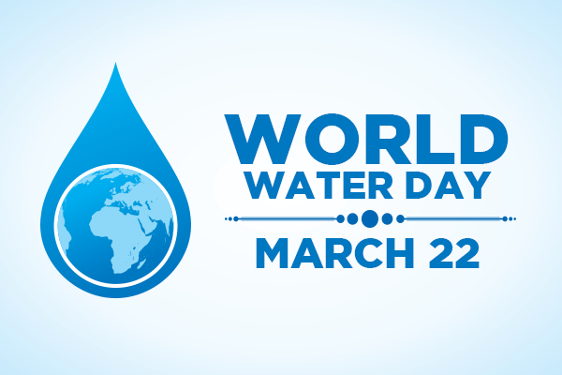
Takk for oppmerksomheten!

