Slide 1
Verdens Vanndag 2017
De kommunale renseanleggene som byenes nyrer (og avløpsvannet som blodet) i den urbane metabolismen
– om deteksjon av de stygge stoffene
Dr. Malcolm Reid, NIVA

Slide 2
What goes up must come down – and what goes in must come out

Slide 3
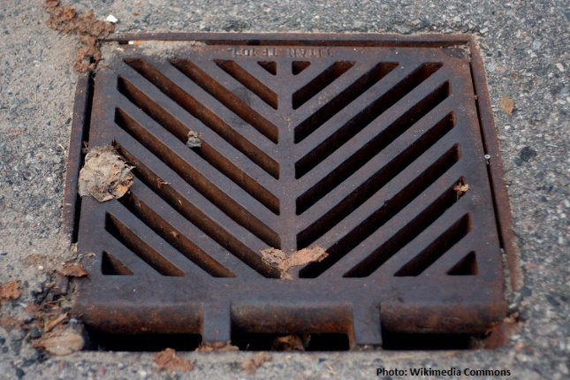
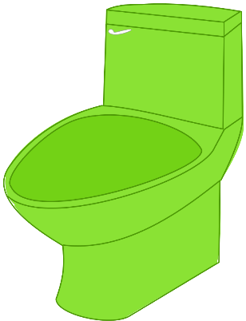
Down the drain
Everything
We eat
We drink
We put on our bodies
From the industry
From run-off
End up in the sewer

Slide 4
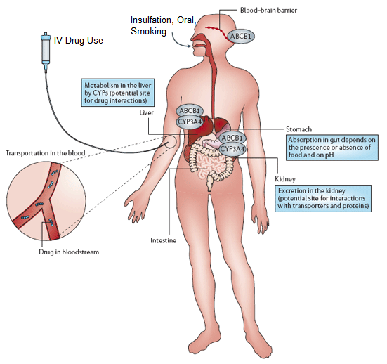
A sample of wastewater can be like a finger-print for a city

Slide 5
Wastewater analysis
Wastewater treatment plants are like the neck of an hourglass

Slide 6
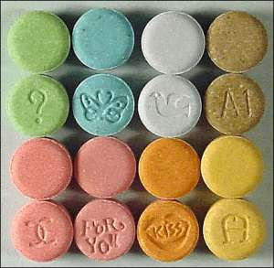
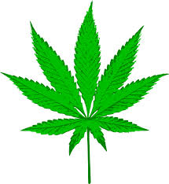
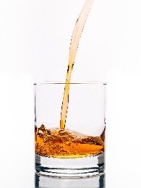
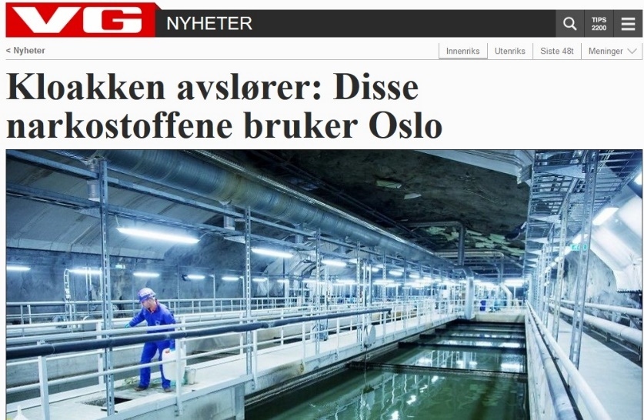
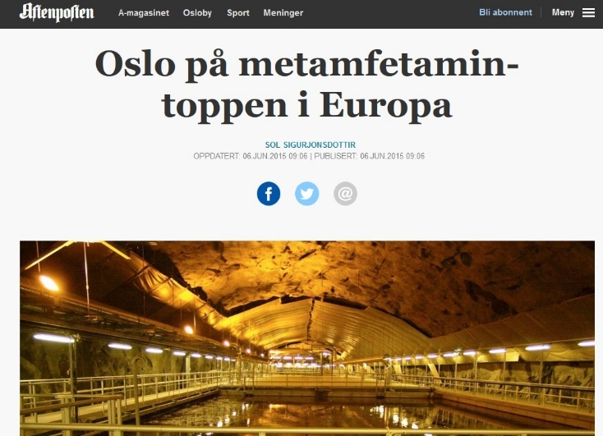
Illicit drugs and alcohol

Slide 7
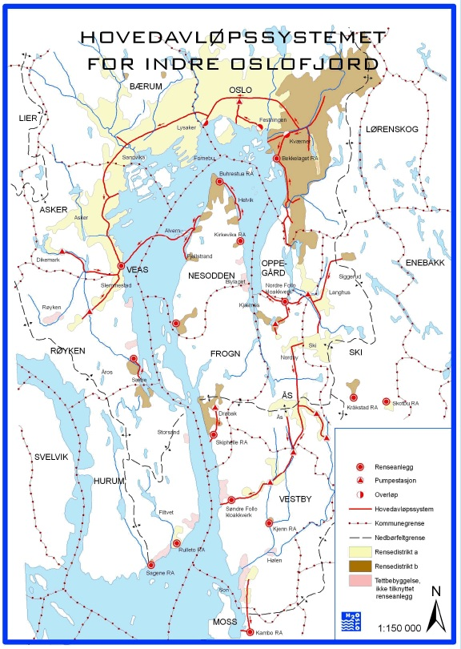
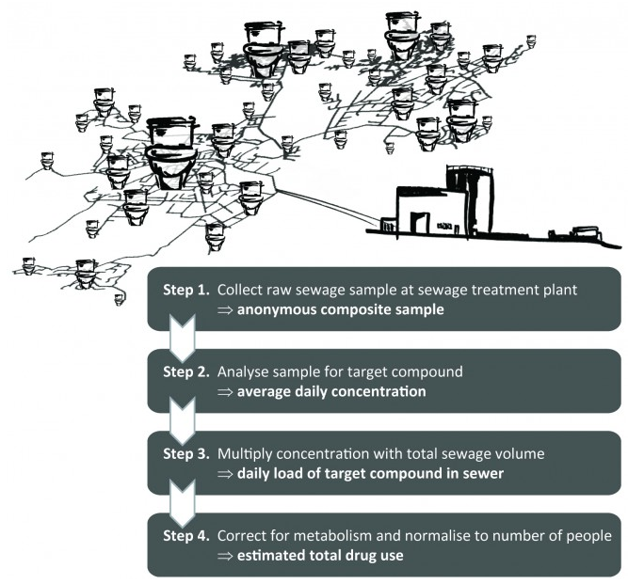

Slide 8
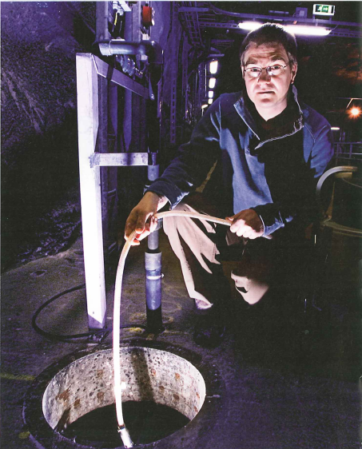
Sample collection

Slide 9
Illicit drugs and alcohol

Slide 10
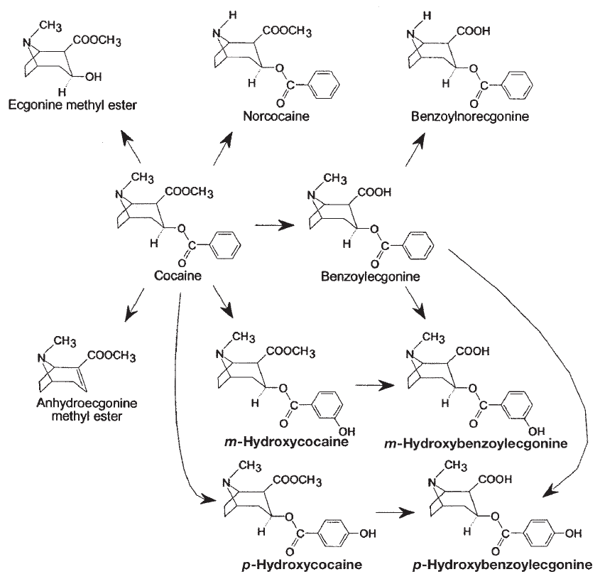
Urinary metabolites
Disposal?
Evidence of use
Notes:
10

Slide 11
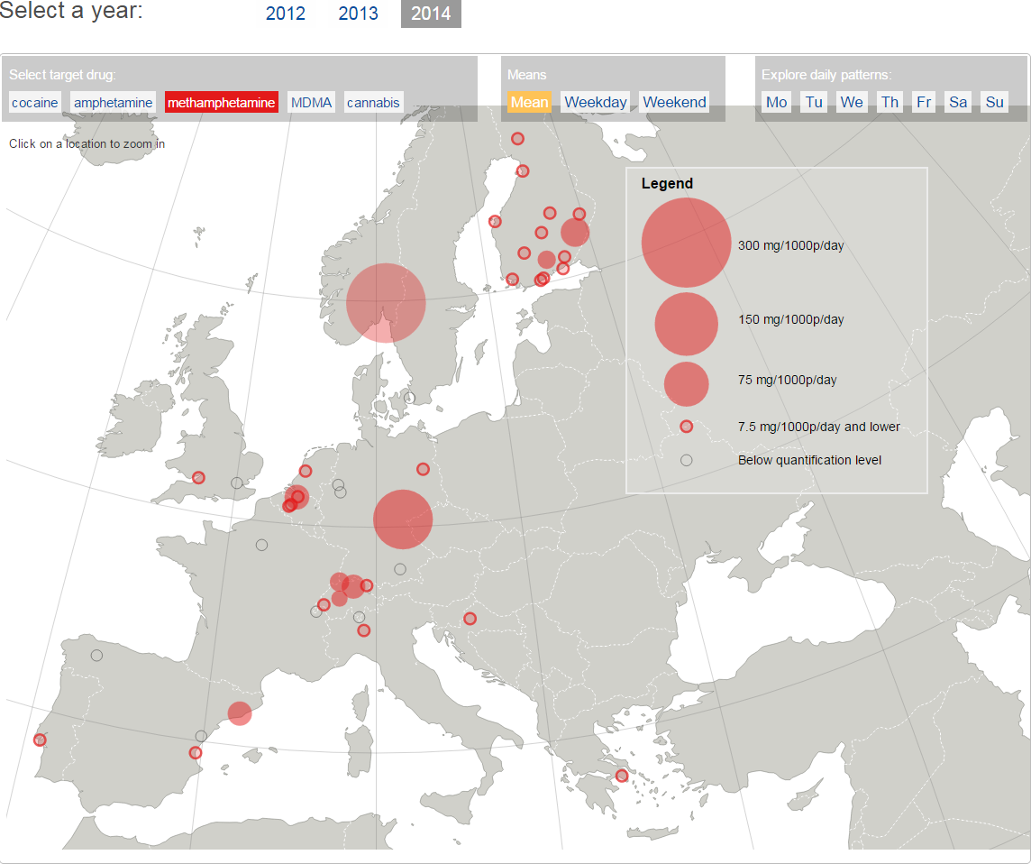
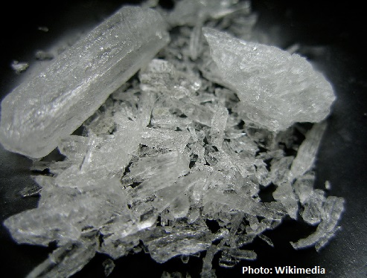
http://www.emcdda.europa.eu/topics/pods/waste-water-analysis

Slide 12
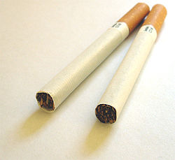
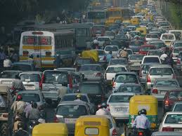
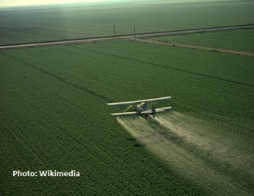
Health biomarkers, Pesticides on food, Air pollution etc.
Sewage contains a broad range of endogenous and exogenous biomarkers that potentially can be used to evaluate community-wide health related factors
Analysis allows for inter-comparison of health-status among distinct communities
Results can help establish correlations between stressors and health

Slide 13
Health biomarkers, Pesticides on food, Air pollution etc.
Sewage contains a broad range of endogenous and exogenous biomarkers that potentially can be used to evaluate community-wide health related factors
Analysis allows for inter-comparison of health-status among distinct communities
Results can help establish correlations between stressors and health

