Slide 1

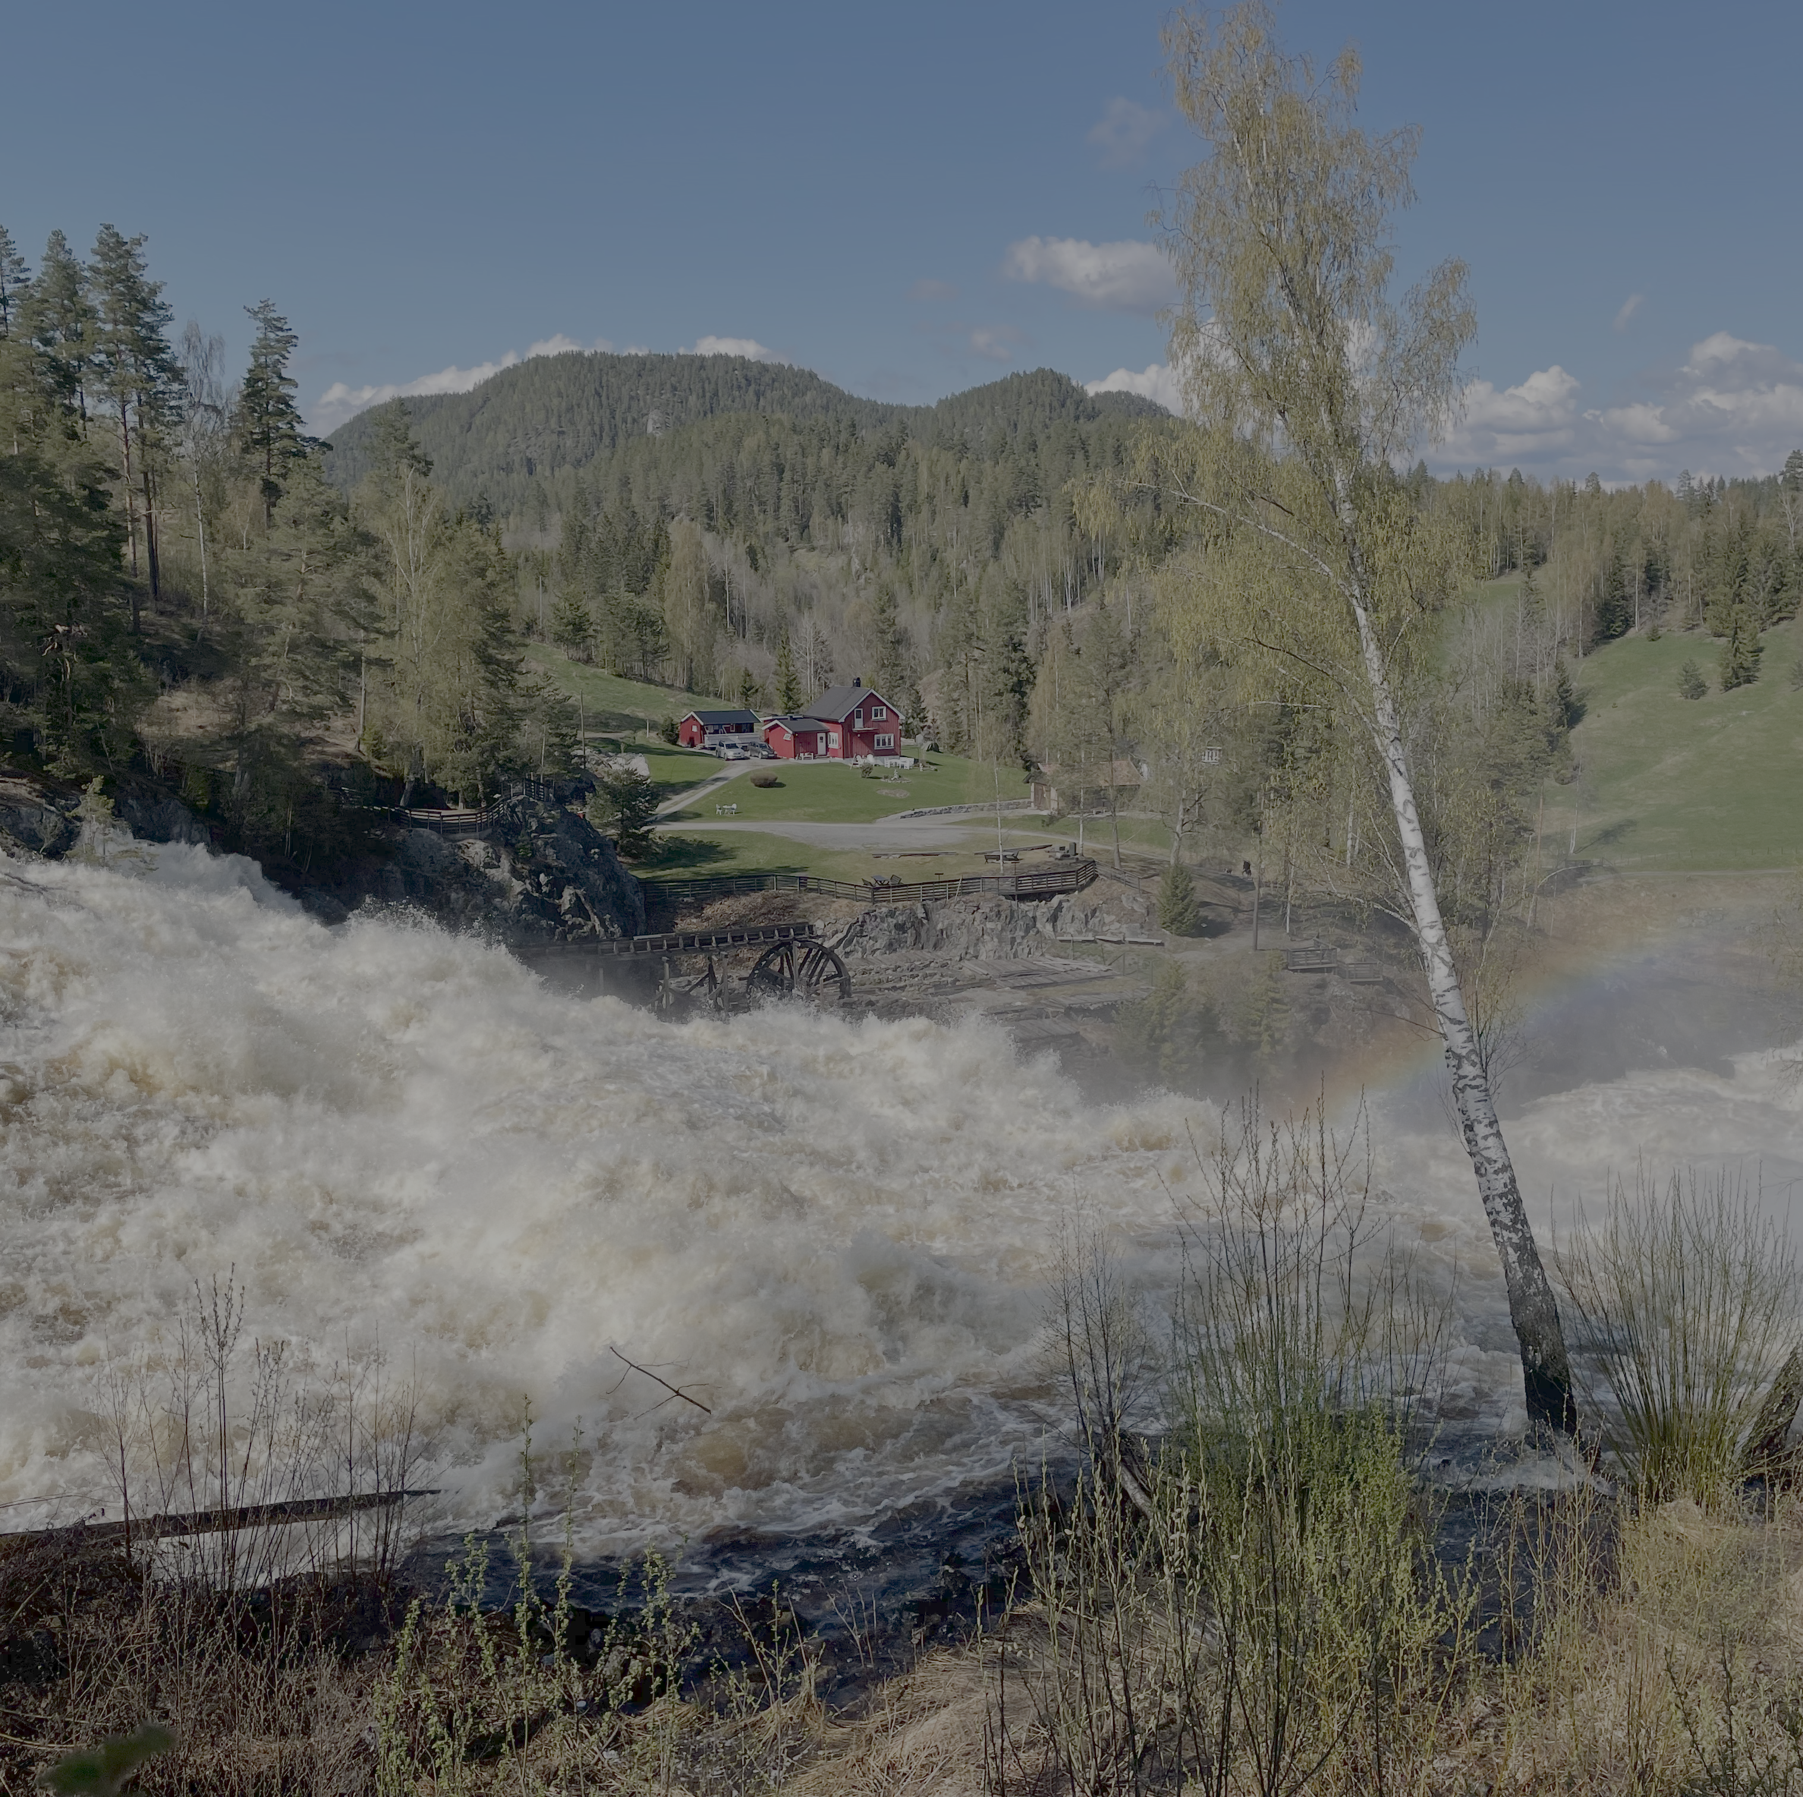
CAMELS-Nordic Dataset for Hydrological ML Studies
Authors:
Kristen J. Valseth, Kent-Andre Mardal, Olga Silantyeva, Gaute Lappegard, & Lars Magnus Valnes

Slide 2
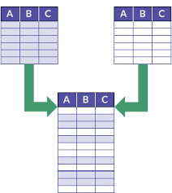
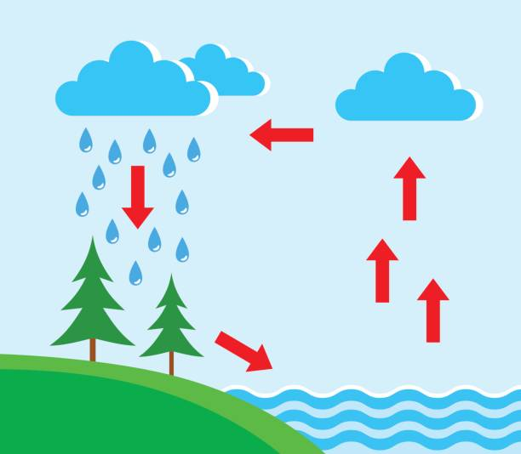

What are CAMELS datasets?
Catchment Attributes and MEteorology for Large-sample Studies
Synthesizes diverse sets of data into a coherent dataset that is comparable at the catchment scale.
Summarizes meteorological forcing and discharge daily time series.
Characterizes catchment land cover, soil, and geology.

Slide 3
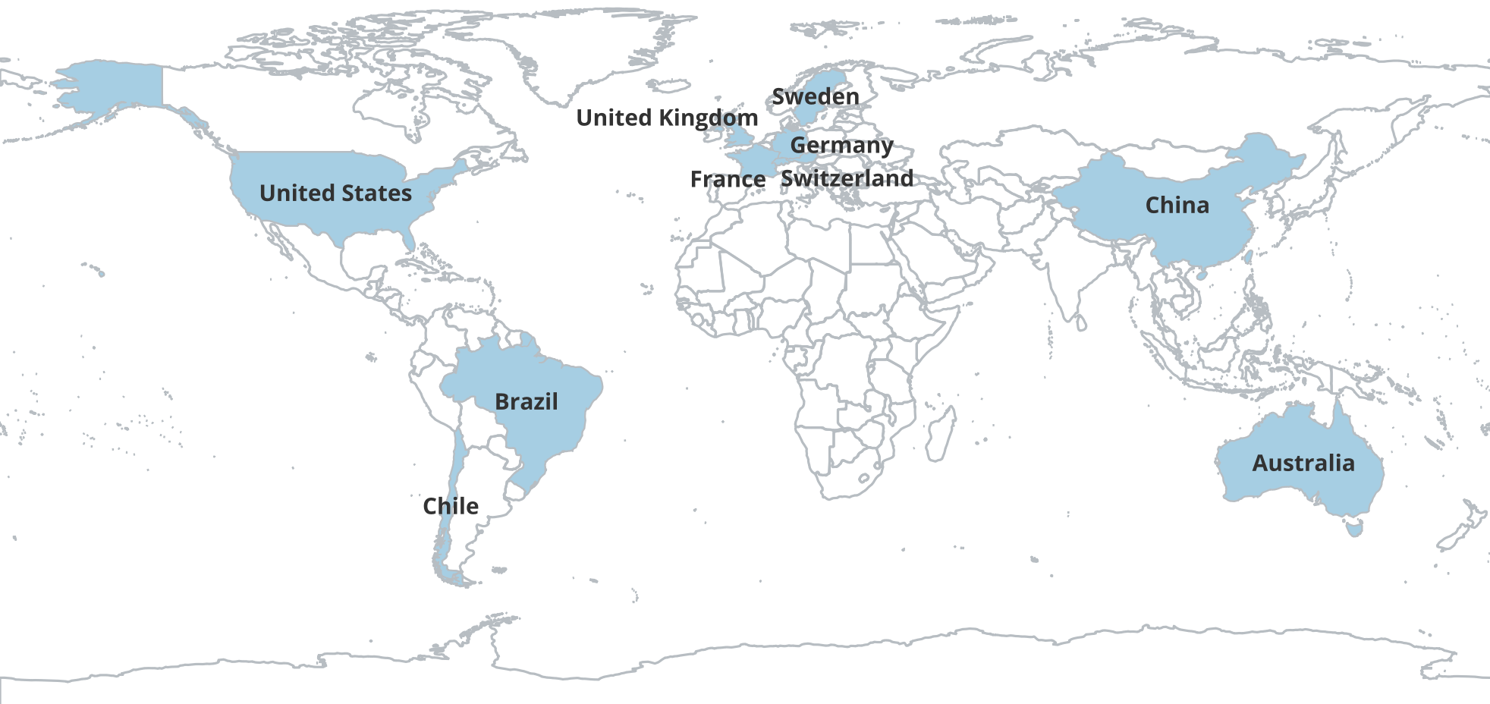
CAMELS datasets around the world.

Slide 4
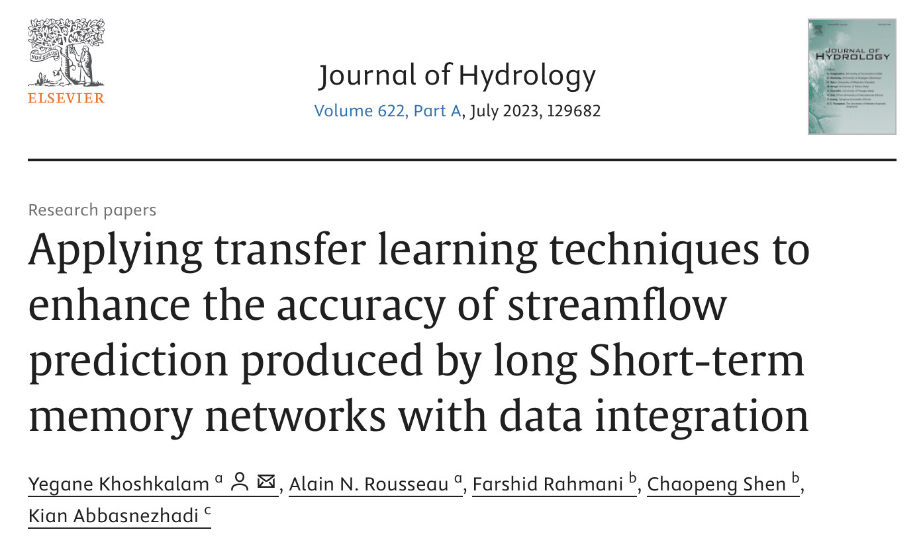
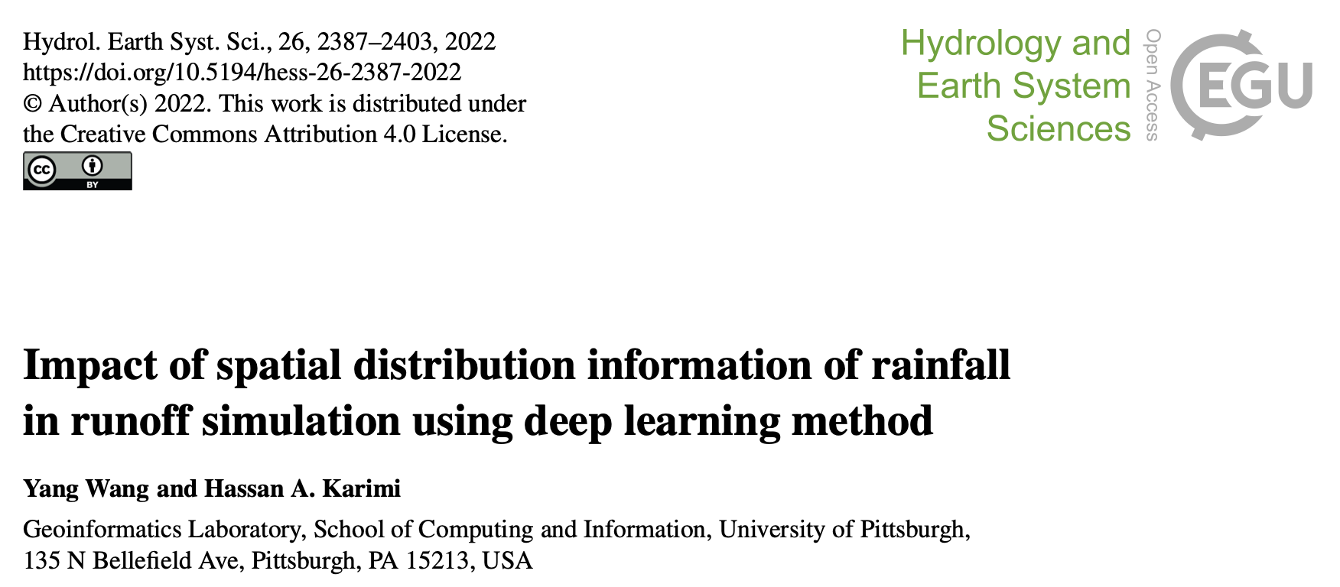
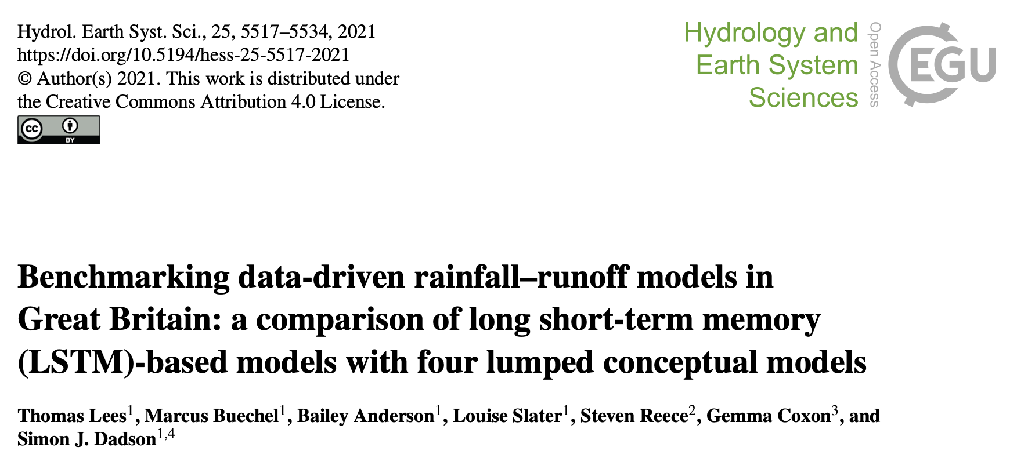
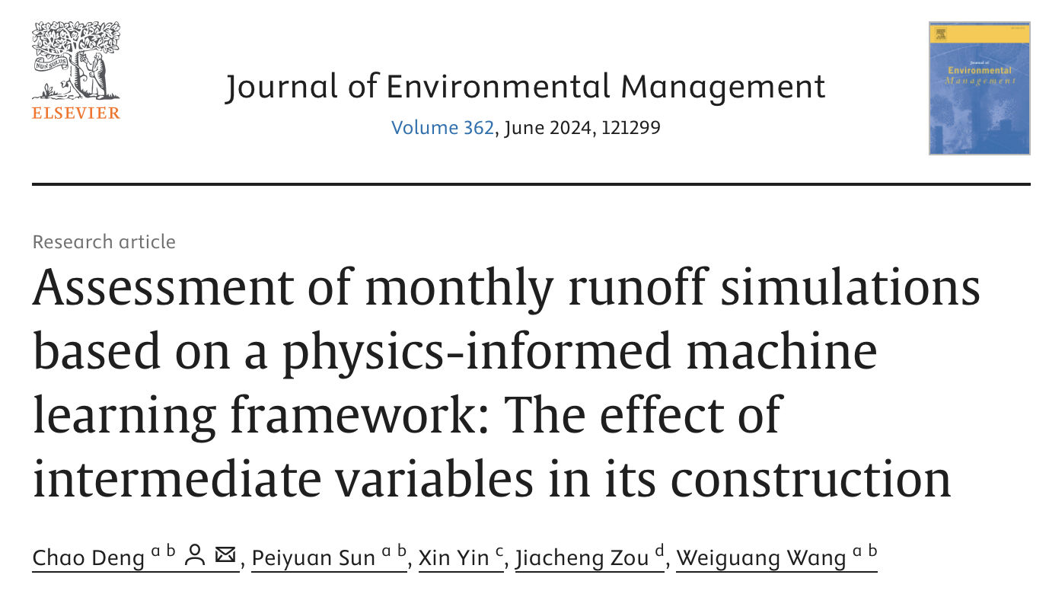
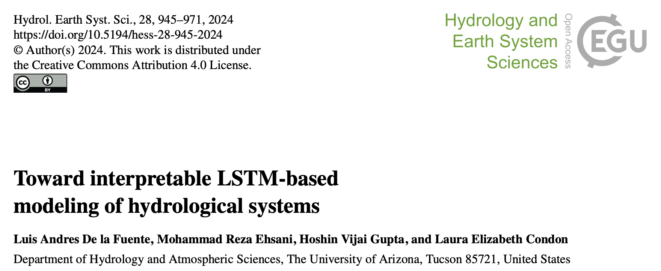
ML studies using CAMELS datasets.

Slide 5



Motivation for creating CAMELS-Nordic.
To support and advance hydrological modeling and climate research efforts in Norway and the Nordic countries.
Creating not only a coherent dataset but one that is updateable with python tools.
Identifying current data gaps and deficiencies.

Slide 6
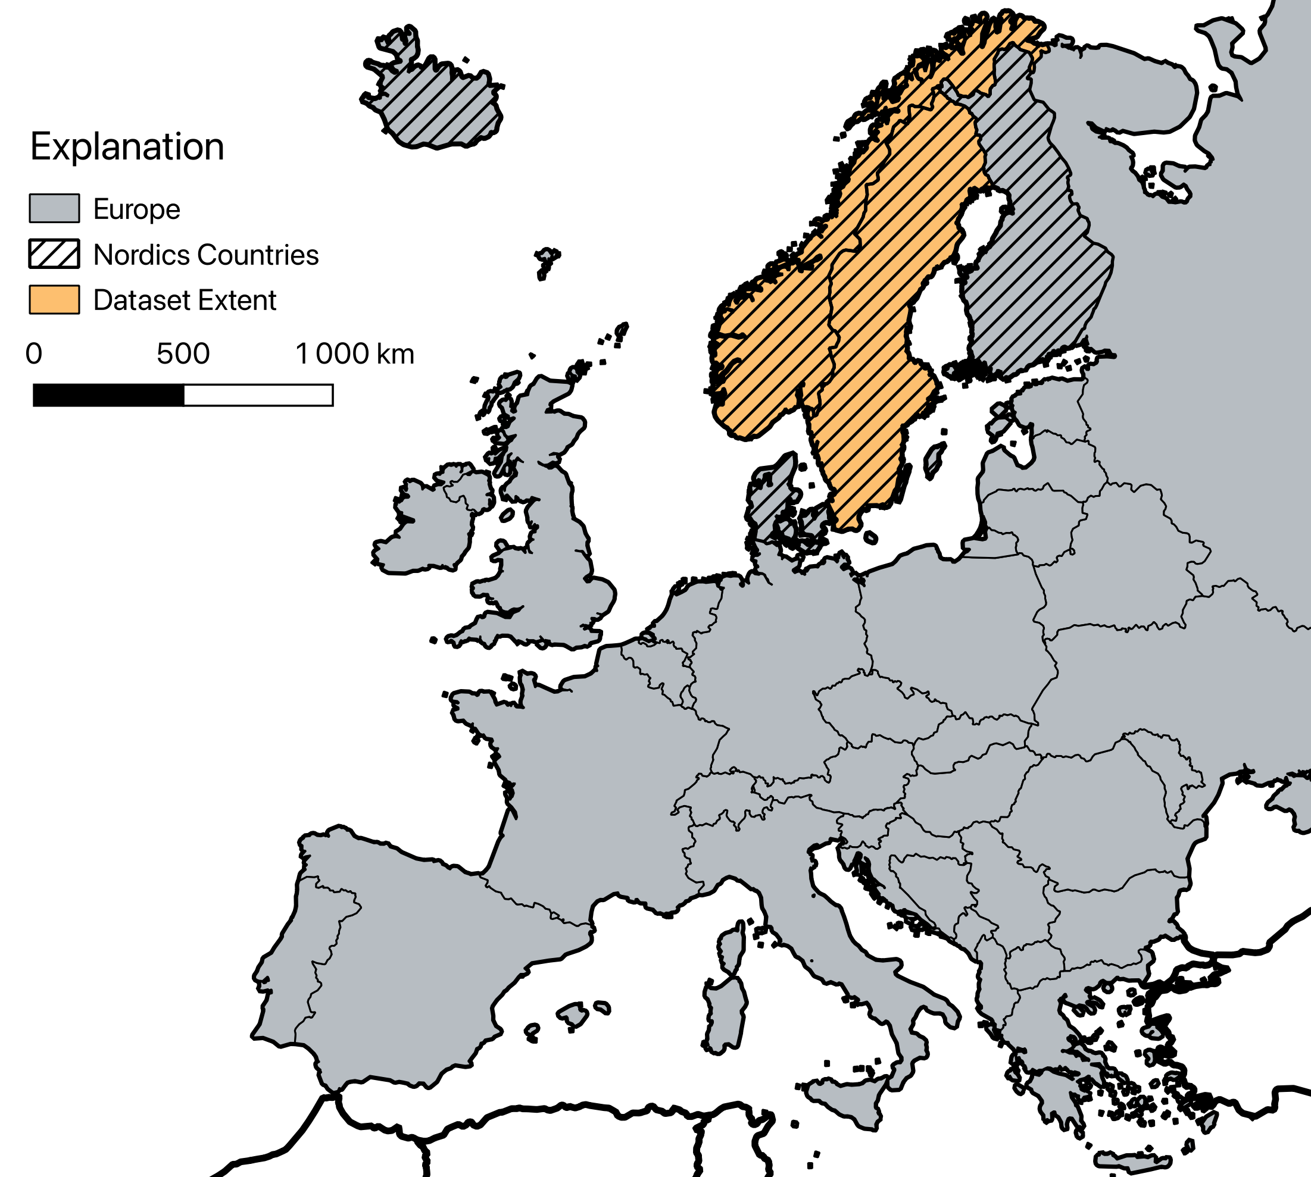
Extent of CAMELS-Nordic dataset

Slide 7
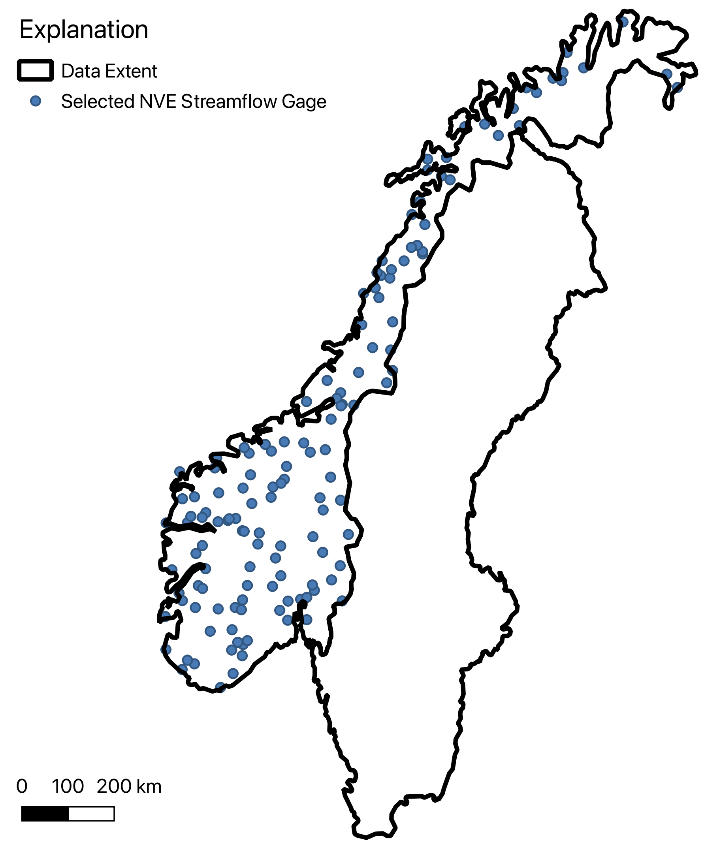
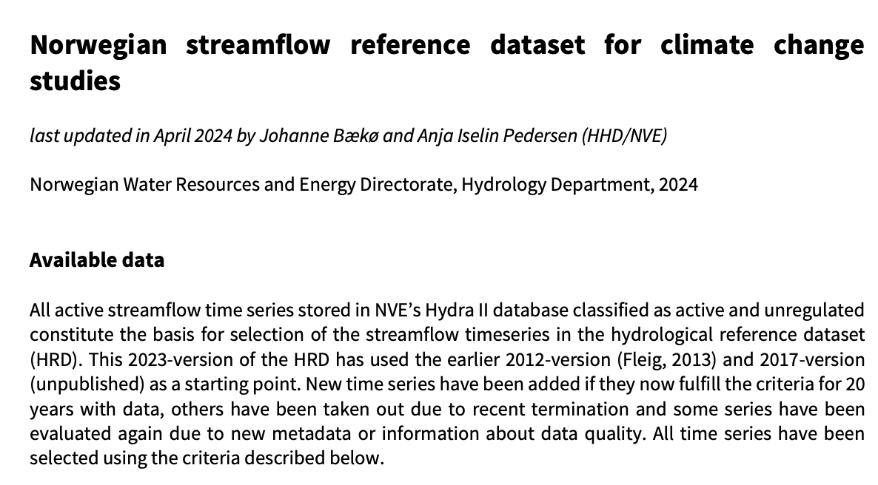
Selection of streamflow gages in Norway.

Slide 8
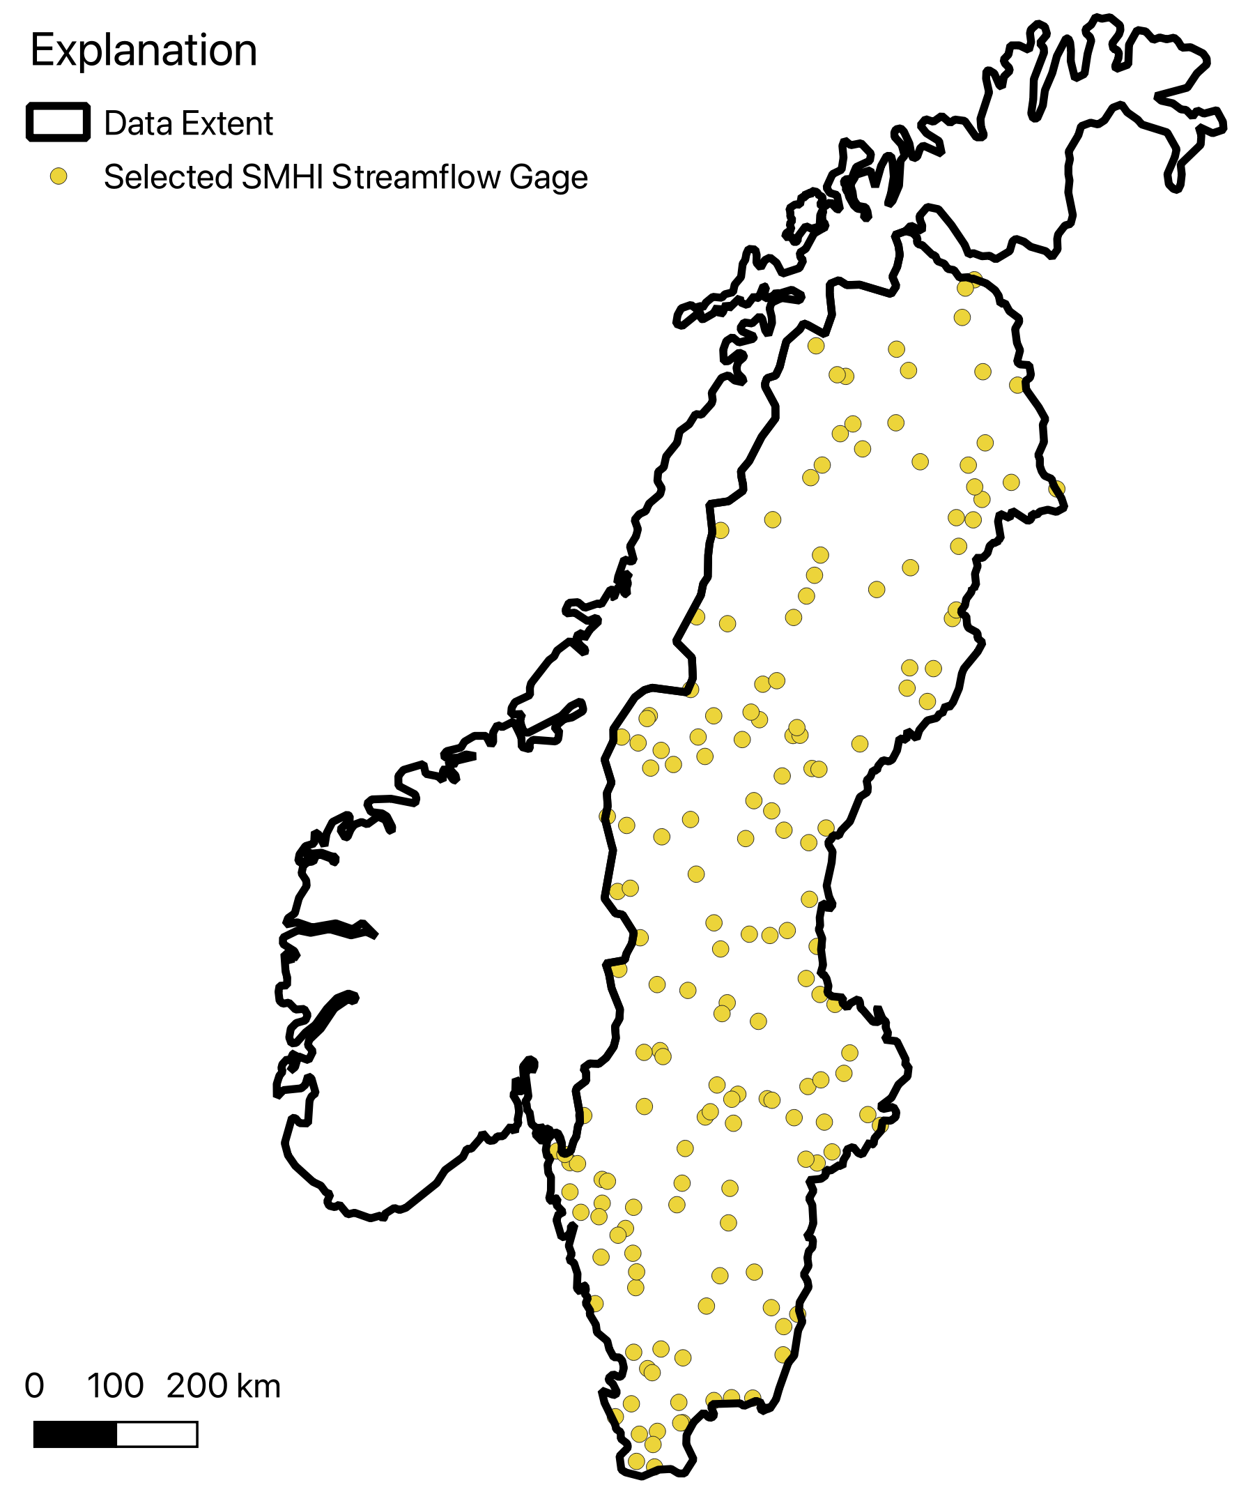
Selection of streamflow gages in Sweden.
All stations with complete daily record 1980-2022 available on the Swedish Meteorological and Hydrological Institute Open Data Portal.

Slide 9
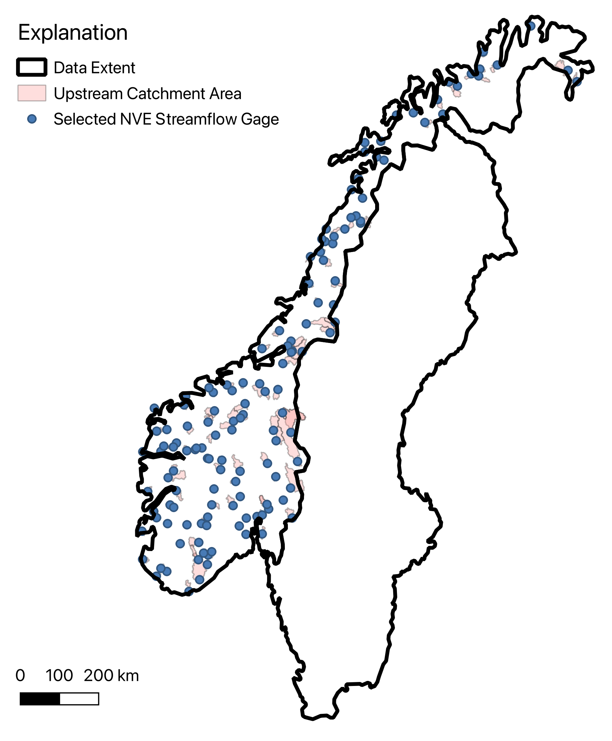
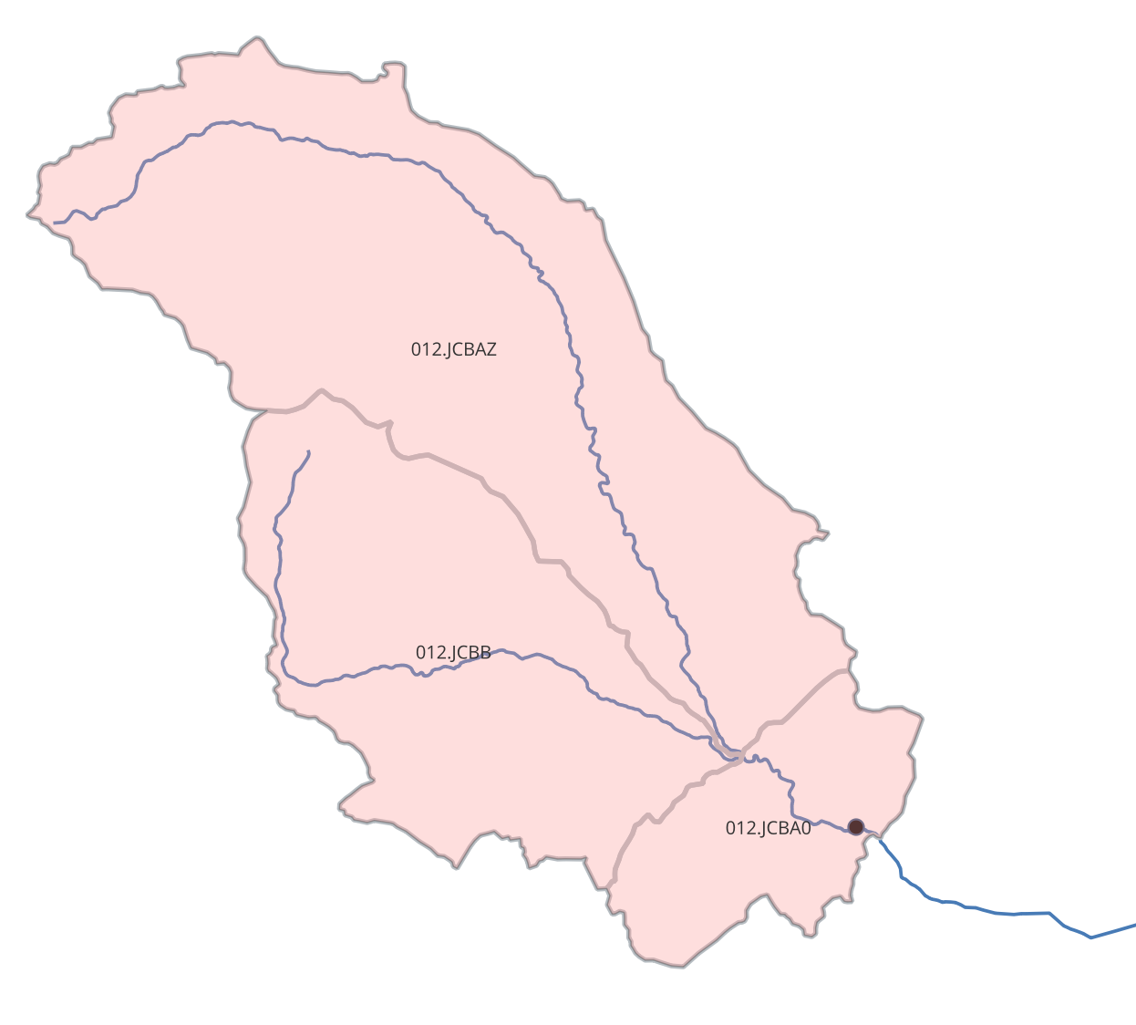
Selection of Norwegian catchments.

Slide 10
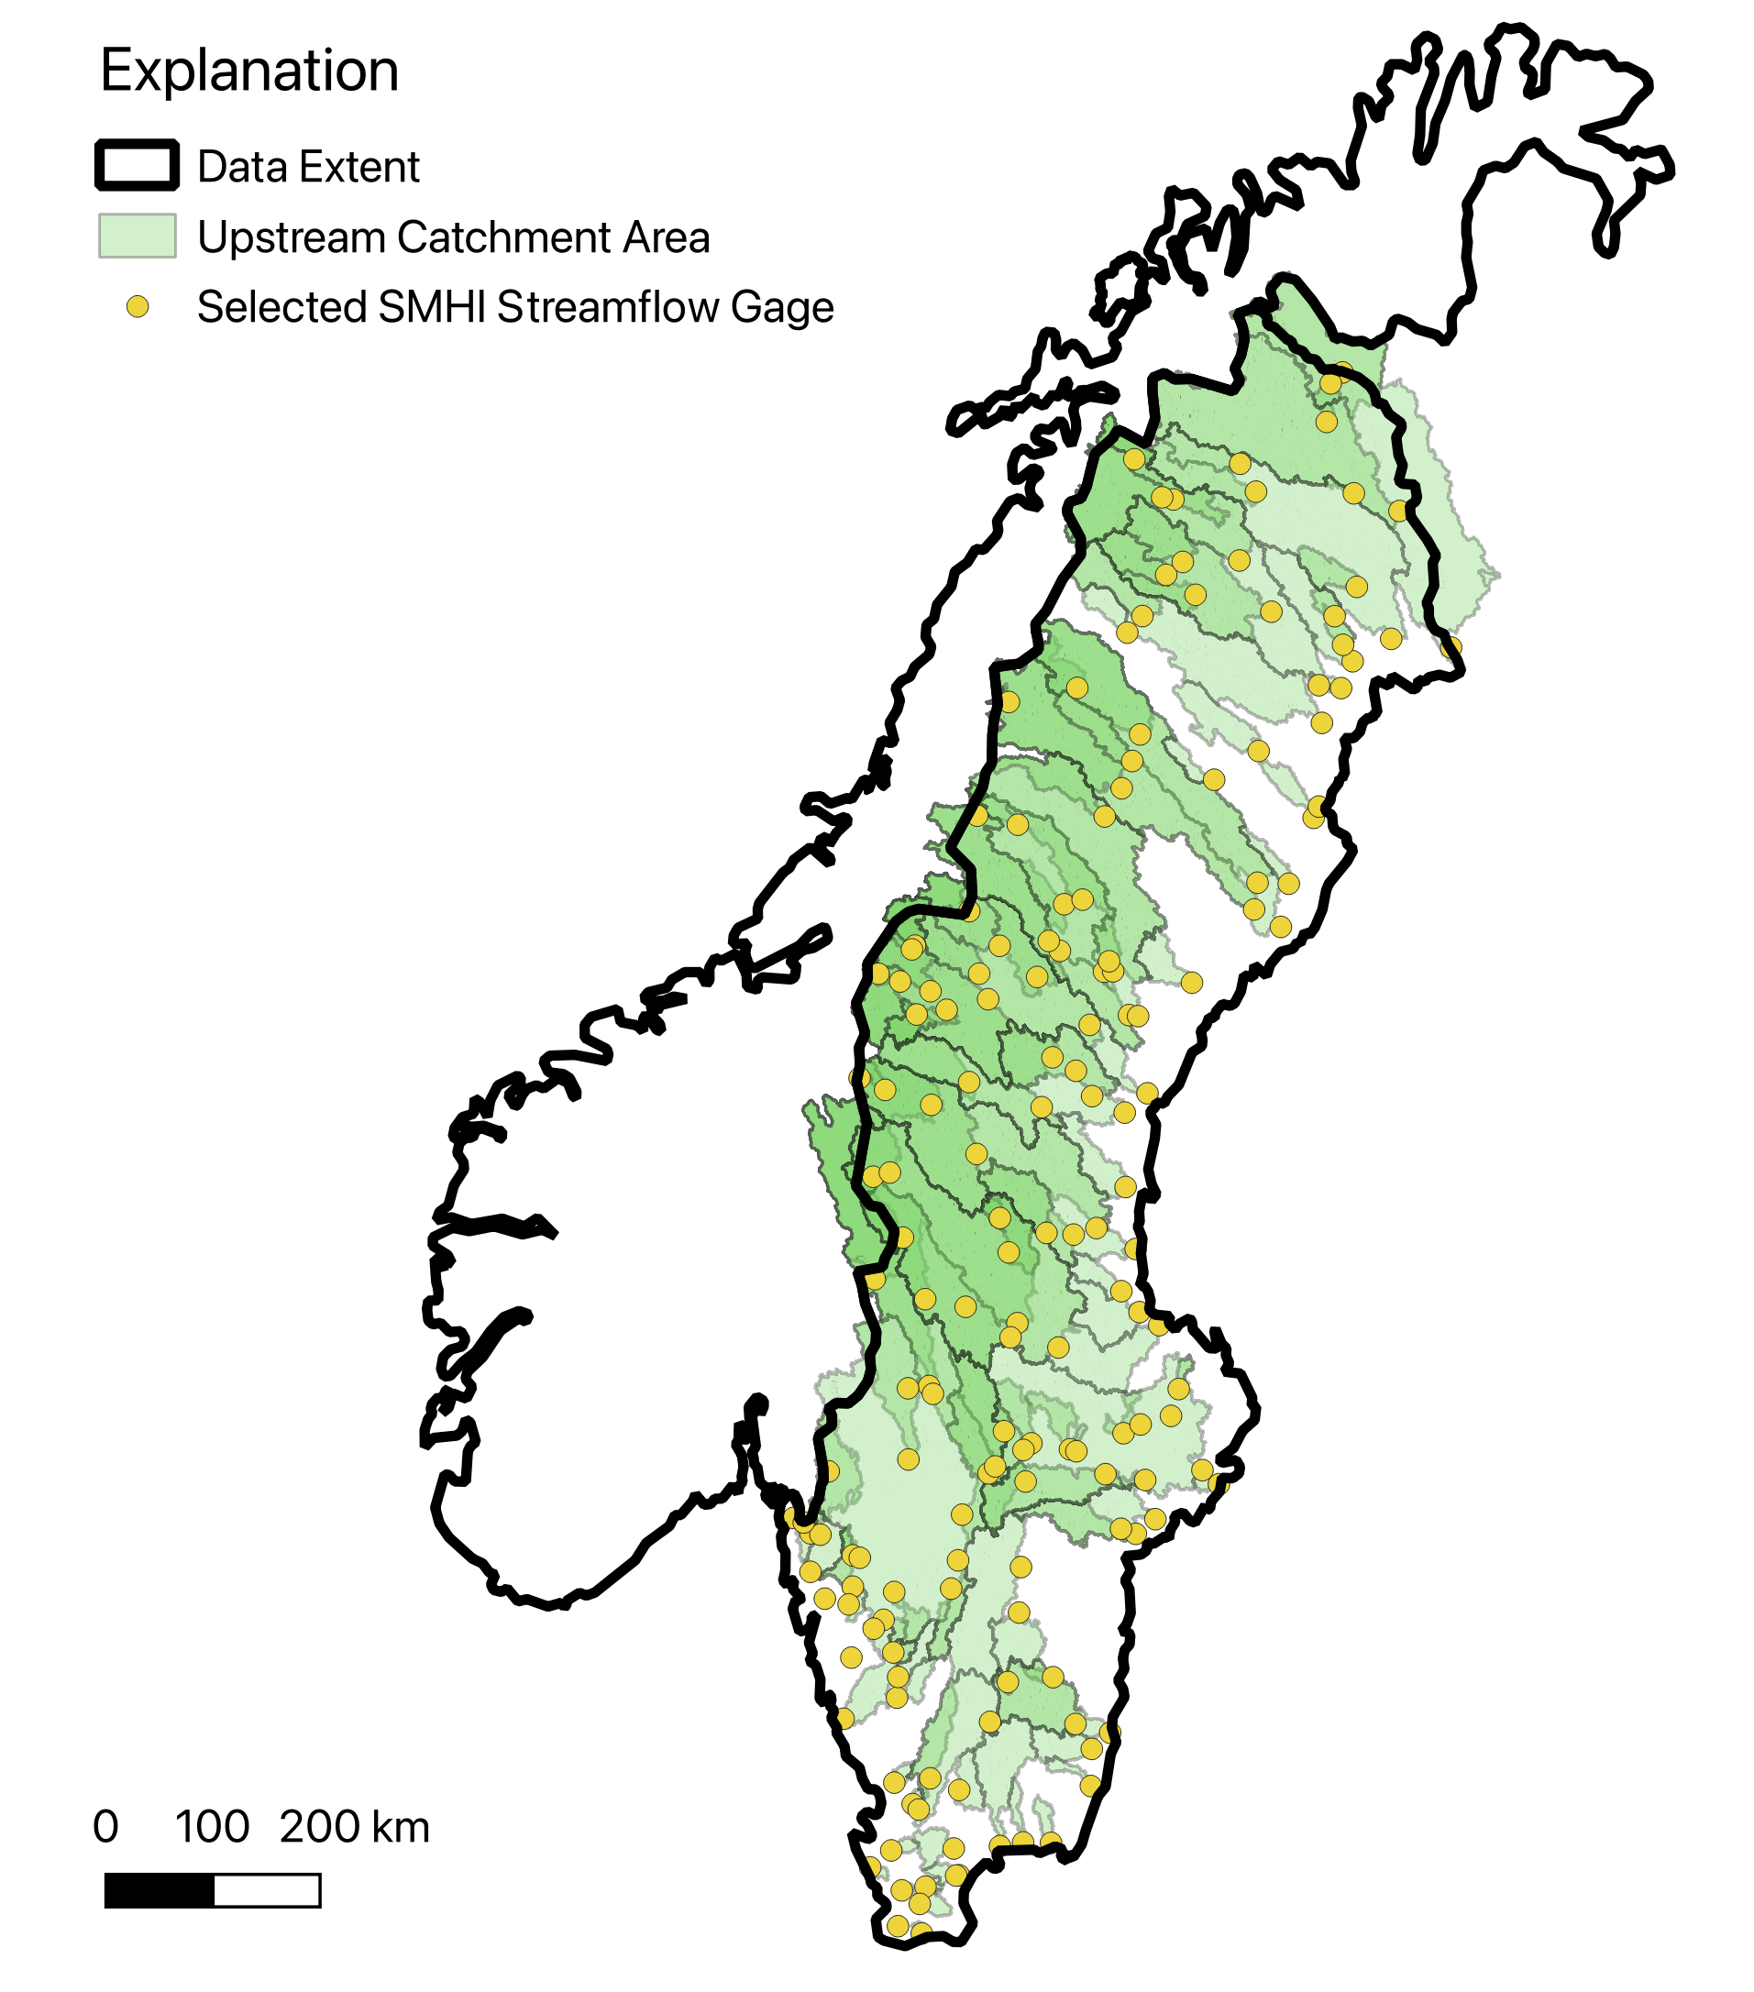
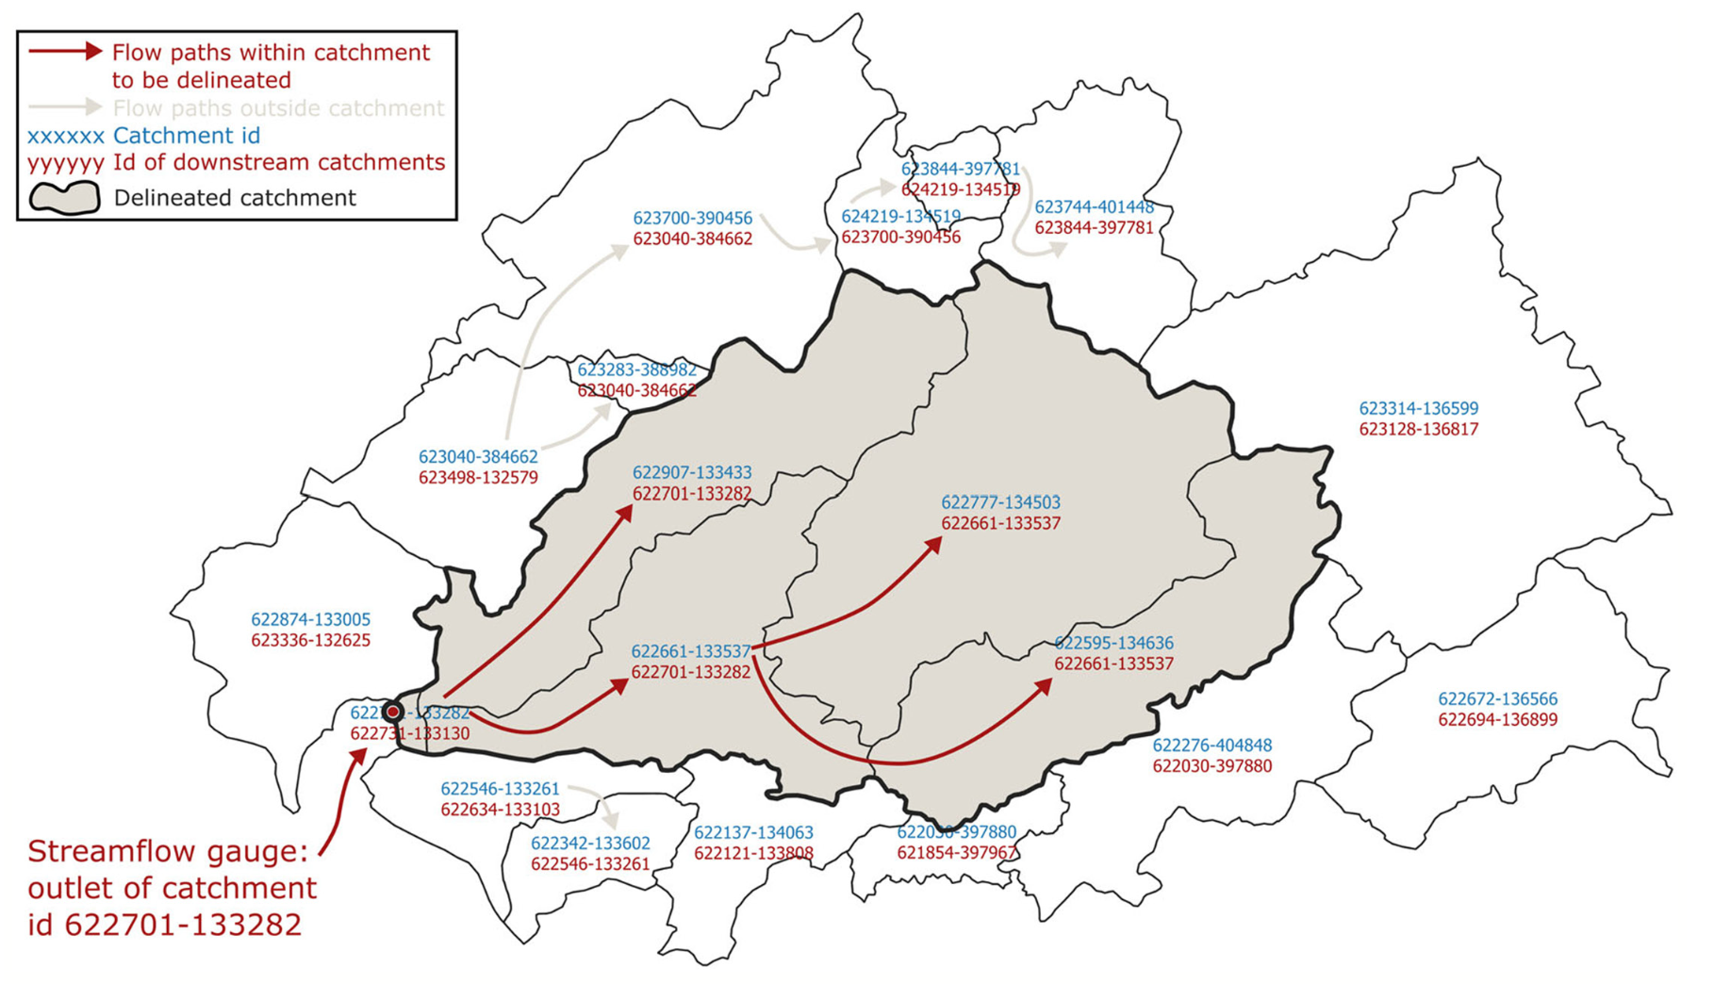
Selection of Swedish catchments.
C. Teutschbein. Camels-SE: Long-term hydroclimatic observations (1961–2020) across
catchments in sweden as a resource for modelling, education, and collaboration. Geoscience Data Journal, 11(4):655–668, 2024. doi: https://doi.org/10.1002/gdj3.239.

Slide 11
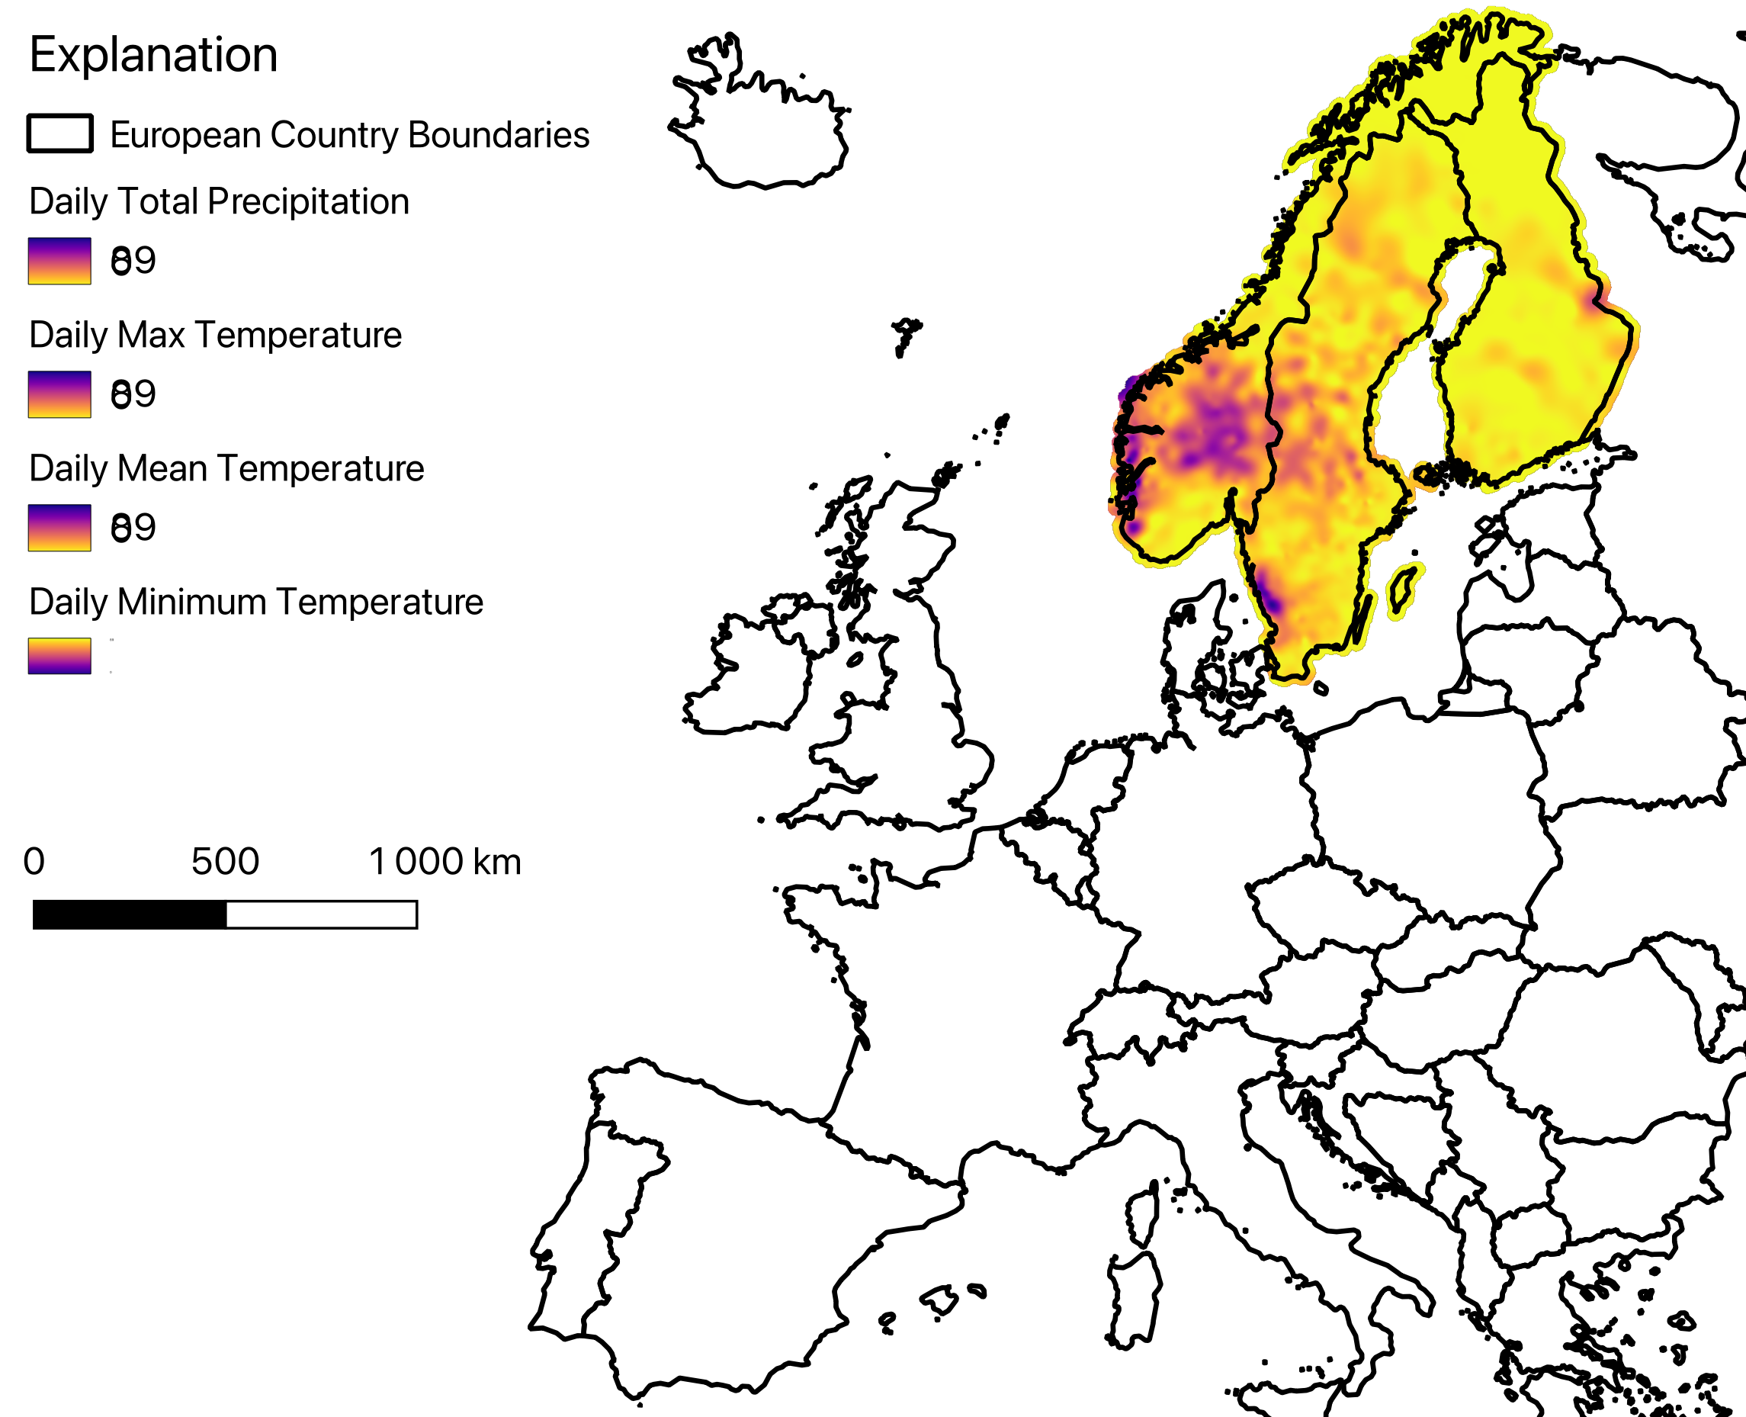
Datasets include in CAMELS-Nordic.
Nordic Gridded Climate Dataset
E-OBS daily gridded meteorological data
Corine Landcover Dataset 2018
NGU Løsmasser
SGU Jordarter

Slide 12
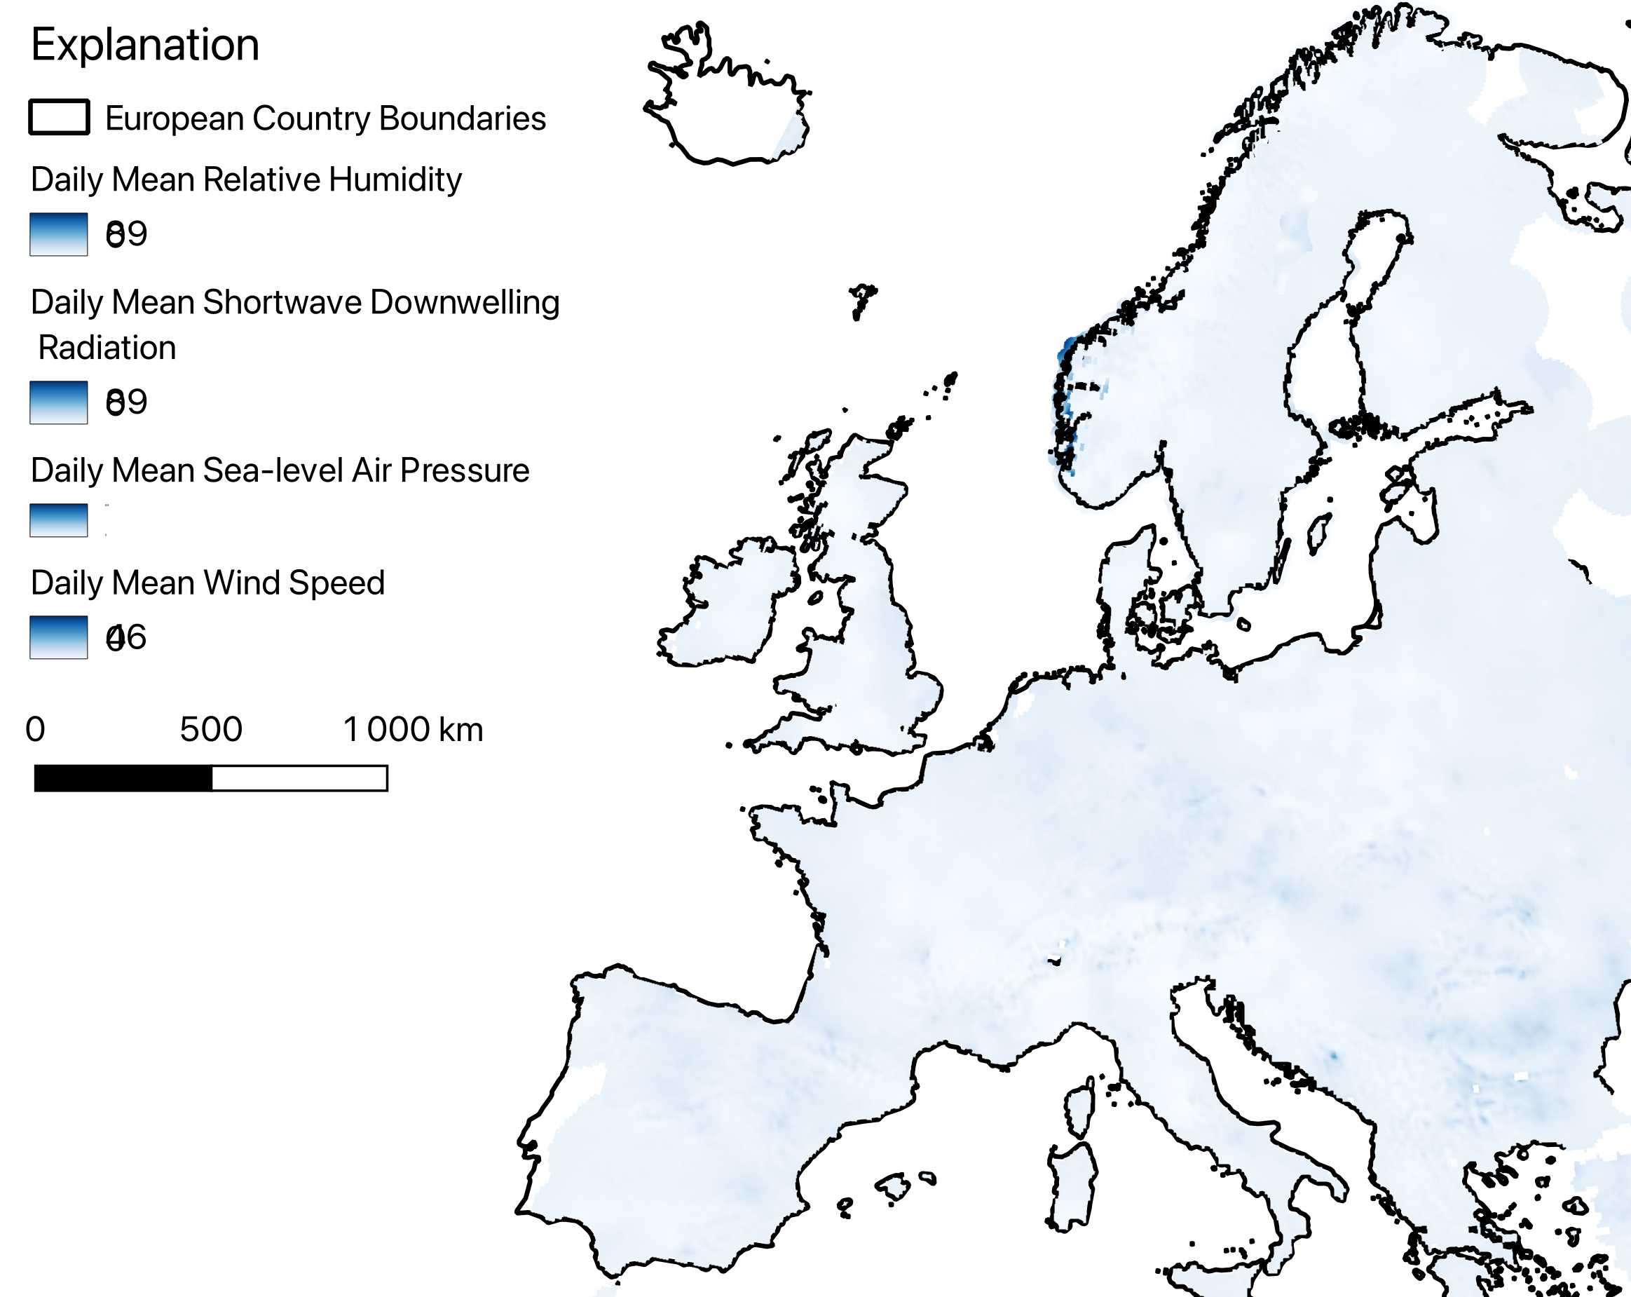
Datasets include in CAMELS-Nordic.
Nordic Gridded Climate Dataset
E-OBS daily gridded meteorological data
Corine Landcover Dataset 2018
NGU Løsmasser
SGU Jordarter

Slide 13
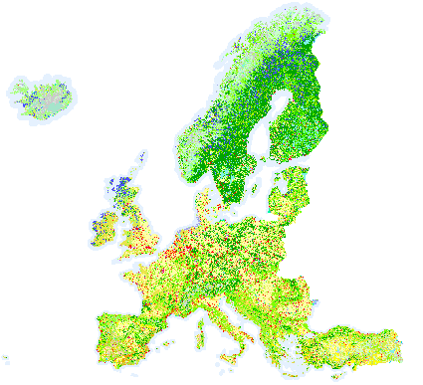
Datasets include in CAMELS-Nordic.
Nordic Gridded Climate Dataset
E-OBS daily gridded meteorological data
Corine Landcover Dataset 2018
NGU Løsmasser
SGU Jordarter

Slide 14
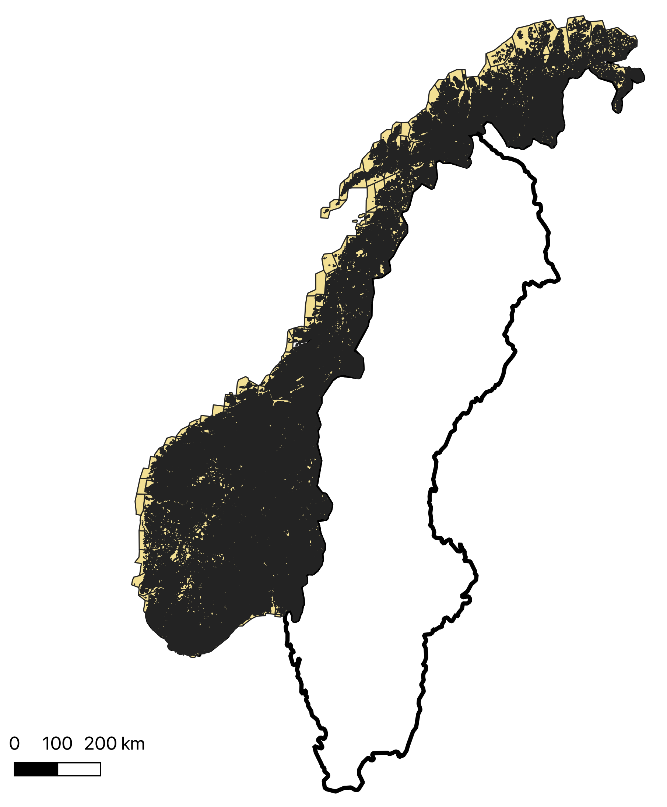
Datasets include in CAMELS-Nordic.
Nordic Gridded Climate Dataset
E-OBS daily gridded meteorological data
Corine Landcover Dataset 2018
NGU Løsmasser
SGU Jordarter

Slide 15
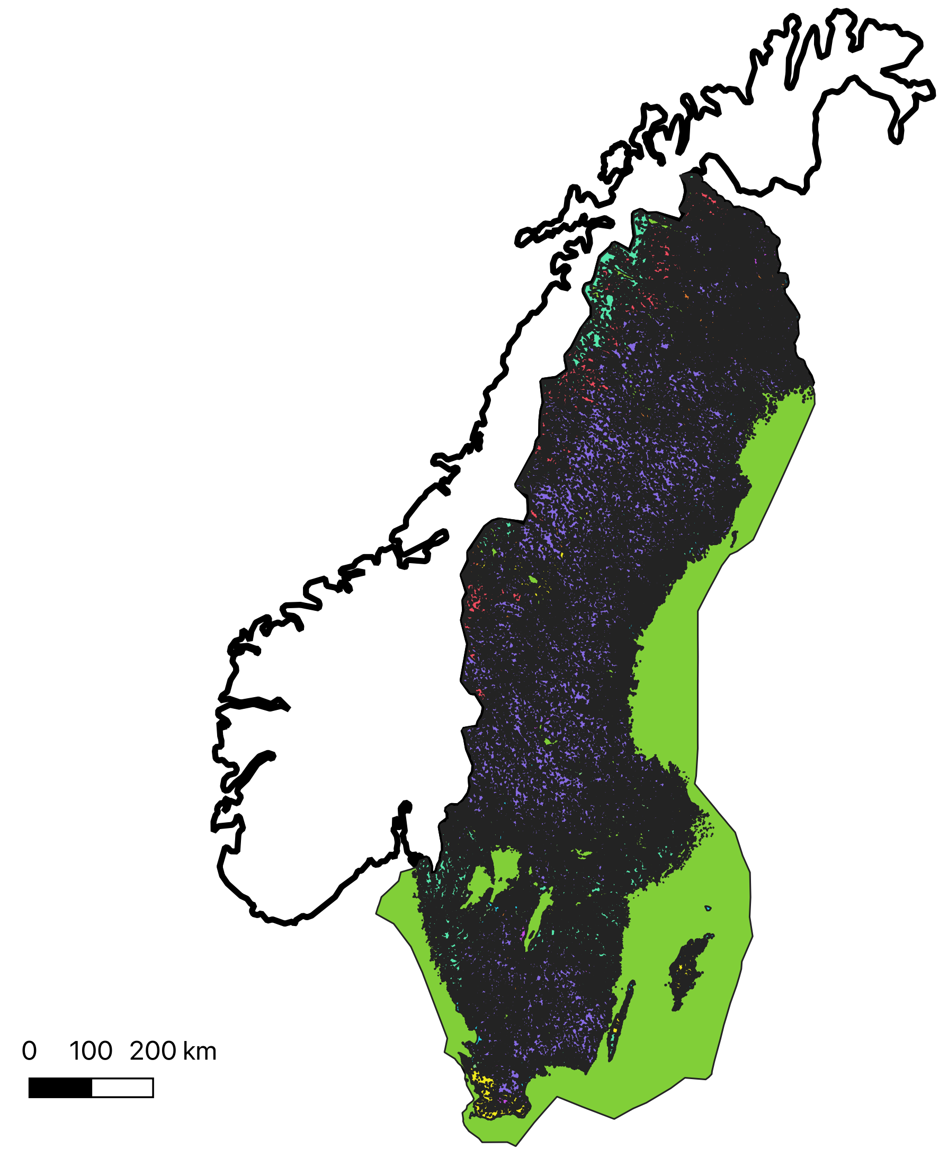
Datasets include in CAMELS-Nordic.
Nordic Gridded Climate Dataset
E-OBS daily gridded meteorological data
Corine Landcover Dataset 2018
NGU Løsmasser
SGU Jordarter

Slide 16
Hydrological signatures calculated for CAMELS-Nordic catchments.
mean daily discharge
runoff ratio (ratio of mean daily discharge to mean daily precipitation)
5 % flow quantile (low flow)
95 % flow quantile (high flow)
frequency of high-flow days (> 9 times the median daily flow)
average duration of high-flow events (number of consecutive days > 9 times the median daily flow)
frequency of low-flow days (< 0.2 times the mean daily flow)
average duration of low-flow events (number of consecutive days < 0.2 times the mean daily flow)
frequency of days with Q=0

Slide 17
Catchment properties calculated for CAMELS-Nordic for catchments.
Geographic properties
Catchment area [km2]
Mean elevation [m a.s.l.]
Mean slope [m a.s.l.]
Soil types
Clay [%]
Silt [%]
Sand [%]
Peat [%]
Landcover properties
Agriculture [%]
Forest [%]
Glaciers [%]
Open land [%]
Shrubs and grassland [%]
Urban [%]
Water, i.e., streams and lakes [%]
Wetlands [%]
Bedrock [%]
glaciers [%]

Slide 18
Data gaps and deficiencies
Norway
Soil properties
Sweden
Snow Water Equivalent
Glaciers
Identification of streamflow gages with limit human impact

Slide 19
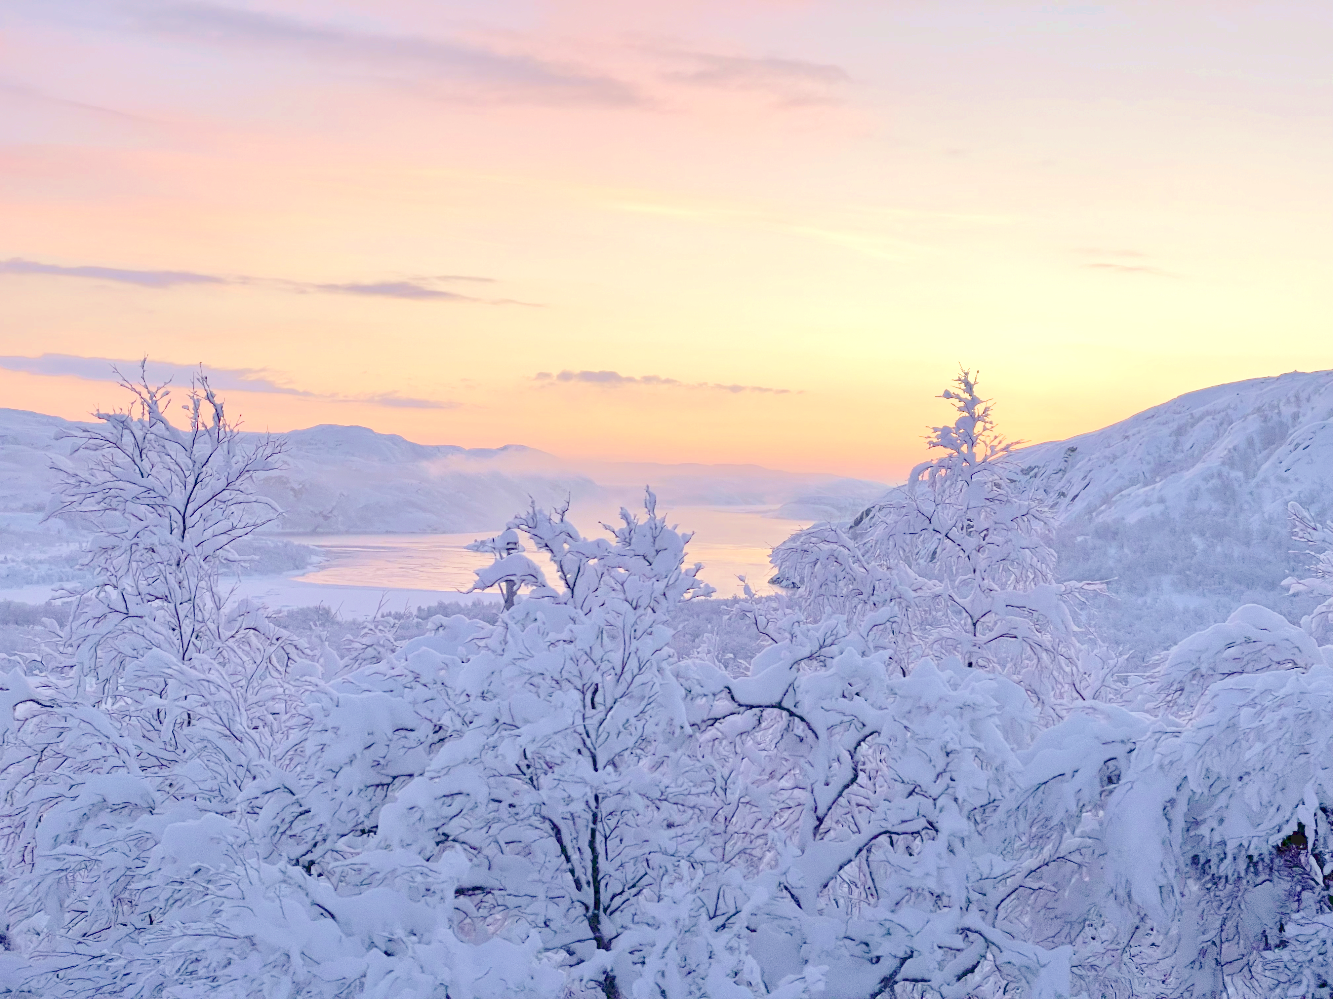
In summary, the CAMELS-Nordic dataset provides an opportunity to advance science in both hydrology and ML fields.
Thank you!
Notes:
This template is for a conclusion slide. Use the headline (no more than two lines) to state your most important conclusion. Begin the headline with In summary or In conclusion to ensure that the audience knows they have come to the presentation’s end. Support that headline with an image and parallel points.
This slide should be your last slide. Audiences lose patience when they believe that they have come to the end, but other slides follow.
Notice that the word Questions appears at the bottom of this slide. That strategy is much more effective than burning a slide with just the word Questions. This slide allows the audience to look at the most important slide of the presentation during the question period. See The Craft of Scientific Presentations, 2nd ed., pages 182-183.

