Slide 1

Machine learning for ecosystem modelling
Use cases: land cover classification and land surface model parameter estimation
Hydrological Council Meeting, Statkraft
25.04.2025
Lasse T. Keetz
Department of Geosciences
Notes:
Hello everyone, my name is... Postdoc at the University of Oslo. Today I will present ML applications for ecosystem modelling that I worked with in my PhD.

Slide 2
Ex. 1: Norwegian Nature Type Classification

Slide 3


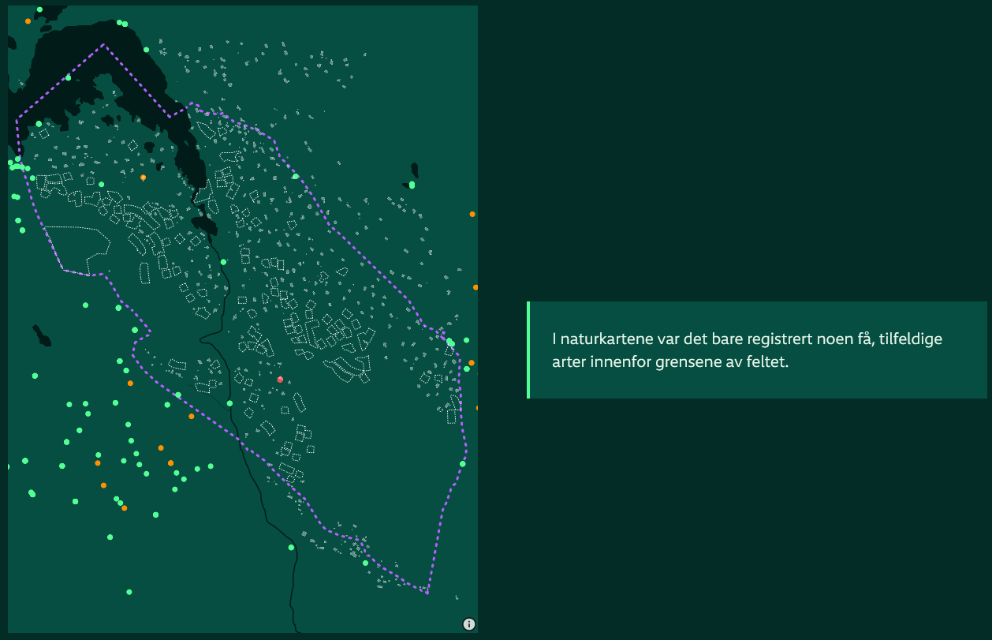
Norge i rødt, hvitt og grått - NRK, 06.01.2024
Systemet som sviktet skogen - NRK, 08.06.2024
De tomme kartene - NRK, 11.01.2025
Notes:
If you have followed Norwegian media recently, there was a lot of attention on how Norwegian nature is destroyed through infrastructure projects
Difficult to know how much “different types of nature” there is and how to quantify it
Reoccurring theme: how do we minimize the destruction of vulnerable ecosystems?

Slide 4
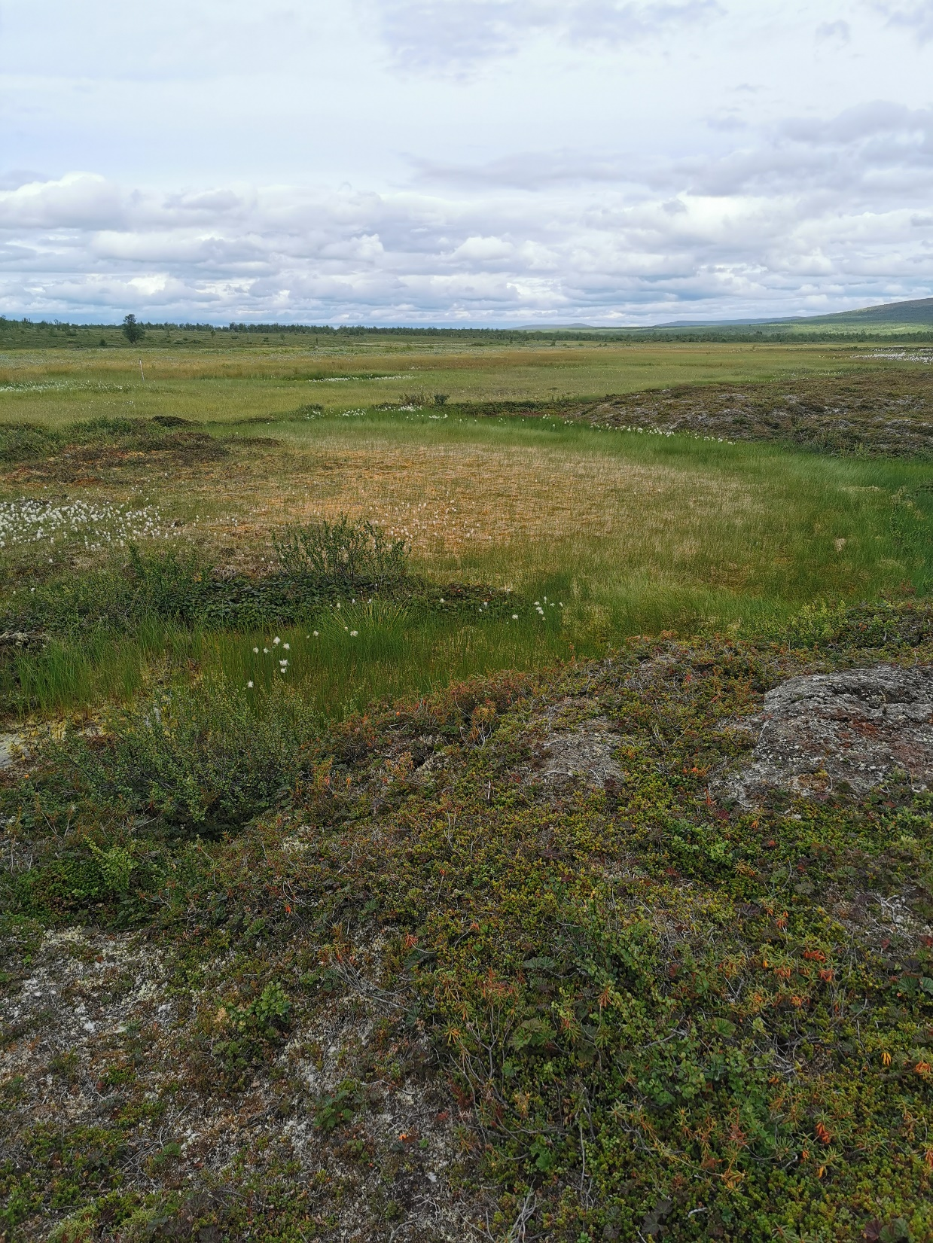

Code | Land-cover class
Heath and mountain
1ab* | Moss snowbed
 | Sedge and grass snowbed
1c | Frozen ground, leeward
2a | Frozen ground, ridge
2b | Dry grass heath
2c | Lichen heath
2d | Mountain avens heath
2ef* | Dwarf shrub heath
 | Alpine calluna heath
2g | Alpine damp heath
Wetland
8a | Damp forest
8b | Bog forest
8cd* | Poor swamp forest
 | Rich swamp forest
9ad* | Bog
 | Mud-bottom fen and bog
9bc* | Deer-grass fen
 | Fen
9e | Sedge marsh
 | ...................................
LATICE field site in Iškoras, Finnmark (northern Norway). Photo by Lasse Keetz.
Field mapper. Photo by Lasse Keetz.
Notes:
How do we classify nature?
How much area is currently covered by different types of nature?
How much could there potentially be? How could the spatial distribution change in future environmental conditions?
Important for biodiversity conservation, climate mitigation strategies, economy, …

Slide 5
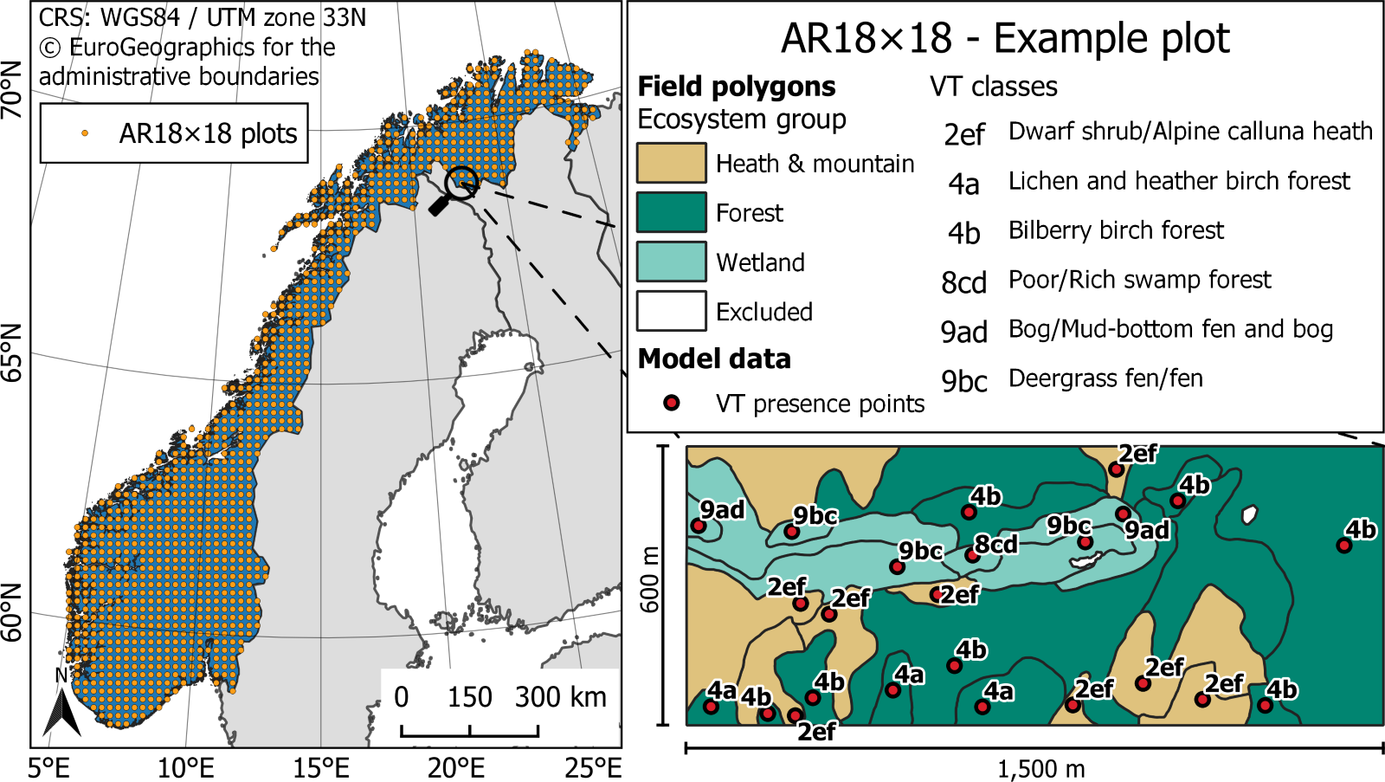
VT data description: Bryn et al. (2018).
Notes:
Start with vegetation map
Explain dataset (AR18x18)
But then even if you have a big (and expensive) dataset like this – what happens in between the sampling locations?

Slide 6
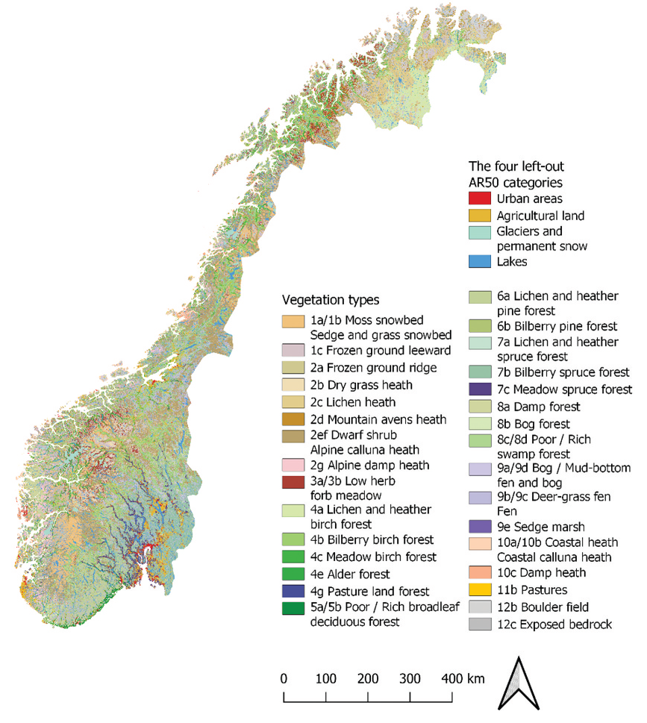
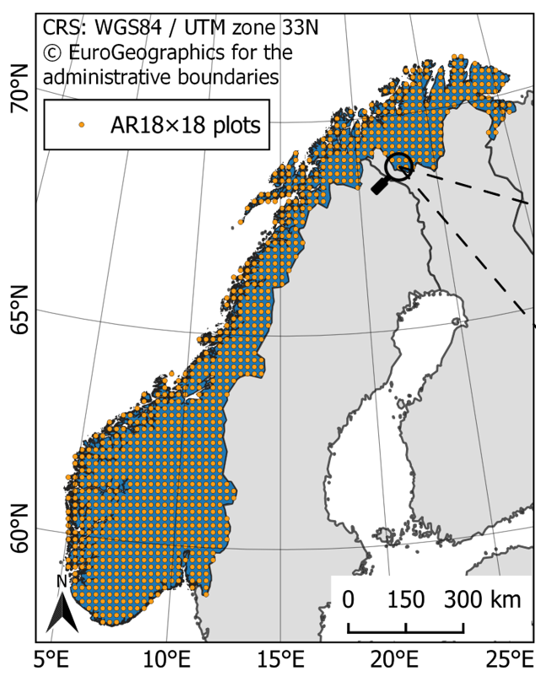
Environmental predictors
Pixel-wise multi-class ML classification
Temperature
Precipitation…
Vegetation type
field observations
Numerical or
categorical raster
data
20.5 | 18.2 | …
… | … | …
… | … | …
890 | 892 | …
… | … | …
… | … | …
 | Temperature [°C] | Preci-pitation [mm] | …
Observation 1 | 20.5 | 890 | …
Observation 2 | 18.2 | 892 | …
… | … | … | …
Vegetation type
2d
7a
…
Edited from: Horvath et al. (2021)
Figure credit: Peter Horvath, Natural History Museum, UiO
Notes:
Classical species distribution modelling:

Slide 7
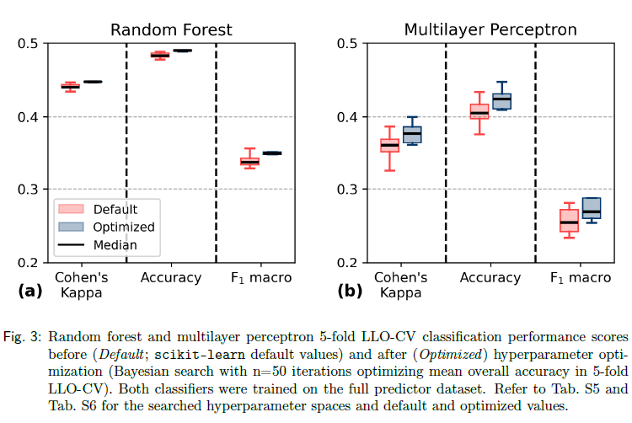
Predictor categories
Based on Horvath et al. (2019)
Baseline land cover (n=5; eg., AR50)
Climate (n=32; e.g., mean temp.)
Geospatial (n=13; e.g., DEM)
Geology (n=5; e.g., type of bedrock)
Custom satellite-based (n=39)
VTs / target classes: 31
Predictors / features: 94
Total observations: 22,173
Notes:
Predictor set created based on ecological theory
First compared two machine learning algorithms
About OA: approximately 50% of the time the model predicted correctly what you can actually see on the ground

Slide 8
Class-level performance
General trend: more data → better predictions
Class-specific issues
  E.g., poor/rich swamp forest (8cd; a wetland) often misclassified as other forest types
Notes:
Individual predictions of 31 classes

Slide 9
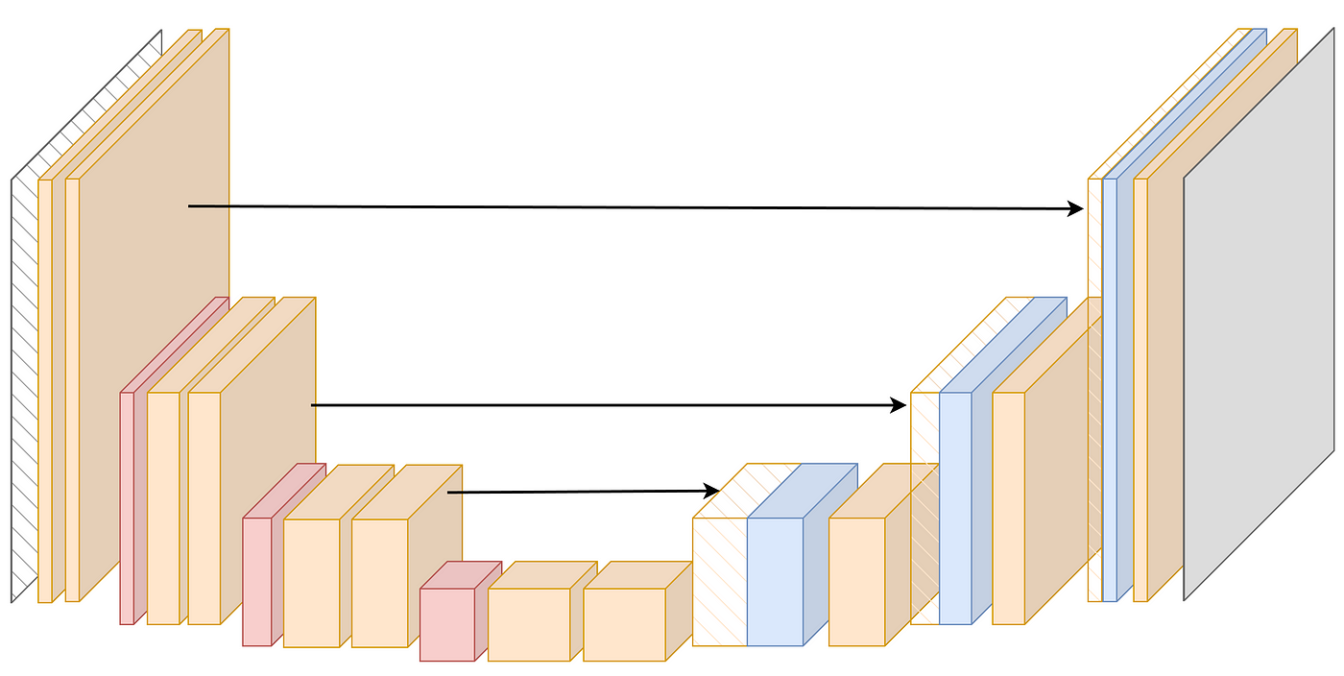

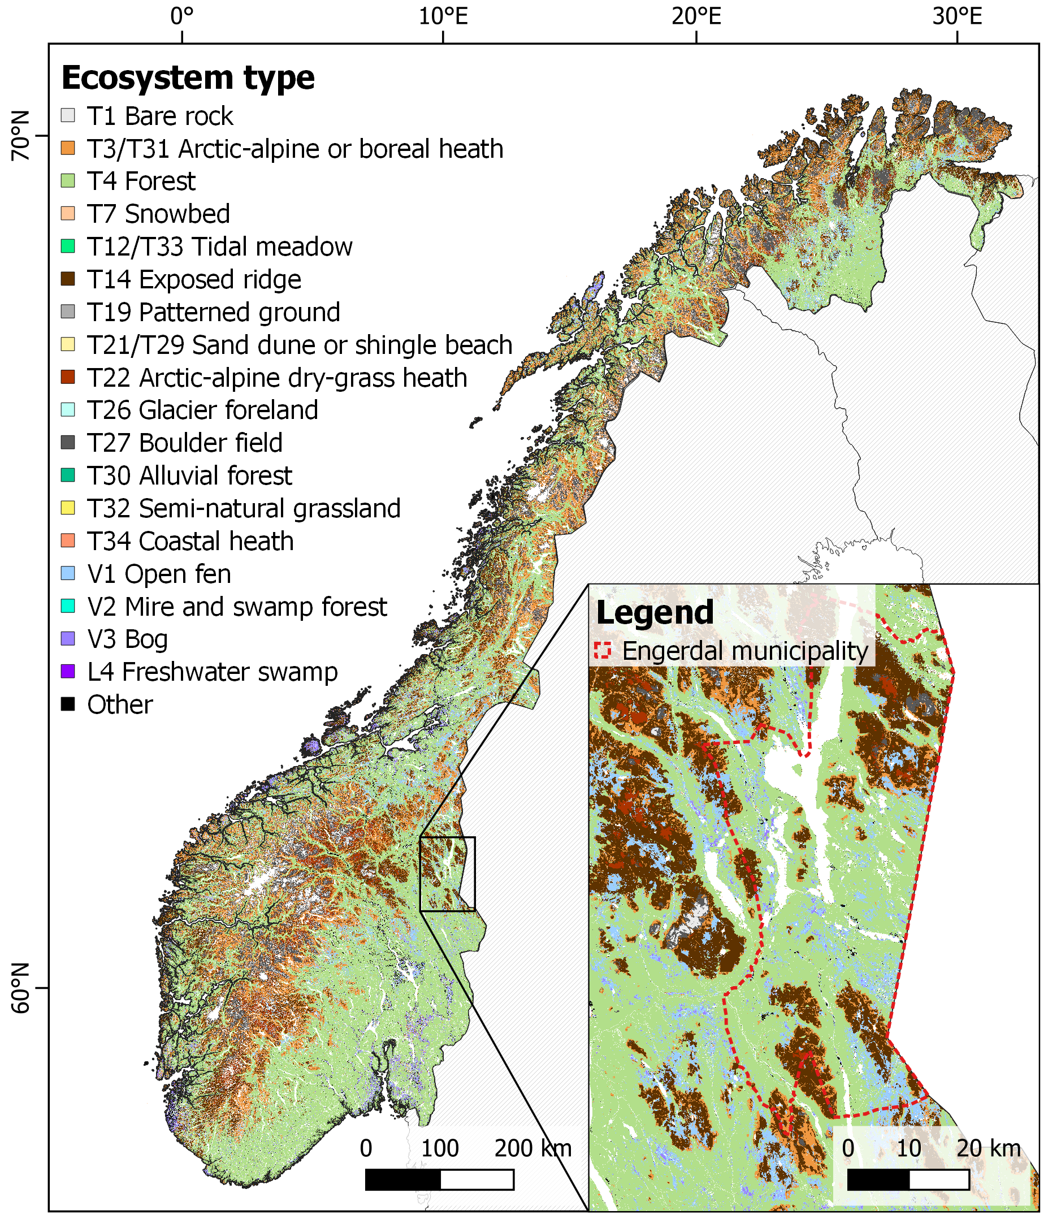
Related work: convolutional neural network (UNET) classification
UNET model architecture. Made by Conor O’Sullivan. From: https://medium.com/data-science/u-net-explained-understanding-its-image-segmentation-architecture-56e4842e313a
Adam Naas, PhD candidate at the Natural History Museum (NHM), UiO. Photo: private.
Targets: 54 NIBIO ecosystem type classes, field surveys
Predictors: Sentinel-1 and 2, DEM/DSM, climate, land use (total 24)
→ 10x10 m spatial resolution
ca. 38% overall accuracy (pixel-wise comparison)
Notes:
Main limitation is the data, especially field maps → high inconsistency

Slide 10
Ex. 2: Land Surface Model (LSM) Parameter Estimation

Slide 11
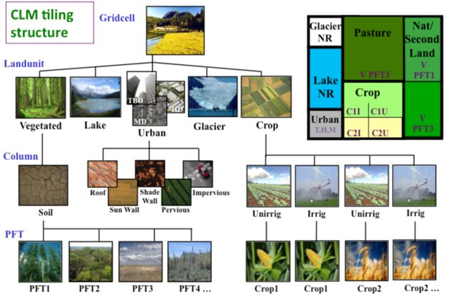
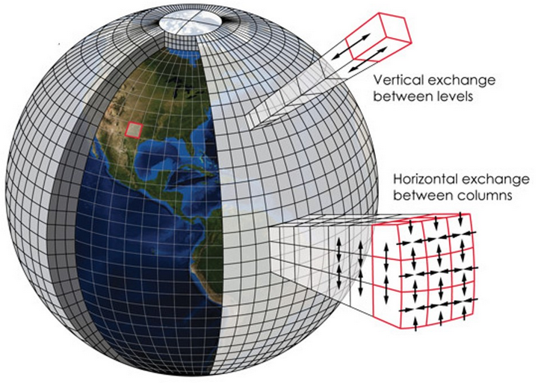
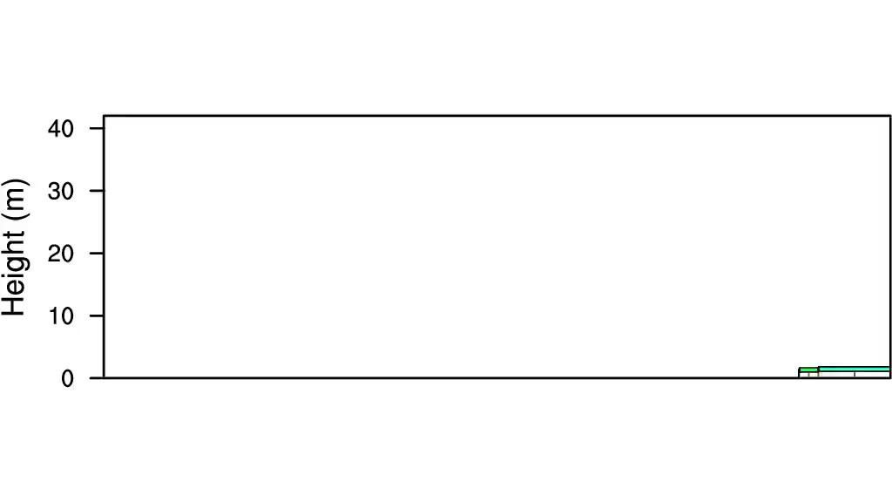
Land surface model – CLM-FATES
From: Lawrence, David & Hurtt, George & Arneth, Almut et al. (2016). The Land Use Model Intercomparison Project (LUMIP): Rationale and experimental design. Geoscientific Model Development Discussions. 2016. 1-42. 10.5194/gmd-2016-76.
Adapted from: https://cml.jbnu.ac.kr/cml/11846/subview.do
600 Years of Forest Dynamics using the FATES model at Barro Colorado Island, Panama. Created by Charles Koven.

Slide 12
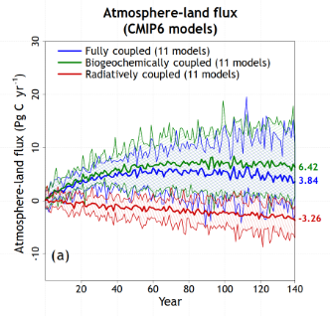
Motivation
Inconsistencies between…
  …LSM predictions and observations (e.g., LAI biases)
  …different LSMs and long-term projections
State-of-the-art LSMs → 100’s to 1000’s of parameters
High parametric uncertainty
  «We found that parameter effects can exceed scenario effects […]» (Kennedy et al., in review)
Figure 2. Model mean values and the range across models for annual simulated atmosphere–land CO2 flux for participating CMIP6 models from the fully, biogeochemically, and radiatively coupled versions of the 1pctCO2 experiment.
From: Arora, V. K., Katavouta, A., Williams, R. G., et al. (2020): Carbon–concentration and carbon–climate feedbacks in CMIP6 models and their comparison to CMIP5 models, Biogeosciences, 17, 4173–4222, https://doi.org/10.5194/bg-17-4173-2020, 2020.
Notes:
China is, by a significant margin, Asia's and the world's largest emitter: it emits nearly 10 billion tonnes each year, more than one-quarter of global emissions.

Slide 13
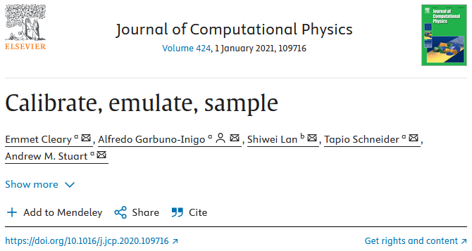

Slide 14
Key ideas
Computationally feasible approximate Bayesian inference for parameter estimation when forward models are expensive to run and/or not (easily) differentiable
Three modular steps, each can be tackled with different methods:
  Calibrate → fast approximate samplers (e.g., Ensemble Kalman methods)
  Emulate → machine learning emulator for parameter-to-data map (e.g., Gaussian Process Regression)
  Sample → comprehensive uncertainty estimation with (emulator-based) MCMC → gold standard but computationally not feasible with complex forward models
Aims to improve experimental design for emulator training

Slide 15
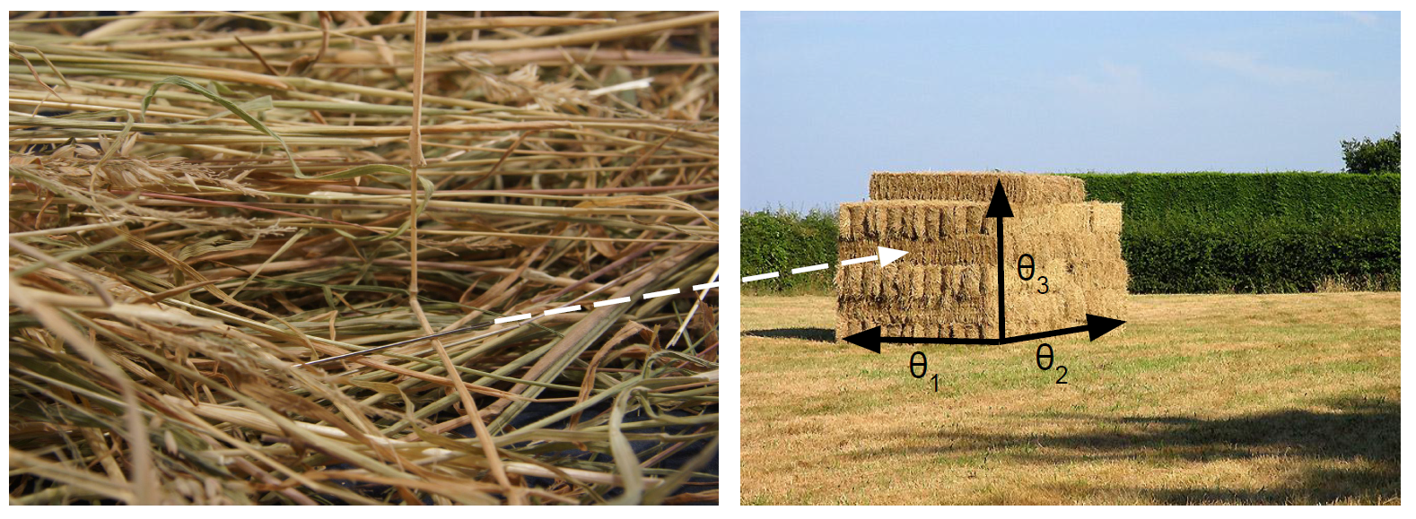
Notes:
Bayesian data assimilation, update a prior belief based on data
PROBLEM: LSMs are computationally very expensive, limits the amount of likelihood (parameter to data) evaluations we can do!

Slide 16
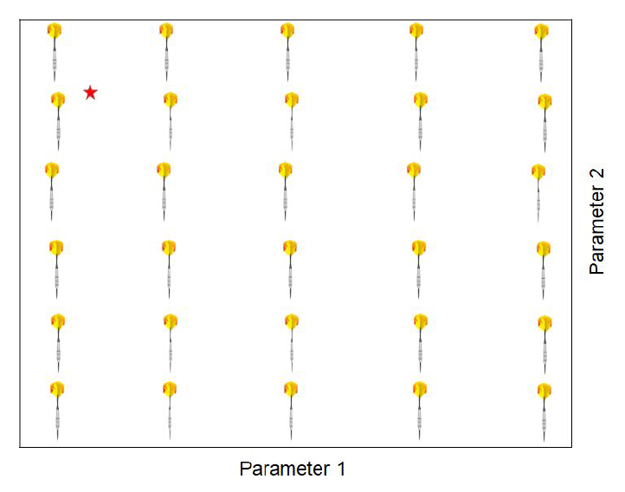
Problem: emulator design
Emulator-based MCMC has previously been successfully applied to LSM/(ESM) parameter estimation (e.g., Fer et al. 2018, Sawada 2020, Watson-Parris et al. 2021)
But: how do we optimally construct the parameter-to-data map to ensure good emulator performance when computational cost of forward model is severely limiting?
Notes:
Naively: gridded sampling. Could miss region of interest, hit local minima…

Slide 17
We only need to emulate the needle(s)!

Slide 18

Initial “calibrate” step
Here: Iterative Ensemble Kalman Smoother (IEnKS)
Proven successful for nonlinear models, especially this iterative variant (e.g., Aalstad et al. 2018)
However, solution remains rough approximation of full posterior:
  Gaussian linear assumptions
  No comprehensive uncertainty quantification
Parameter 2
Parameter 1
«True» value
Updated belief

Slide 19

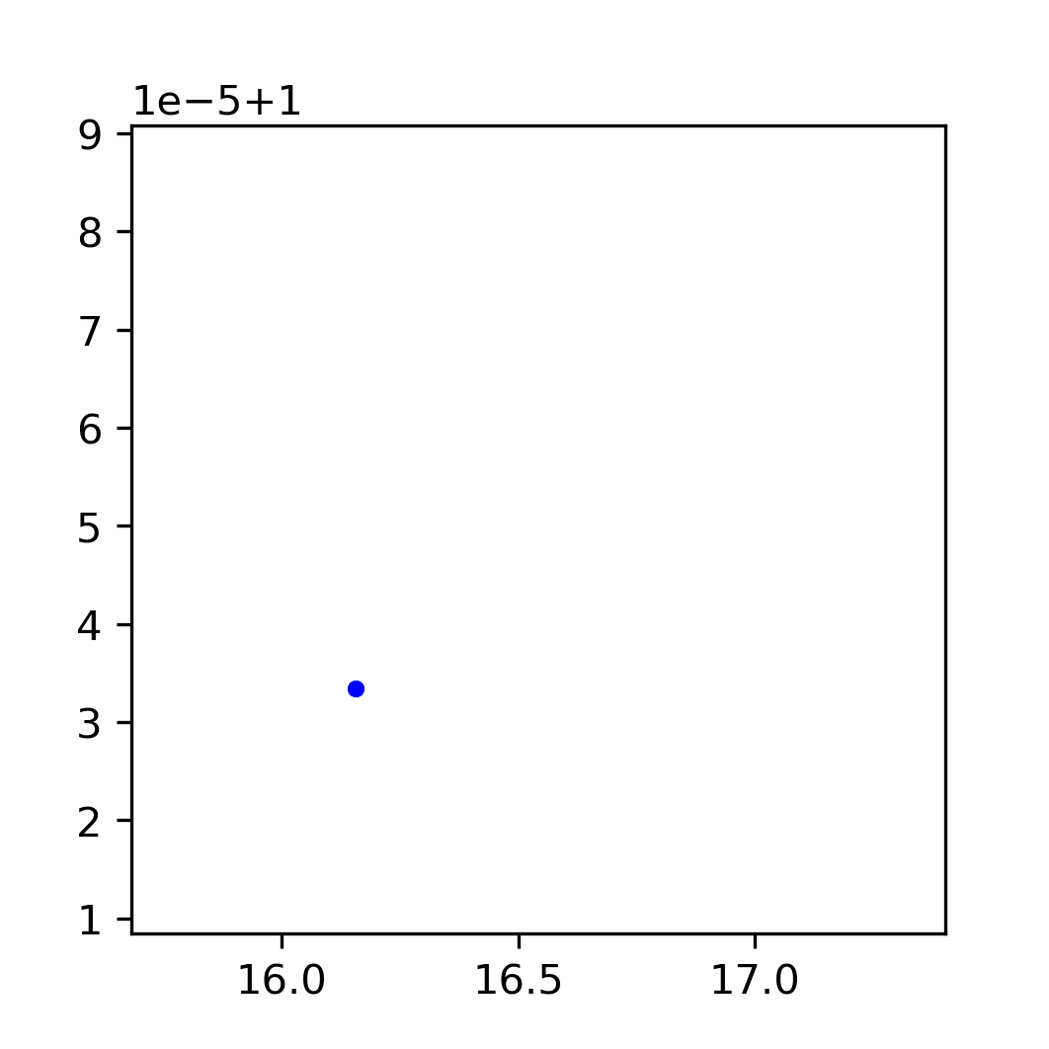
ML Emulator
Parameter 2
MCMC
Parameter 1
«True» value
Updated belief

Slide 20
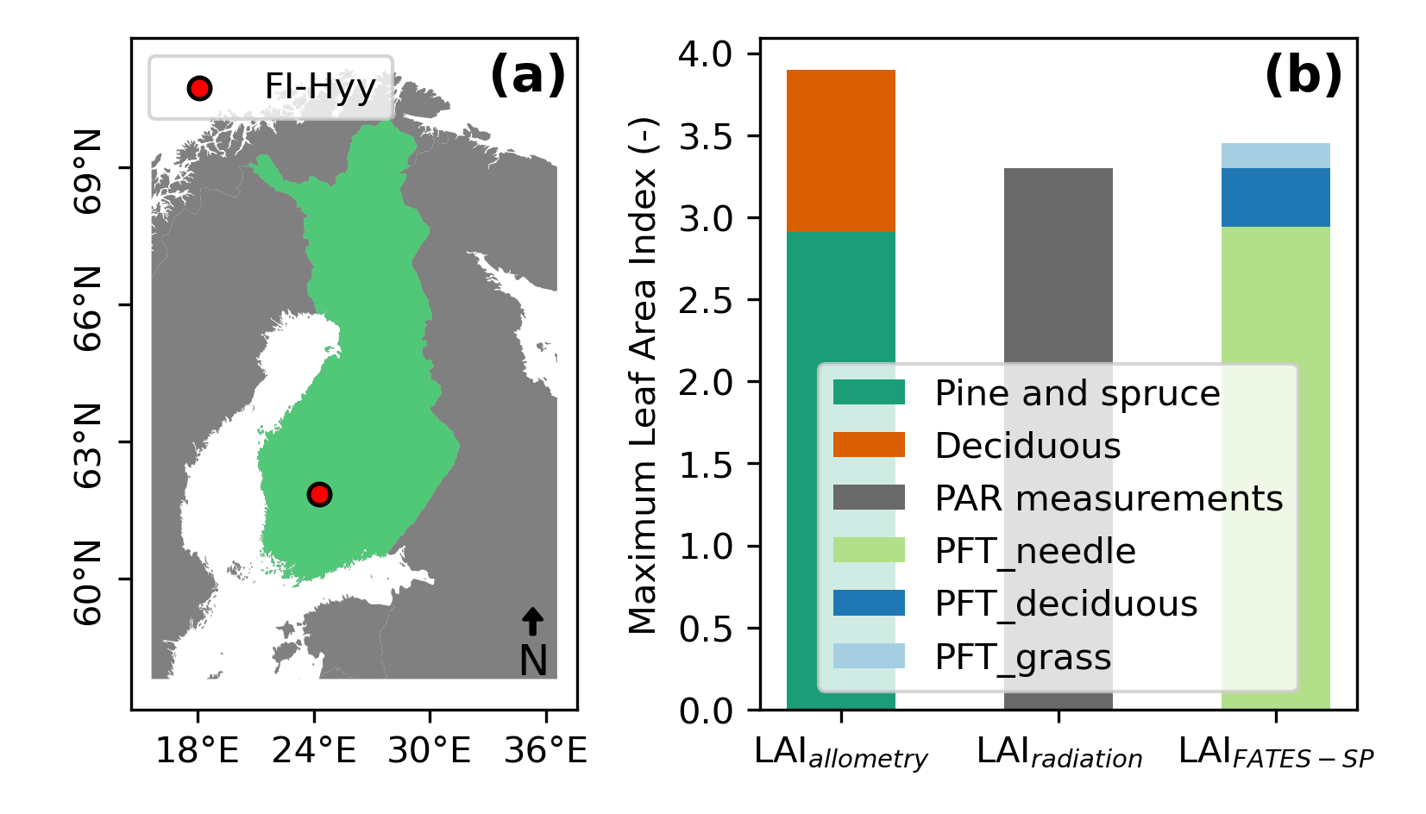
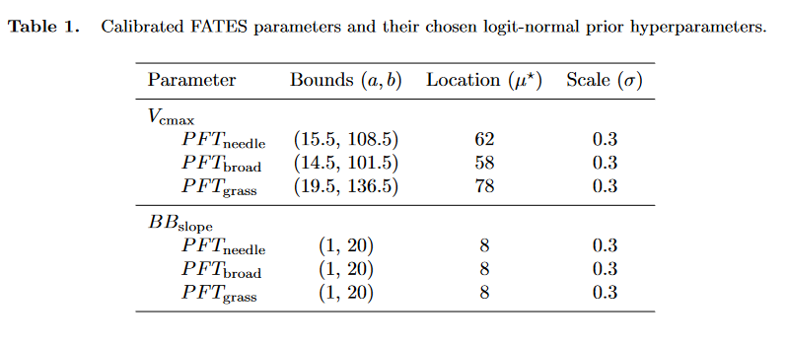
Experiment setup
Single-site: Hyytiälä, southern Finland
CLM-FATES „land-only“ mode
  GSWP3 climate forcing and CLM default surface datasets
Estimated parameters: V_{cmax}, BB_{slope}
Jointly assimilated eddy-covariance observations:
  Evapotranspiration (ET)
  Gross Primary Production (GPP; modelled from NEE)
  Daily mean values

Slide 21
“Calibrate” – IEnKS performance (twin experiment)
Worked!
Iterations improve results
Not much improvement between 2 and 4 iterations
Notes:
Twin experiment: manually defined CLM-FATES parameters, generated predictions, perturbed predictions with gaussian error model, treated as “artificial observations” in data assimilation → satisfy perfect model assumption that model can map perfectly to noise observations

Slide 22
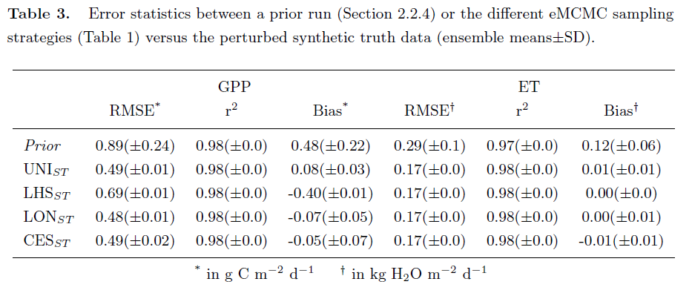
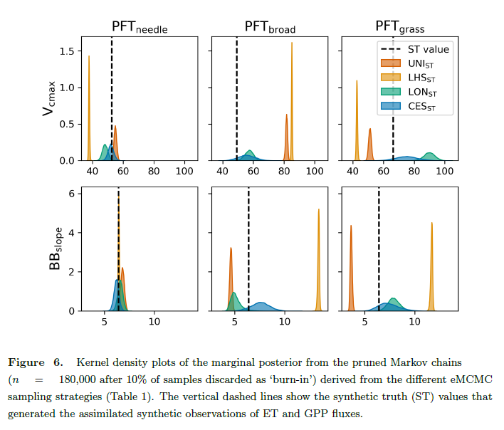
Full CES (twin experiment)
CES vs. data-blind sampling designs:
  All methods reduced model-data errors
  Only CES included all ST parameters in posterior
Equifinality issues
Page 22
Notes:
Real data more messy, but I luckily don’t have time to get into it here ☺

Slide 23
Thank you!

Slide 24
Bonus slides

Slide 25
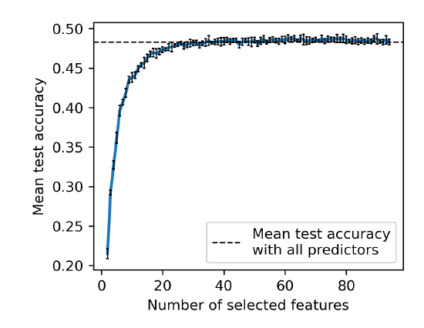
Variable importance
Land cover and satellite predictors most important
Climate (and geospatial to lesser extent) predictors improved models
Notes:
Permutation tests, kicking out variable with lowest permutation importance, repeat → can reach same performance with approx. 25 of the variables
Trying to make sense or explain results

Slide 26
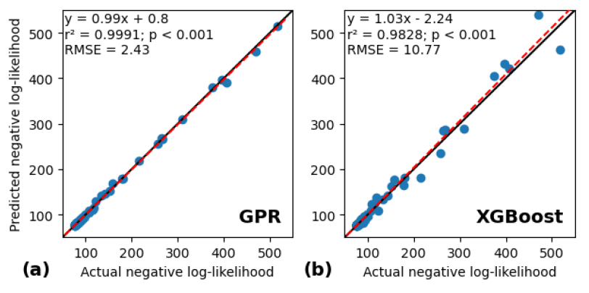
“Emulate” – ML model
Good negative log-likelihood predictions (“model-observation mismatch, scaled by assumed observation errors”)
Gaussian Process Regression (GPR) outperformed XGBoost
Reasonable estimation of parameters within MCMC (twin experiment)! But:
  Hyperparamter tuning and regularization important!

Slide 27
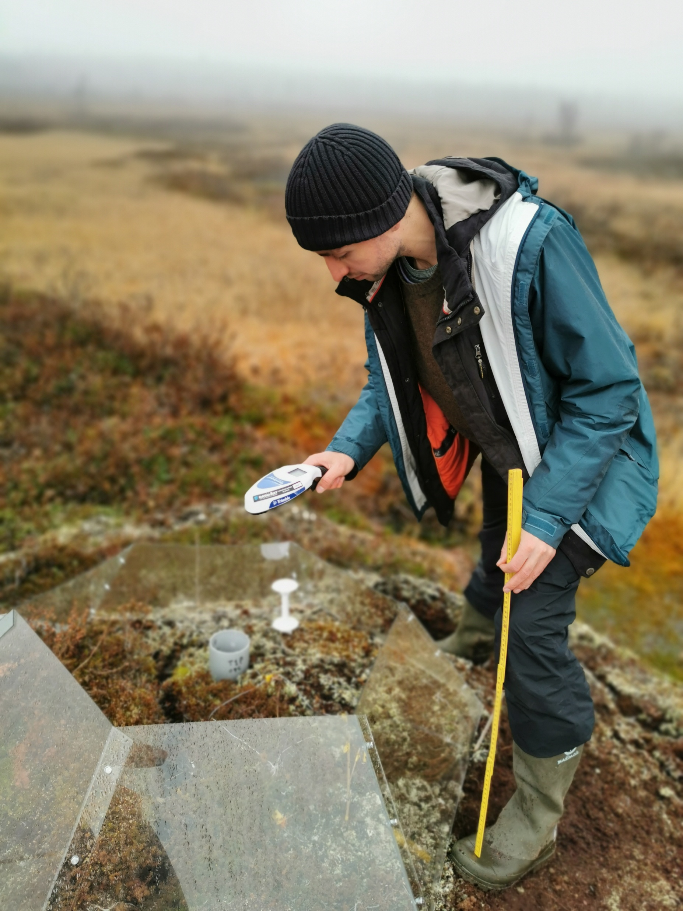
Personal background
BA: Environmental Systems Science and Geography, Osnabrück University (Germany)
MSc: Physical Geography and Ecosystem Science, Lund University (Sweden)
PhD: Ecosystem modelling: vegetation-environment interactions, University of Oslo
Currently: Researcher at UiO, machine learning and data assimilation for land surface modelling
Iškoras, Finnmark, Norway. Photo by Inge Althuizen.

