Slide 1
Predicting streamflow and hydropower production with Long Short Term Memory models
25.04.2025
Ole Wulff (NORCE), Thea Roksvåg (Norsk Regnesentral), Kamilla Wergeland (Småkraft/UiB) & Silius Vandeskog (Norsk Regnesentral)

Slide 2
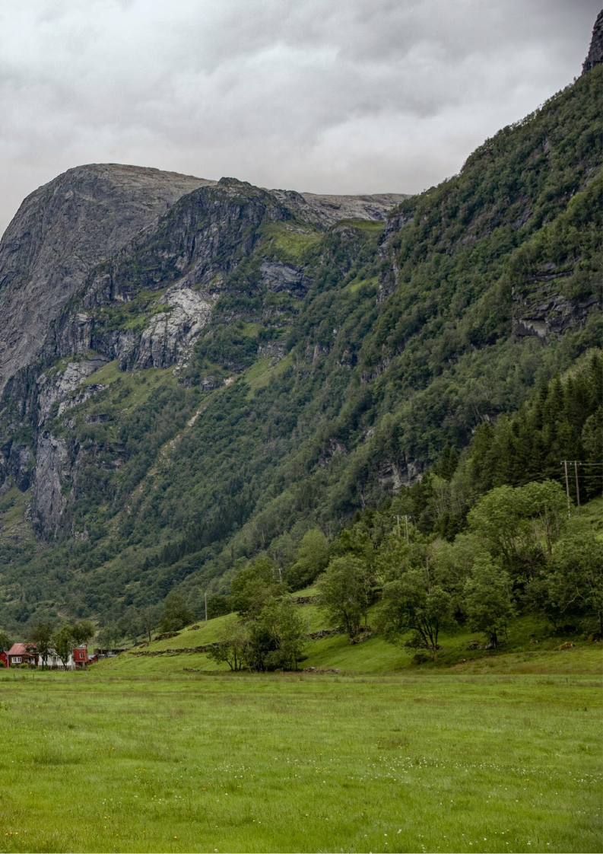
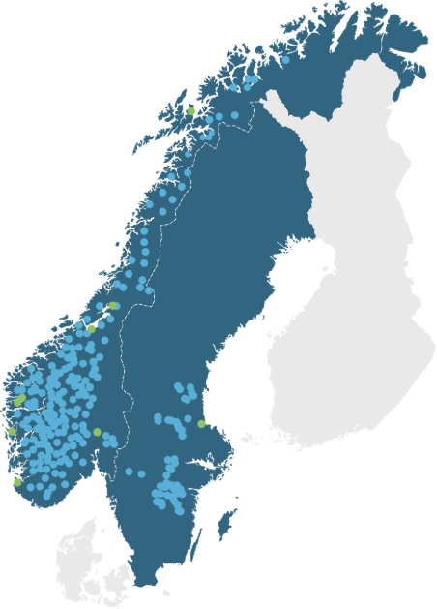
Småkraft AS
32 % of 1.039 GWh under construction
Upgrades
Solar
Wind power
Large scale hydro
Other, new small-scale hydro
Småkraft AS
1) NVE Q4 2024

Slide 3
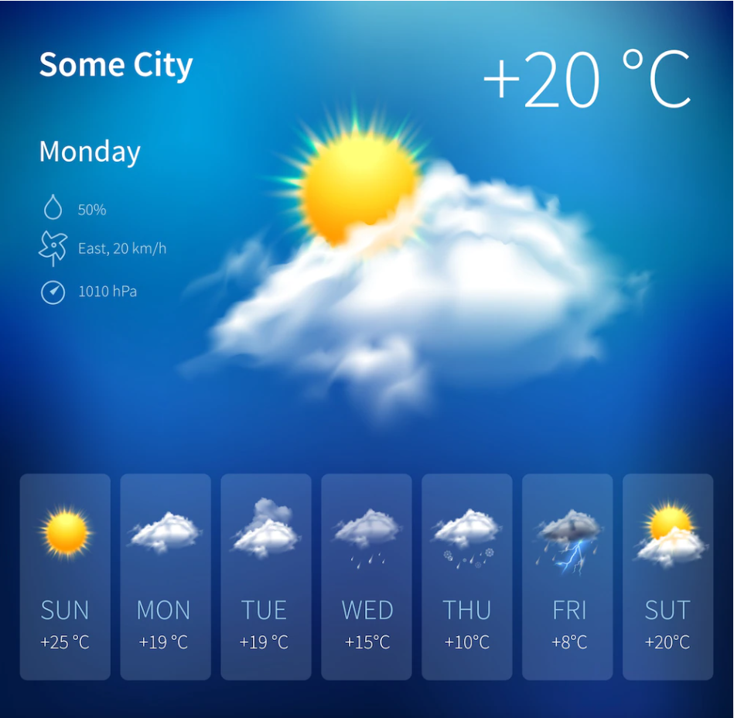
Småkraft AS in Climate Futures
Historical streamflow based on observations and reanalysis
Short to mid-term forecast based on weather models
Future streamflow based on climate change
Accurate estimations of past streamflow:
Power plant valuation for acquisitions
Expected production volumes for budgeting purposes
Portfolio uncertainty estimation (P10, P90)
Accurate forecast the next days to weeks:
Reduce imbalance costs
Plan maintenance with minimal downtime in production
Optimize production by exploiting regulation opportunities
Knowledge about future streamflow:
Identify the right project
Optimize future and existing power plants
Identify risks related to more extreme events

Slide 4
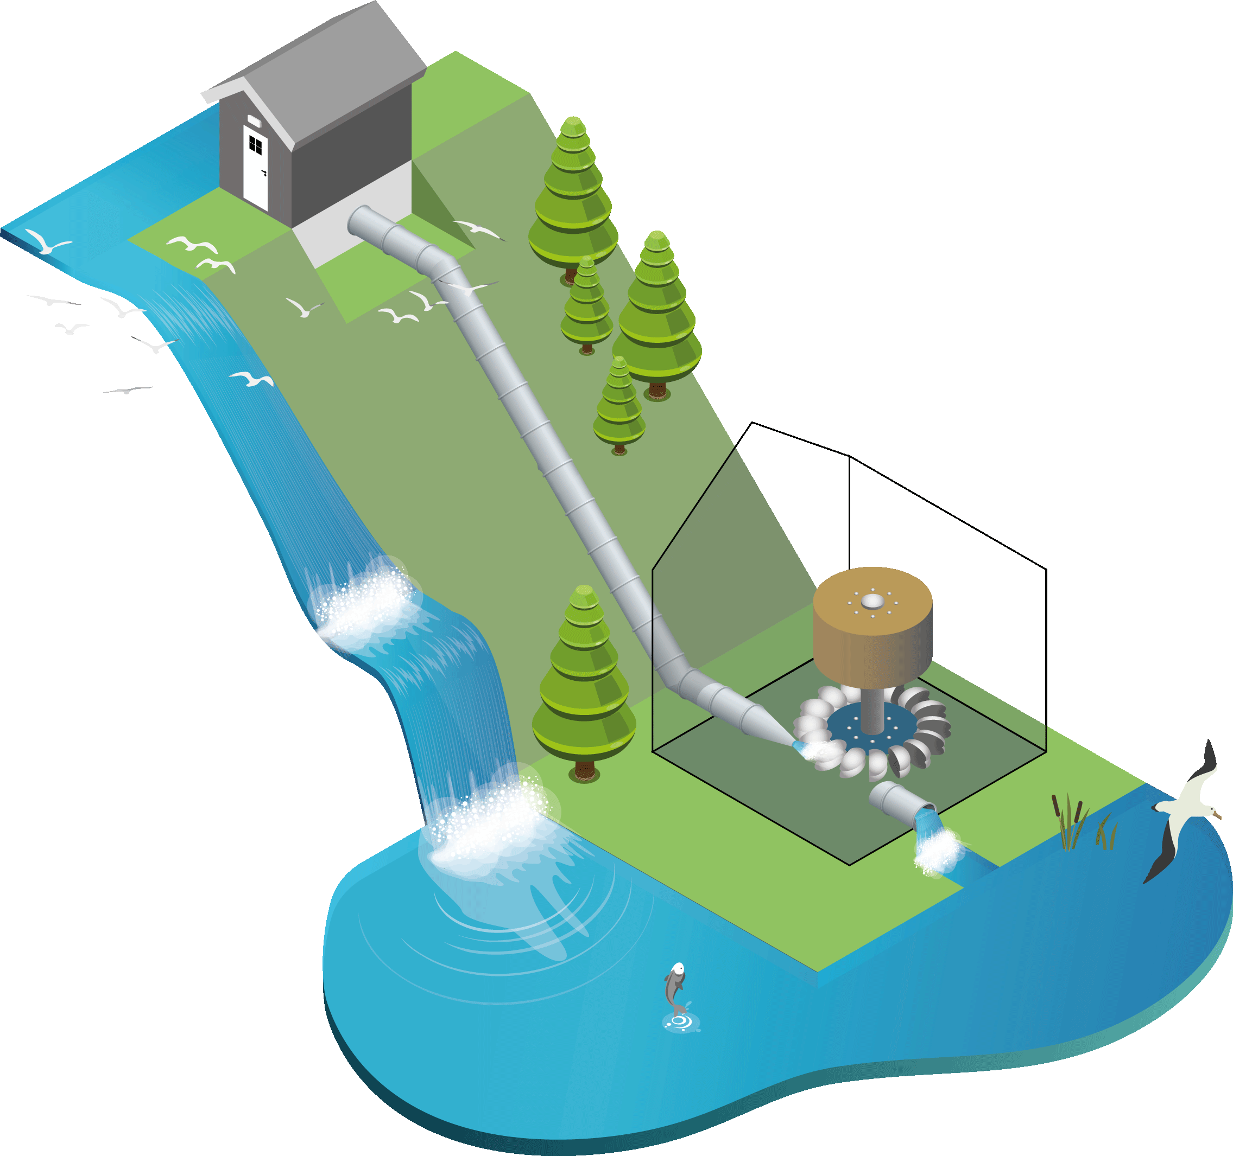
Calculating production from streamflow
Streamflow (m3/s) to power production:
$$q^{∗}=q−q_{eco}$$
Power (kW) from streamflow:
$$P(q^{∗})=ρ∙g∙η(q^{∗})∙(h_{gross}−h_{loss}\left(q^{∗}\right))∙q^{∗}$$
Head loss (m) due to friction in the water way:
$$h_{loss}(q^{∗})=f∙\frac{l_{pipe}}{d_{pipe}}\frac{v(q^{∗})^{2}}{2g}$$
Velocity (m2/s):
$$v(q^{∗})=\frac{q^{∗}}{A}$$

Slide 5
Back-calculated inflow from hydropower plants

Slide 6
Recap: Our aim
Develop hydrological models that can predict streamflow (and thus also power production) in gauged and ungauged catchments
We develop two competing model types (one traditional, one data-driven)
Data:
136 Småkraft catchments
Only production data (censored for large streamflows)
Short time series
190 NVE catchments
Streamflow data
Long time series

Slide 7
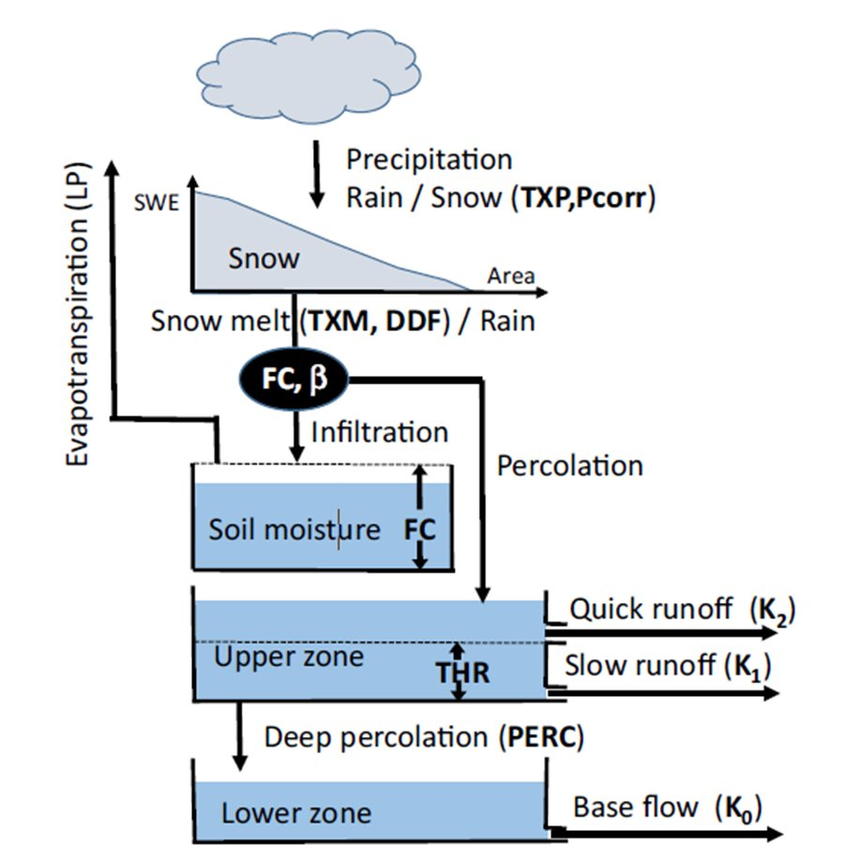
First model: HBV
Conceptual hydrological model
Most used model for simulating Norwegian streamflows by NVE
R implementation in the HBV.IANIGLA package
Input:
Daily precipitation and temperature
Elevation (hypsometric curves)
Made by Kolbjørn Engeland, NVE

Slide 8
Calibration
Calibration must be performed separately, for each catchment
Different calibration methods for gauged and ungauged catchments
Gauged:
Simulate streamflow (and maybe compute power production) from the HBV model
Find parameters that maximise Nash-Sutcliffe efficiency (NSE) between simulated and observed data
Optimisation method and initial parameter values chosen based on discussion with NVE
Ungauged:
Regionalisation method based on donor catchments

Slide 9
Donor-based regionalisation
?
Ungauged
catchment
Coordinates, size, climate conditions, gradient, river length, %forest, %mountain, %lakes
Gauged catchments with
calibrated HBV models

Slide 10
Donor-based regionalisation
?
Ungauged
catchment
Coordinates, size, climate conditions, gradient, river length, %forest, %mountain, %lakes
Gauged catchments with
calibrated HBV models

Slide 11
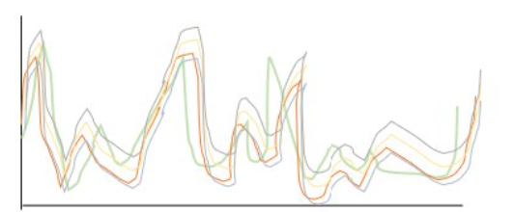
Donor-based regionalisation
Weather data
Use the daily median of the five simulations as our final simulation
m^3/s
Date

Slide 12
Cross-validation
Gauged catchment performance:
Training data from 1990-2020
Test data from 2021-2023
Ungauged catchment performance:
Use data from all but one catchments, to simulate streamflow in that catchment
Compare performance against seNorge avrenning, NVEs national gridded runoff data product (made from a regional HBV model)

Slide 13
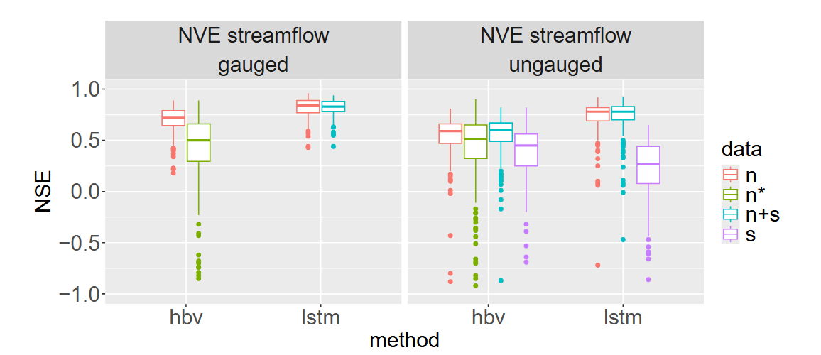
HBV results
NVE only
SeNorge avrenning
NVE + Småkraft
Småkraft only

Slide 14
HBV results
NVE only
SeNorge avrenning
NVE + Småkraft
Småkraft only

Slide 15
Switching to data-driven hydrological models
We have data from >300 catchments, but the conceptual model makes it impossible to use more than a fraction of these to predict streamflow
Data-driven models are made to use as much data as possible

Slide 16
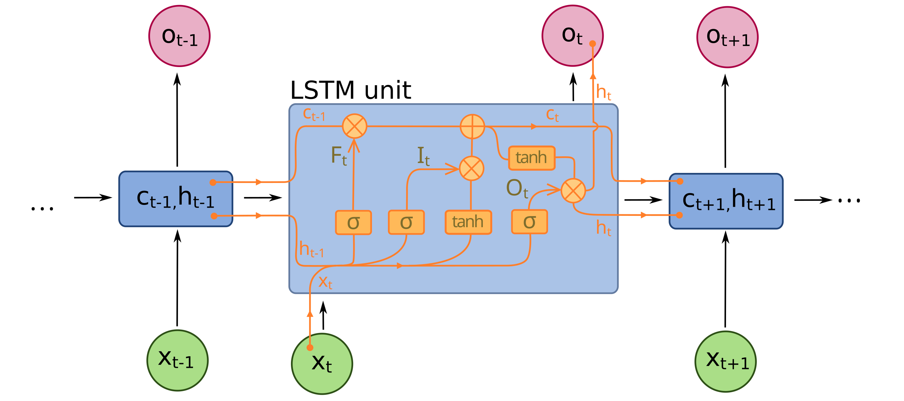
Second model: Long Short-Term Memory (LSTM)
Type of recurrent neural network
Has performed very well in the literature
Python implementation in the neuralhydrology package
Input:
Daily precipitation and temperature
Elevation (hypsometric curves)
Static catchment covariates used for donor-matching with the HBV model
By fdeloche - Treball propi, CC BY-SA 4.0, https://commons.wikimedia.org/w/index.php?curid=60149410

Slide 17
Calibration (model training)
Global calibration, using all available catchments (minus validation/test data)
Loss function:
NVE data: Simulate streamflow and compute NSE
Småkraft data: Simulate streamflow, compute power production, then compute NSE

Slide 18
Results
NVE only
SeNorge avrenning
NVE + Småkraft
Småkraft only

Slide 19
Results
NVE only
SeNorge avrenning
NVE + Småkraft
Småkraft only

Slide 20
Discussion
LSTM beats HBV in most settings, even in gauged catchments
However:
LSTM is a black box
LSTM is not physically consistent
Balancing NVE/Småkraft data in the LSTM is difficult, especially in the upper tail
Combining NVE/Småkraft data works, but not as well as we had hoped

Slide 21
Future work – hourly streamflow forecast
Motivation:
Day-ahead nominations and imbalance costs
Production planning for power plants with small reservoirs
Data:
Hourly streamflow observations from NVE
Production data and back-calculated inflow from Småkraft
NORA3 atmosphere hindcast
MEPS ensemble forecast

